Slide 1
Results of Onshore and Offshore Composite Repair Studies
Workshop Presentation
Prepared for: BSEE / PHMSA
Prepared by: Colton Sheets, PE
Date: 17 January 2018

Slide 2
Results of Onshore and Offshore Composite Repair Studies
BSEE Added
"THE RESEARCH PROJECT OUTCOME DID NOT CONCLUDE AS A HIGHLY INFLUENTIAL OR INFLUENTIAL CATEGORY. THEREFORE, BSEE WOULD NOT CONDUCT A PEER REVIEW FOR THIS RESEARCH.”

Slide 3
Agenda / Outline
Purpose: Discuss the results of the recently completed study investigating the suitability of composite repair systems as structural reinforcement for onshore and offshore applications.
Study Objectives
Project Review - Onshore
  Load Transfer Study
Project Review - Offshore
  Exposure Testing
  Full-scale Testing
Results Discussion

Slide 4
Study Objectives
Onshore study:
  Does installation pressure have an effect on performance?
    Completed with both external wall loss and plain dents
Offshore study:
  Replicate offshore / subsea environment. Can nominal performance be maintained?
  Potential for a variety of loading conditions offshore. Is structural reinforcement provided?

Slide 5
Project review: load transfer study

Slide 6
Project Review: Load Transfer Study
Purpose of the study was to evaluate the effect of internal pipe pressure during installation of composite reinforcement systems and the load transfer that takes place between the composite repair and pipe during pressurization
  Pipe samples fabricated with simulated external corrosion defects that were reinforced using several composite repair systems
  Samples also fabricated with plain dents
  Installations performed with varying levels of internal pressure in the pipe
  Samples then burst or pressure cycled to failure

Slide 7
Test Samples and Installation Pressures - Corrosion
Three (3) unreinforced samples
  Sample 1 – Burst Test
  Sample 2 – Pressure Cycle
  Sample 3 – Pressure Cycle
Five repair systems tested with six samples per repair system
12-hour pre-installation holds at 1,236 psi (50% SMYS)
Three burst samples - corrosion
  Sample 1 – 0 psi installation pressure
  Sample 2 – 25% SMYS installation pressure (618 psi)
  Sample 3 – 50% SMYS installation pressure (1,236 psi)
Three pressure cycle samples - corrosion
  Sample 4 – 0 psi installation pressure
  Sample 5 – 25% SMYS installation pressure (618 psi)
  Sample 6 – 50% SMYS installation pressure (1,236 psi)

Slide 8
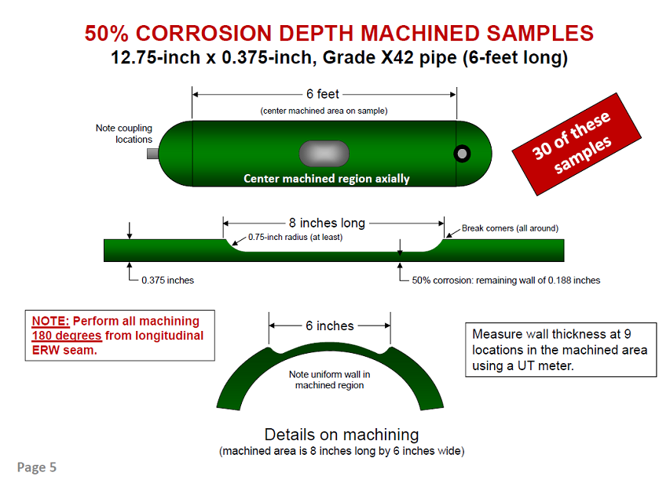
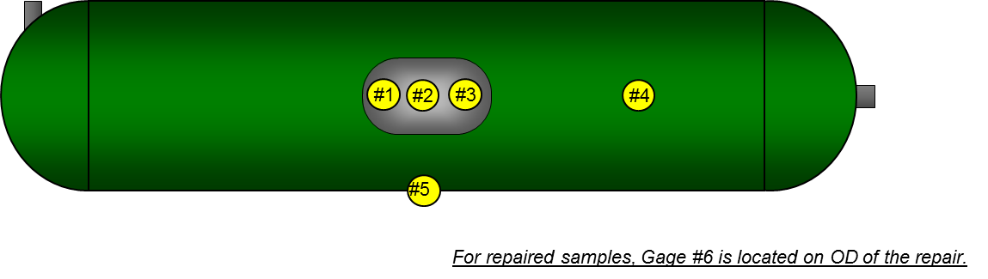
Sample Configuration (50% Corrosion)
Measured Yield Strength (psi) | Measured Tensile Strength (psi)
50,100 | 65,300
#5
#4
Strain gage locations

Slide 9
Test Procedure
Burst test – 5-minute pressure holds at the following:
  Installation Pressure 2 (25% SMYS) – 618 psi
  Installation Pressure 3 (50% SMYS) – 1,236 psi
  72% SMYS – 1,780 psi
  80% SMYS – 1,977 psi
  100% SMYS – 2,471 psi
Pressure cycling
  Cycle between 40%-80% SMYS (988 psi to 1,977 psi)
  Pressure was cycled until failure occurred or until run-out (250,000 cycles) was reached
NOTE: All strain gages zeroed following 24-hr hold at the respective installation pressures (to allow resin cure)

Slide 10
Test Overview: Dents Installed with Pressure
Two dent samples were reinforced with pressure in the pipe
  12.75-inch x 0.188-inch, Grade X42 pipes with two 15% depth plain dents
Installations of the composite repair systems were performed at an internal pressure of 793 psi (64% SMYS).
Following installation of the repair systems, these samples were subjected to cyclic pressure testing from 10% - 72% SMYS (124 psi to 892 psi). The target runout was 250,000 cycles.

Slide 11
Reinforced Samples – Corrosion: Burst Summary
  A narrow range of failure pressures was observed and was a reflection of the failures being driven by the tensile properties of the base pipe (i.e. almost all failures located outside of the repair)
  Maximum range between failure pressures was for a given repair system was 63 psi. The minimum range was 9 psi.
Repair System 1
Repair System 2
Repair System 3
Repair System 4
Repair System 5

Slide 12
Load Transfer Study – Corrosion: Burst Tests
Installation pressure had no noticeable effect on the burst pressure of the composite repaired samples
  All repairs exceeded unreinforced burst pressure
All repairs averaged approximately the same burst pressure regardless of installation pressure and were predominantly governed by the tensile properties of the nominal base pipe
  Only one manufacturer had failures located within the repair – all other failures occurred in base pipe outside of the repair
  67 psi – max pressure range between repairs
  9 psi – min pressure range between repairs

Slide 13
Reinforced Samples – Corrosion: Cycle Summary
All reinforced cyclic pressure samples achieved the runout target of 250,000 cycles [ΔP = 40–80% SMYS (988 to 1,976 psig)].
No consistent correlation between changes in strain range, or maximum / minimum strain and installation pressure was observed during cyclic pressure testing.
Installation pressure has little to no noticeable effects on the fatigue life of reinforced corrosion samples
  All repairs reached runout target of 250,000 cycles

Slide 14
Reinforced Samples – Dents with Pressure Summary
Four dents were repaired by two composite repair manufacturers with internal pressure in the pipe of 64% SMYS and cycled from 10% - 72% SMYS.
None of the dents reinforced with internal pressure in the pipe achieved the 250,000 cycle runout target.
The minimum number of cycles to failure was 18,747.
The samples with composite repairs that were installed with internal pressure in the pipe showed signs of significant disbonding between the load transfer (filler) material, the pipe, and the composite reinforcement
  This was evident in post-test sectioning as well as from inter-layer strain readings

Slide 15
Load Transfer Study – Overall Conclusions
For the repairs and 50% wall loss anomalies that were part of this study, there was no indication that internal pipe pressure at the time of installation had any effect on the performance of the composite repair system’s burst pressure or fatigue life.
  This conclusion is limited to corrosion depths up to 50%
For the repairs used to reinforce plain dents under pressure, the results show the potential for a significant reduction in fatigue life compared to plain dent repairs installed without internal pressure .

Slide 16
Project review: Offshore study

Slide 17
Project Overview – Offshore Study
BSEE / PHMSA Offshore Composite Repair Study
  Study had two primary components:
    Long-term exposure testing simulating environments encountered offshore / subsea
    Full-scale testing following exposure tests simulating a range of potential loading conditions
  A wide range of tests completed as part of the two components:
    Simulated subsea installation and curing of composite repairs
    Long-term simulated offshore exposure testing
    Post-exposure load testing
      Internal pressure
      Bending
      Tension

Slide 18
Project Overview – Exposure Testing
Objective 1 – Evaluate composites for their long-term suitability in offshore / subsea conditions
  Non-standard environments require additional vetting
  Vetting should consider all aspects of composite repair qualification – in the expected environment
    Material selection
    Design
    Installation
  Full-scale testing a way to test major components simultaneously

Slide 19
Project Overview – Test Samples (1/2)
12-inch samples with machined wall loss
  Machined wall loss depth approx. 75% of the nominal wall thickness
Reinforced with wet-layup composite systems
  E-glass
  Carbon fiber
Samples were designated for five full-scale tests following exposure testing:
  Burst
  Cyclic pressure
  Bending
  Axial tension
  Axial tension with delamination

Slide 20
Project Overview – Test Samples (2/2)
Intentional delamination samples represented a poor installation and evaluated its effect on composite performance
High-temperature PTFE tape was installed axially around the pipe every 90° starting at the corrosion defect.
Delaminations covered approx. 60% of the steel pipe surface.

Slide 21
Exposure Testing
Installations and curing completed while submerged in simulated seawater

Slide 22
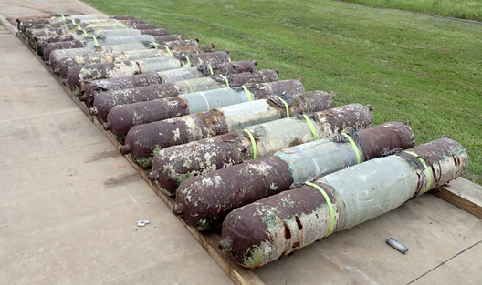
Project Overview – Exposure Testing (1/3)
Samples were submerged in simulated seawater for 10k hours (10k hours ≈ 1.15 years)
Intended to simulate an extended in-service subsea environment
Pressure maintained at 72% SMYS (+/- 15% SMYS)
Samples also subjected to 90 day UV exposure test once removed from seawater

Slide 23
Project Overview – Exposure Testing (2/3)
In addition to UV exposure test, samples completed 12 thermal cycles
High temperature: 110 - 130 °F
Low temperature: 30 - 10 °F

Slide 24
Project Overview – Exposure Testing (3/3)
Finally, samples were pressure cycled for either 25,000 cycles or 50,000 cycles at a pressure range of 36 – 72% SMYS
Plots show snapshot of pressure cycling (top) and peak-valley internal pressures over the course of the 25,000 cycles

Slide 25
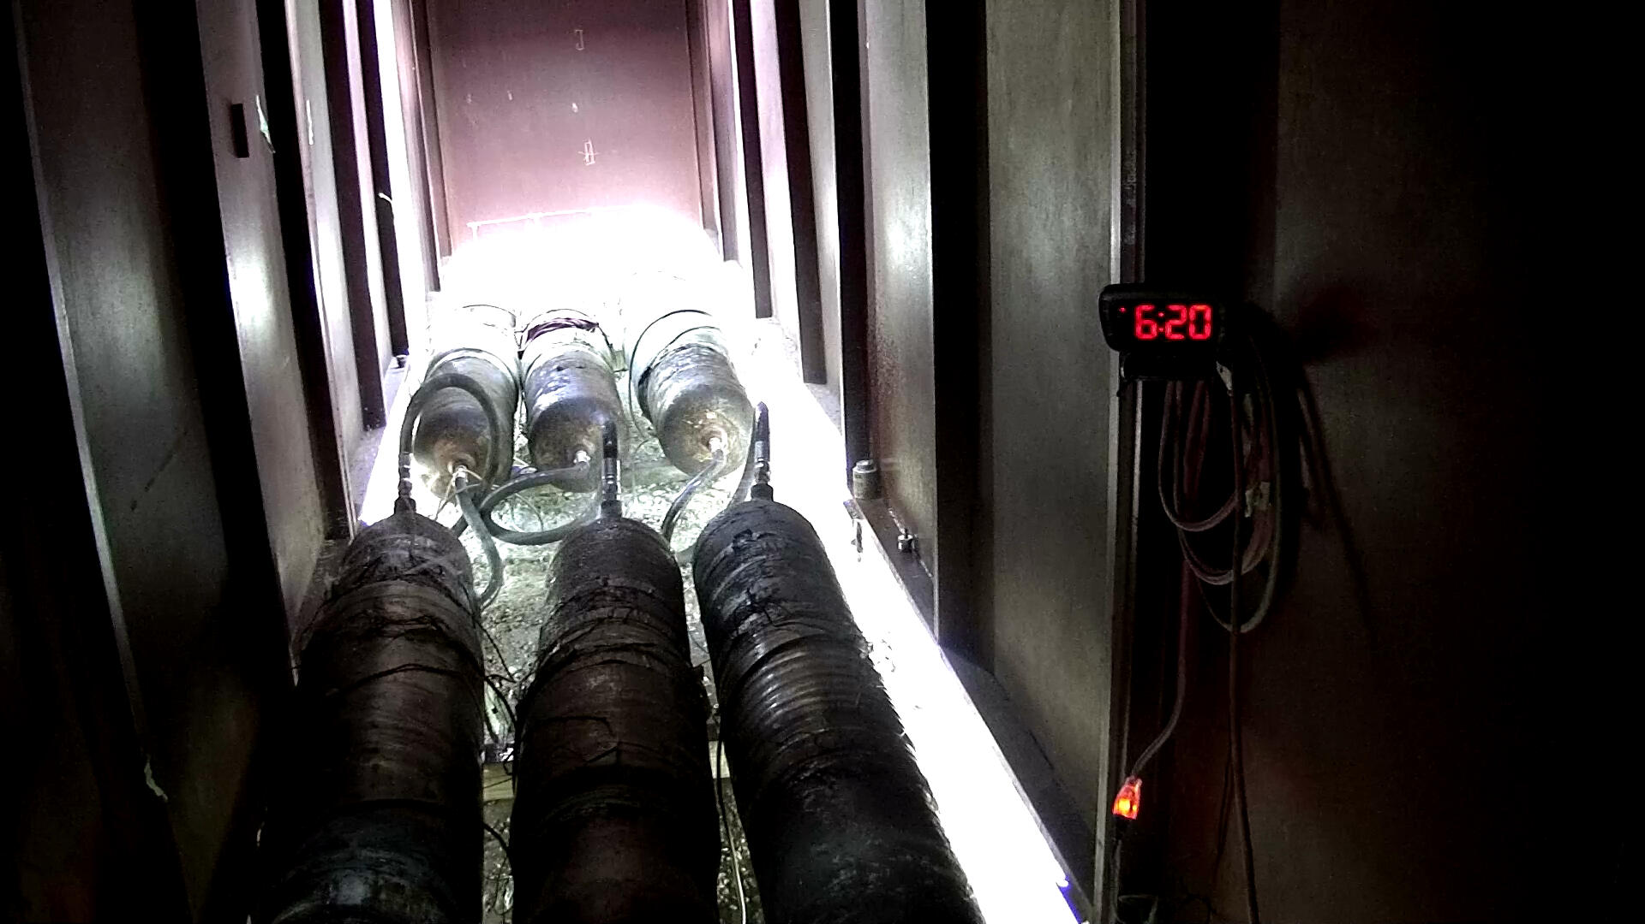
Exposure Testing - Results
All samples survived the 10,000 hour pressure hold
No apparent damage to the repairs was caused by thermal and pressure cycling
Five samples failed during pre-cycling
  Photograph of leak (bottom)

Slide 26
Exposure Testing - Results
Majority of failures were limited to one manufacturer
  Could indicate issue with installation, material selection, or repair design
Highlights the importance of vetting in representative conditions
  Not only beneficial to operators, but also to manufacturers who can review design and make adjustments and improvements
Sample | Manufacturer A | Manufacturer B | Manufacturer C
Burst | Failed after 17,411 cycles | Survived | Survived
Fatigue | Failed after 31,547 cycles | Survived | Survived
Tension | Failed after 3,678 cycles | Survived | Survived
Bending | Survived | Survived | Survived
Delamination | Failed after 23,237 cycles | Failed after 42,223 cycles | Survived

Slide 27
Exposure Testing – Unreinforced Sample
An unreinforced sample was also fabricated and tested to use as a comparison.
Sample had same dimensions and machined wall loss
The sample did not undergo any of the exposure testing and was intended for pre-cycling.
Zero cycles were completed and the sample achieved a maximum pressure of 1,533 psi.
  Reinforced samples cycled from 890 psi to 1,780 psi
  Minimum cycles to failure for reinforced samples was 3,678 cycles

Slide 28
Exposure Testing Summary
A total of 15 samples were tested in the program
  10/15 samples successfully completed the entirety of exposure testing
    4/5 failures were contained to one manufacturer
  15/15 samples successfully completed the 10,000 hour hold period in simulated seawater.
  No structural damage to the composites was evident following either the 90 day UV or thermal cycling exposure tests.
  The minimum cycles to failure for a reinforced sample was over 3,678 cycles.
  An unreinforced sample failed at an internal pressure of 1,533 psi and completed zero cycles.

Slide 29
Project Overview – Full-scale Testing
    Objective 2 – Full-scale testing following exposure tests simulating a range of potential loading conditions
  Non-standard loading conditions require additional vetting
  Full-scale testing allows for simultaneous validation of major aspects of composite repair qualification following exposure testing
    Material selection
    Design
    Installation
  Full-scale tests completed
    Burst
    Cyclic pressure
    Axial tension
    Bending

Slide 30
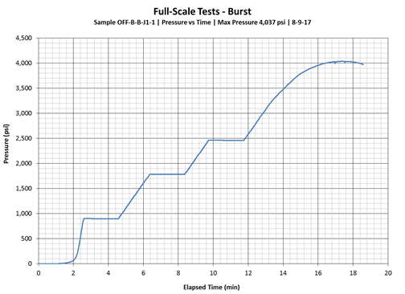
Full-scale Testing – Burst
Two reinforced samples designated for burst survived exposure testing
Two minute hold periods were completed at 890 psi (36% SMYS), 1,780 psi (72% SMYS), and 2,470 psi (100% SMYS)

Slide 31
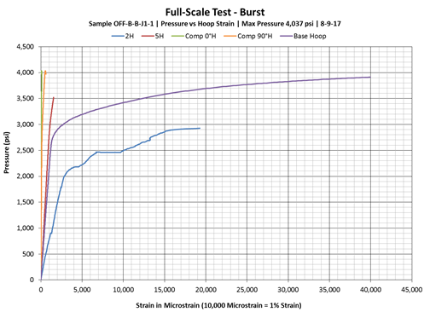
Full-scale Testing – Burst
First of two samples completed all two minute hold periods
Max pressure: 4,037 psi (163% SMYS)
Strain gages indicate significant deformation in the base pipe and corrosion region during the test (2H and Base Hoop).
Failure was located in the base pipe outside of the reinforced wall loss.

Slide 32
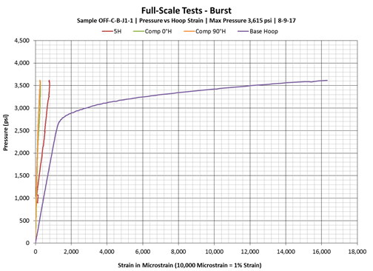
Full-scale Testing – Burst
Second sample also completed all two minute hold periods
Max pressure: 3,615 psi (146% SMYS)
Strain gage in the base pipe indicates significant deformation outside of the repair (Base Hoop).
Failure was located underneath the repair in the machined wall loss region.

Slide 33
Full-scale Testing – Burst
Previous results should be considered in context of unreinforced sample that was also burst tested.
  And did not undergo exposure testing
Maximum unreinforced pressure: 1,681 psi (68% SMYS)
Sample failed prior to reaching the two minute hold period at 72% SMYS.
Failure was located in the machined wall loss region.

Slide 34
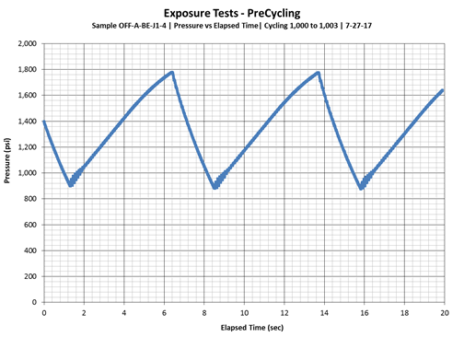
Full-scale Testing – Cyclic Pressure
Two reinforced samples designated for cyclic pressure testing survived exposure testing (50,000 cycles from 36 – 72% SMYS)
Samples continued cycling from 36 – 72% SMYS until failure or reaching a designated runout of 250,000 cycles.

Slide 35
Full-scale Testing – Cyclic Pressure
Failures of the reinforced samples ranged from approx. 3,000 cycles (pre-cycling) to the runout condition of 250,000 cycles.
  The Manufacturer A sample designated for cycling achieved 31,547 cycles
The cycle counts for samples B and C include the 50,000 exposure test pre-cycles.
  For sample C, this means 50,000 pre-cycles followed by an additional 200,000 cycles.
Results demonstrate that the repairs sucessfully increased the number of cycles to failure for corrosion defects in an aggressive cycling environment even after the exposure tests.
Sample | Cycles to Failure
Manufacturer A | 3,678
Manufacturer B | 130,960
Manufacturer C | 250,000*
Unreinforced | 0⁺
*Sample reached runout without failure
⁺Sample failed in first cycle prior to maximum pressure

Slide 36
Full-scale Testing – Tension
Two reinforced samples designated for tension testing survived exposure testing.
Additionally, one delamination sample designated for tension testing survived exposure testing.
Procedure for tension testing was as follows:
  Pressure sample to 1,780 psi (72% SMYS)
  15 minute hold period at applied tension of 200 kips (65% with PEL)
  15 minute hold period at applied tension of 470 kips (110% SMYS with PEL)
  15 minute hold period at applied tension of 620 kips (135% SMYS with PEL)
  Increase tension to failure

Slide 37
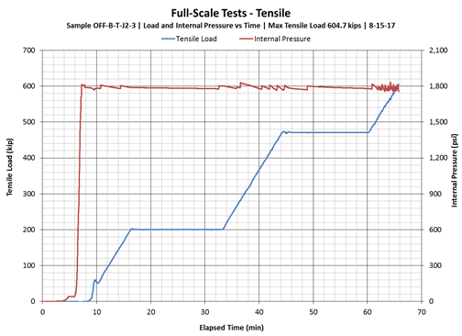
Full-scale Testing – Tension
Tension sample from Manufacturer B reached a maximum applied tensile load of 604.7 kips.
Failure occurred when the sample was no longer able to maintain the internal pressure, and a leak path developed from the corrosion defect to the edge of the repair.
Plot shows that the initial two hold periods were completed, but sample failed prior to third hold period.

Slide 38
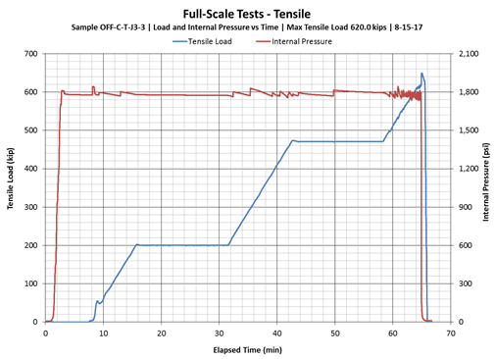
Full-scale Testing – Tension
Tension sample from Manufacturer C reached a maximum applied tensile load of 620 kips.
The failure occurred before the five minute hold at 620 kips began
Again failure occurred when the sample was no longer able to maintain the internal pressure, and a leak path developed from the corrosion defect to the edge of the repair.
Post-test photograph shows failure location

Slide 39
Full-scale Testing – Tension
Delamination sample from Manufacturer C reached a maximum applied tensile load of 635 kips.
  The drop in load was to repair a leak in a pressure line and does not represent a failure of the sample
Test results indicate the delaminations had very little impact on the tension test.
Post-test photograph shows failure location

Slide 40
Full-scale Testing – Tension
The tensile test results indicated that the composite repairs successfully reinforced the corrosion defect after surviving the exposure tests.
Axial strain results showed that the base pipe of each sample plastically deformed before failure occurred in the simulated wall loss.
Sample | Maximum Tensile Load (kip) | Maximum Tensile Load with PEL (kip)
Manufacturer B - Tension | 604.7 | 806.0
Manufacturer C - Tension | 620.0 | 821.3
Manufacturer C - Delamination | 635.0 | 836.3

Slide 41
Full-scale Testing – Bending
All reinforced samples designated for bending survived exposure testing.
  One bend sample from each manufacturer
Procedure for tension testing was as follows:
  With wall loss positioned at 0° (tension):
    Pressurize sample to 1,780 psi (72% SMYS)
    Increase bending to 125 ft-kips (hold for 15 mins)
    Reduce internal pressure and bending to 0 psi and 0 ft-kips
    Rotate sample 180°
  With wall loss positioned at 180° (compression)
    Pressurize sample to 1,780 psi (72% SMYS)
    Increase bending to 125 ft-kips (hold for 15 mins)
    Increase bending to failure

Slide 42
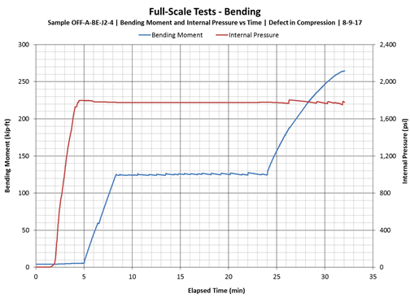
Full-scale Testing – Bending
Manufacturer A’s bending sample successfully completed bend testing with wall loss in tension.
After the sample was rotated to place the corrosion defect in compression, the sample failed at a bending moment of 264.6 ft·kips.
Failure occurred in the reinforced wall loss which ruptured through the composite repair (photograph).

Slide 43
Full-scale Testing – Bending
Manufacturer B’s bending sample successfully completed bend testing with wall loss in tension.
The sample failed at a bending moment of 262.4 kip·ft with the wall loss in compression.
Failure occurred in the wall loss region and leaked from the edge of the repair.
The sample experienced permanent deformation and exhibited a visible curvature following the bend test (photograph).

Slide 44
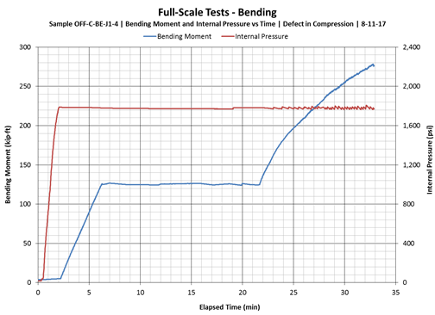
Full-scale Testing – Bending
Manufacturer C’s bending sample successfully completed bend testing with wall loss in tension.
The sample failed at a bending moment of 278.4 kip·ft with the wall loss in compression.
The sample began to deform near the end of the test and it became difficult to maintain the internal pressure
Failure occurred in the wall loss region underneath the composite repair (photograph). Permanent deformation was evident in the sample following testing

Slide 45
Full-scale Testing – Bending
It is clear that all three reached bend samples reached a similar maximum value (corrosion defect in compression).
All three samples experienced permanent deformation of the base pipe surrounding the repair before failure of the repair itself.
Sample | Maximum Bending Moment (kip·ft)
Manufacturer A | 264.6
Manufacturer B | 262.4
Manufacturer C | 278.4

Slide 46
Concluding Remarks – Offshore Program (1/2)
The exposure and full-scale testing phases of the offshore composite repair study produced a significant amount of information on the performance of composite repairs in simulated offshore conditions
Results of the offshore study highlight the unique aspects of each composite repair manufacturer and show that variations in performance exist.
Many of these differences can likely be attributed to the individual design of the composite repairs and proprietary materials used.
This means qualification of individual composite repair systems needs to be completed by manufacturers before they can confidently be approved as offshore structural reinforcements

Slide 47
Concluding Remarks – Offshore Program (2/2)
Although the composite repairs displayed a range of results during testing, all were able to survive the 10,000 hour hold period in simulated subsea conditions.
Additionally, all completed the remaining exposure testing and achieved some number of pre-cycles from 36 – 72% SMYS.
  The unreinforced sample that had not completed exposure testing was unable to complete a single pressure cycle.
Full-scale testing showed that all samples were able to provide reinforcement and prevent failure at internal pressures equal to 72% SMYS.
Additionally, all bend tests reinforced the simulated corrosion defect such that ultimate failure was near that expected of nominal base pipe with no simulated corrosion.
This indicates that all repairs were able to provide reinforcement to the simulated corrosion defect in the hoop direction and increase the ultimate capacity of the pipe sample.
  All following a rigorous set of exposure tests
This held true even for the delamination samples that had intentional defects introduced in the repairs.

Slide 48
Path Forward / Future Work
Future work should use this study as a foundation and continue collecting data on the long-term performance of composite repairs in subsea environments.
  10,000 hours likely a fraction of the time many composite repairs will spend in offshore environments
  Continued investigations into the performance of composite repairs when subjected to multiple years of offshore / subsea conditions will only give further confidence to their suitability for offshore use
Investigate additional aspects of subsea environments that were not considered in this study, including temperature and external hydrostatic pressure.
In the more distant future, it may become necessary to investigate the application of composite repairs remotely; for instance using a remote operated vehicle (ROV) for subsea installations.

Slide 49
Questions?
Colton Sheets
Associate
Stress Engineering Services, Inc.
colton.sheets@stress.com
281-955-2900

Slide 50
Thank You!

Slide 51
Limitations of This Report
This report is prepared for the sole benefit of the Client, and the scope is limited to matters expressly covered within the text. In preparing this report, Stress Engineering Services, Inc. (SES) has relied on information provided by the Client and, if requested by the Client, third parties. SES may not have made an independent investigation as to the accuracy or completeness of such information unless specifically requested by the Client or otherwise required. Any inaccuracy, omission, or change in the information or circumstances on which this report is based may affect the recommendations, findings, and conclusions expressed in this report. SES has prepared this report in accordance with the standard of care appropriate for competent professionals in the relevant discipline and the generally applicable industry standards. However, SES is not able to direct or control operation or maintenance of the Client’s equipment or processes.
Rev | Date | Description | Originator | Checker | Reviewer
0 | 17-Jan-2018 | Issued for use | C. Sheets |  | B. Vyvial

