Slide 1
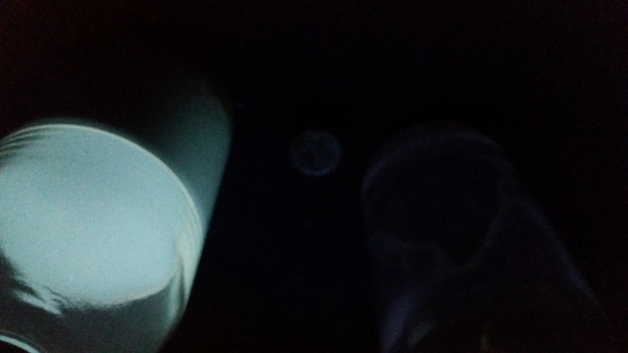
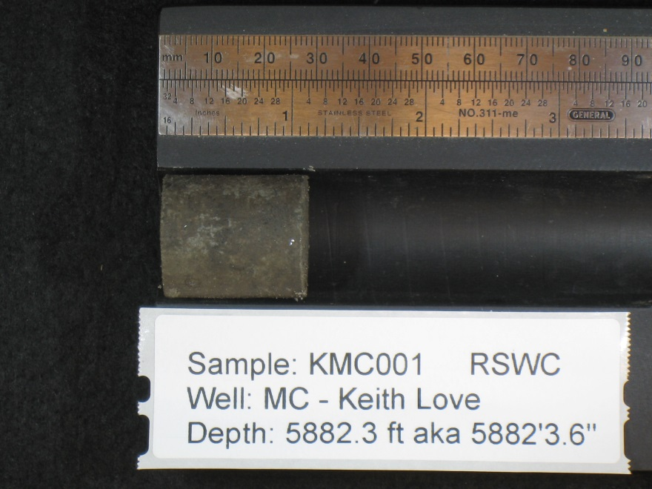
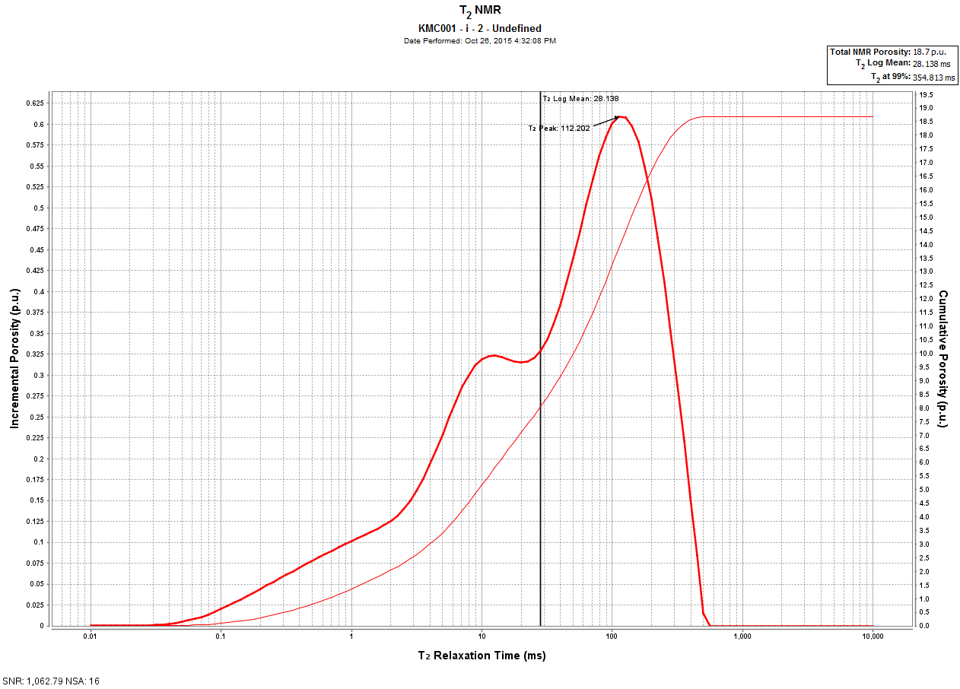
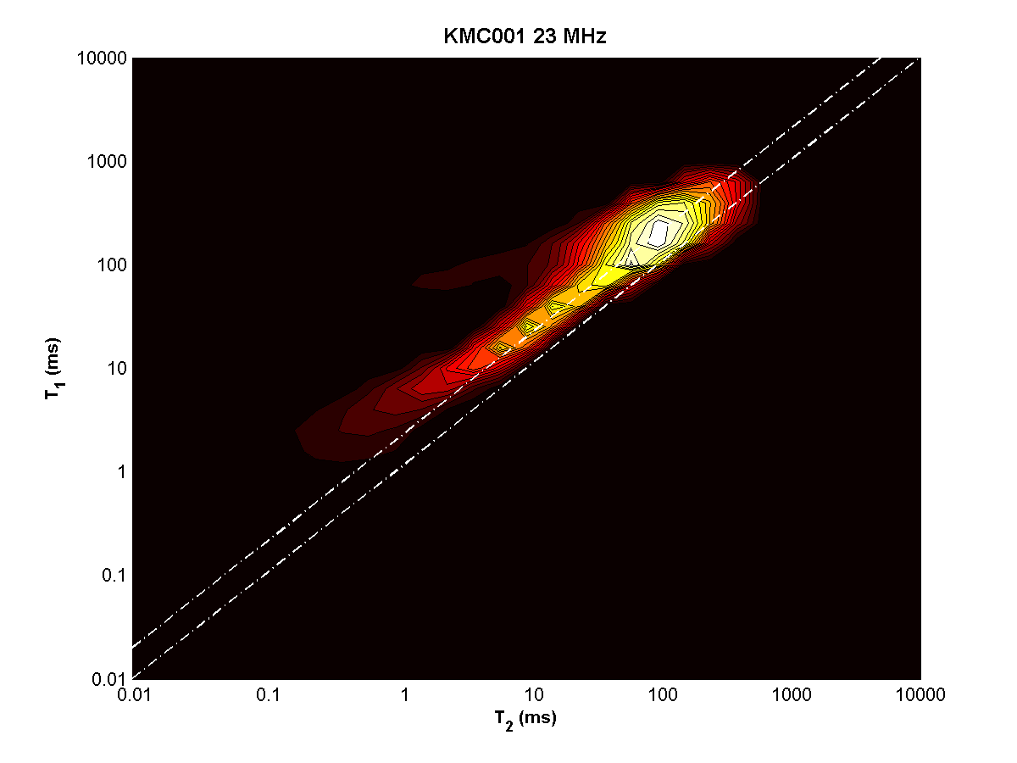
KMC001 – Depth = 5882.3 ft

Slide 2
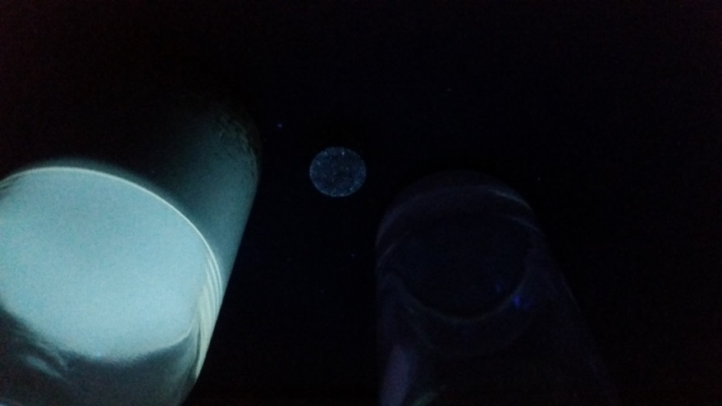
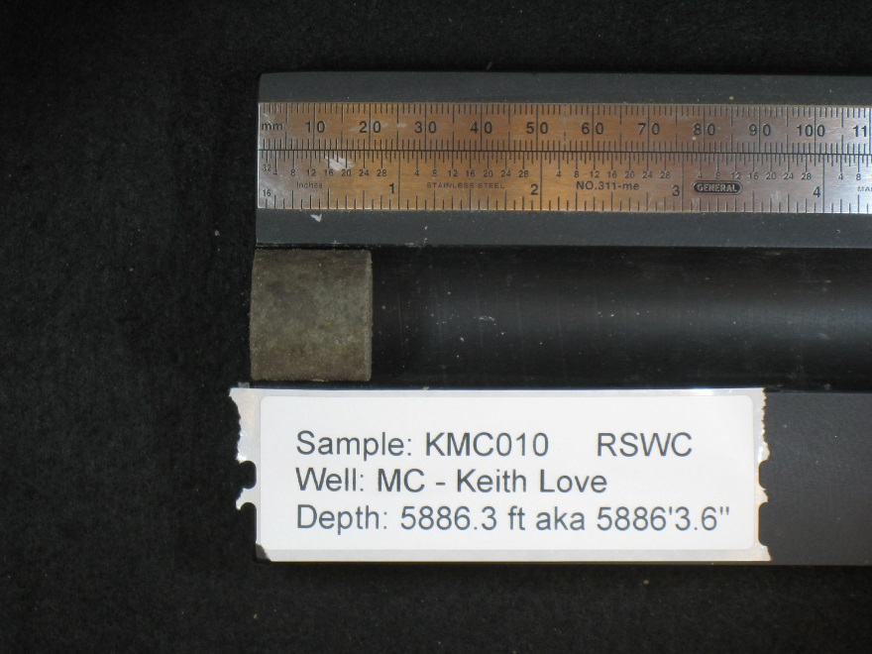
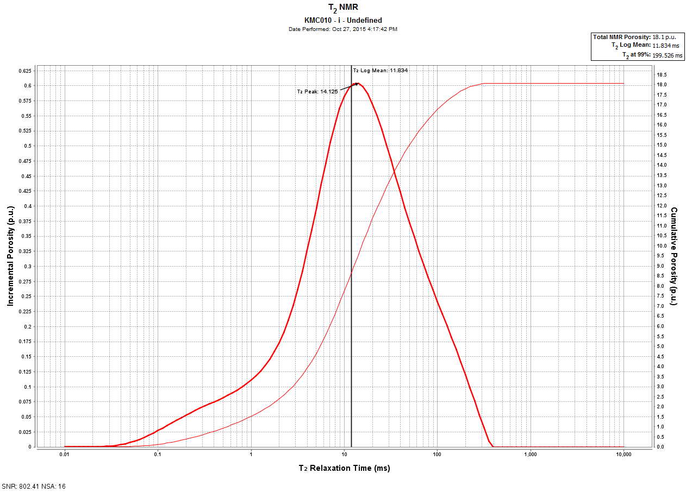
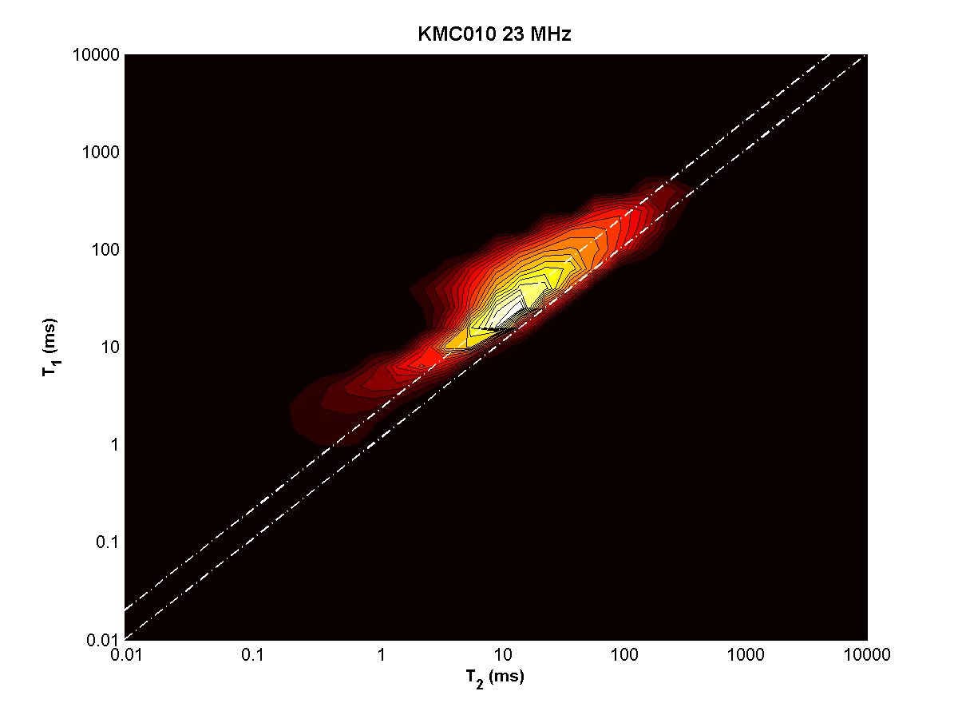
KMC010 – depth = 5886.3 ft

Slide 3
KMC010 – depth = 5886.3 ft
Top
Bottom

Slide 4
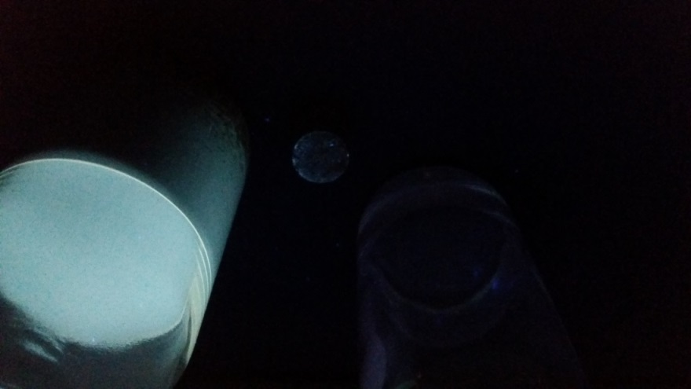
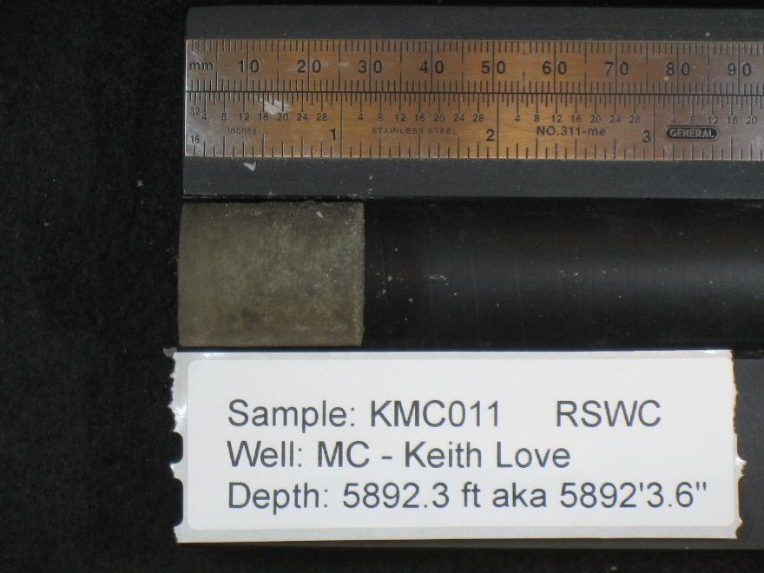
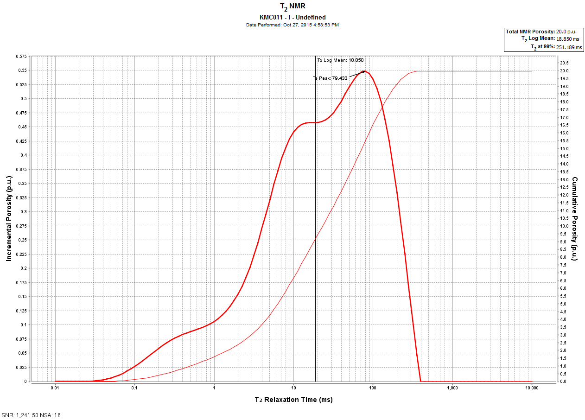
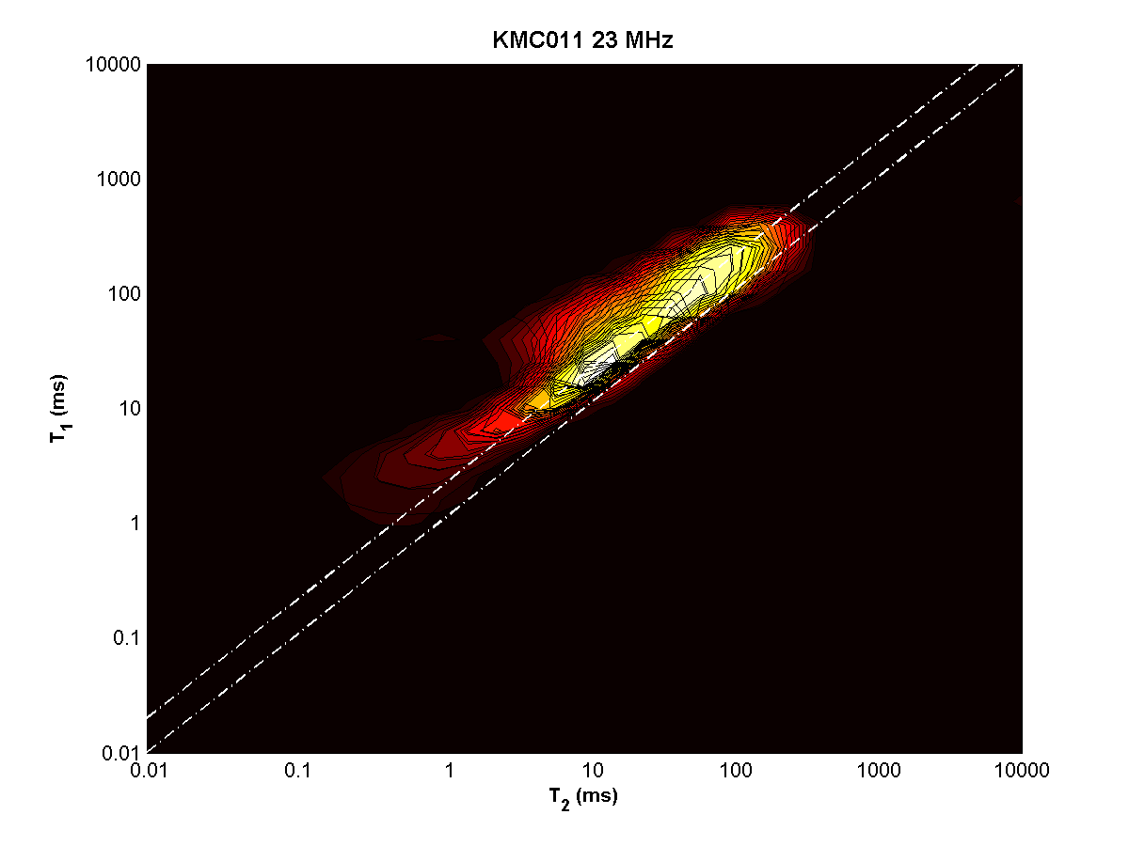
KMC011 – depth = 5892.3 ft

Slide 5
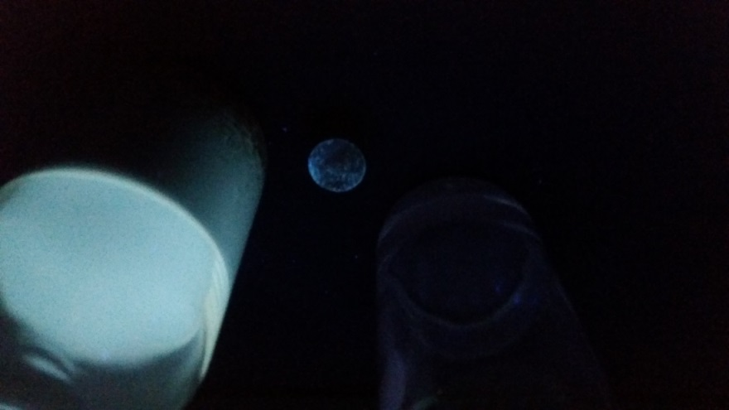
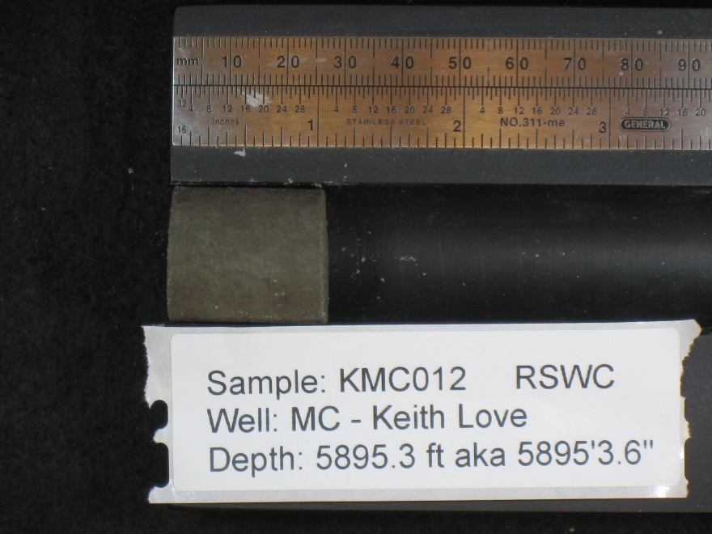
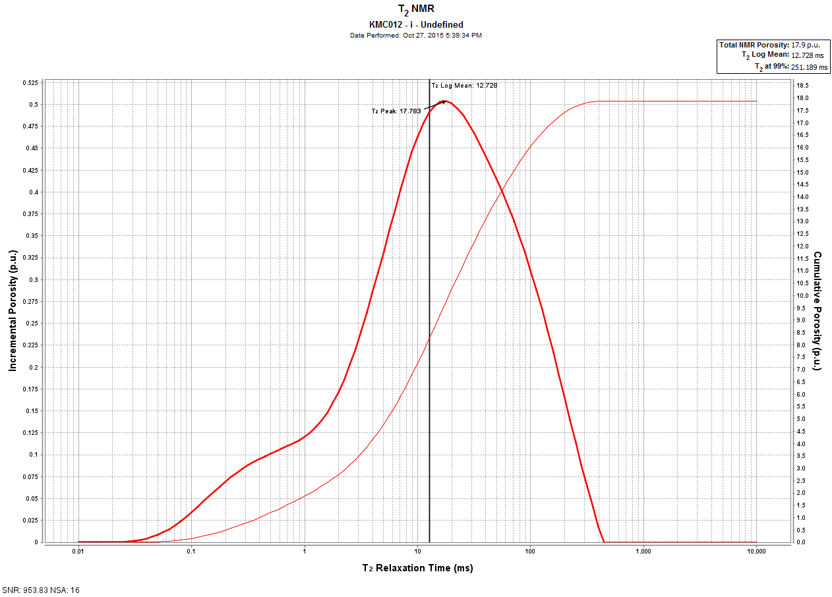
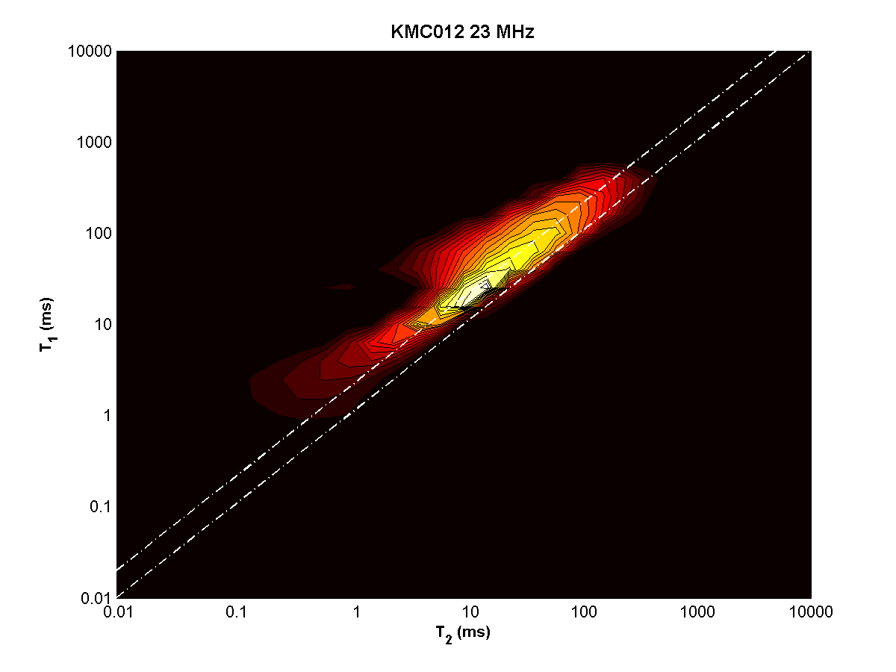
KMC012 – depth = 5895.3 ft

Slide 6
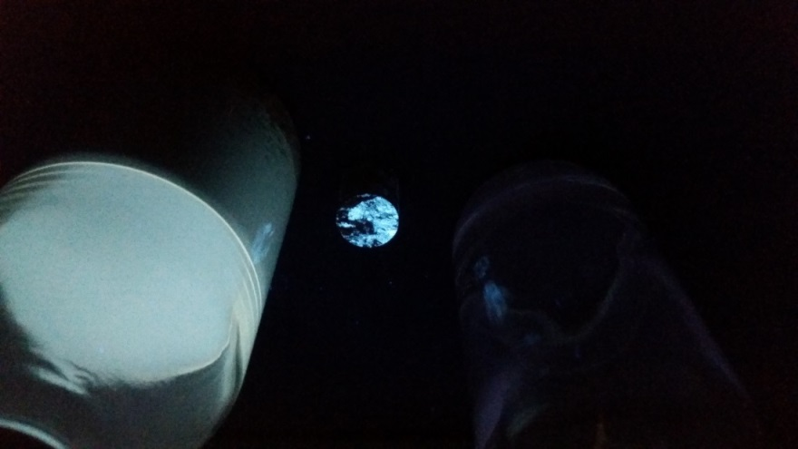
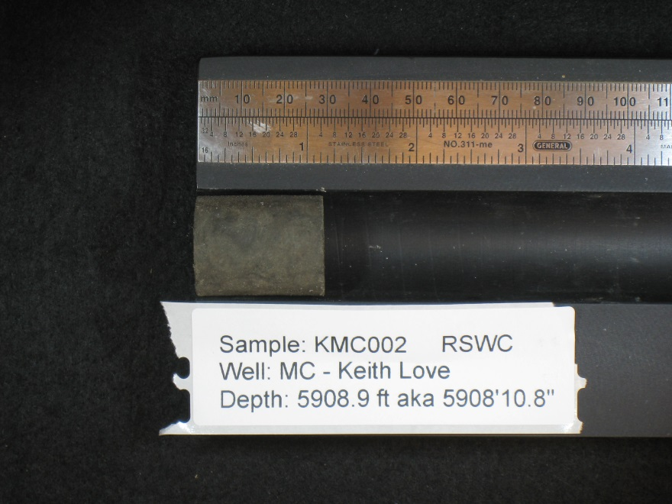
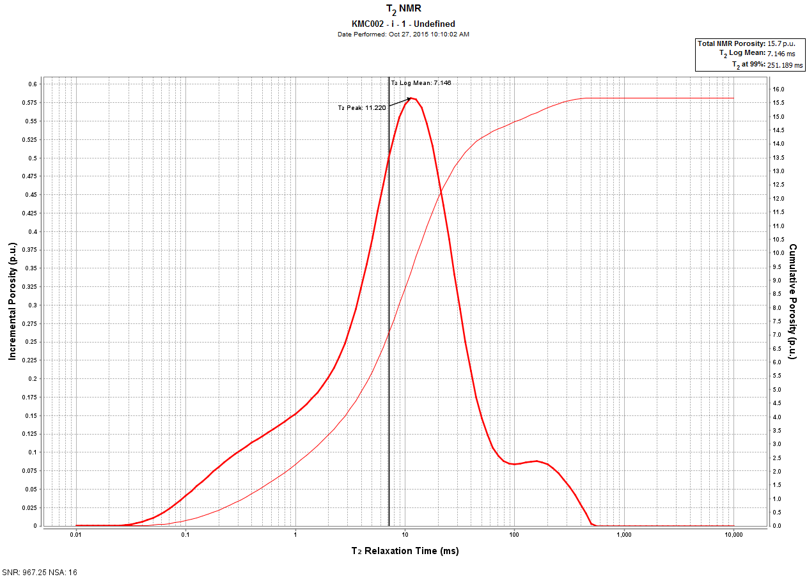
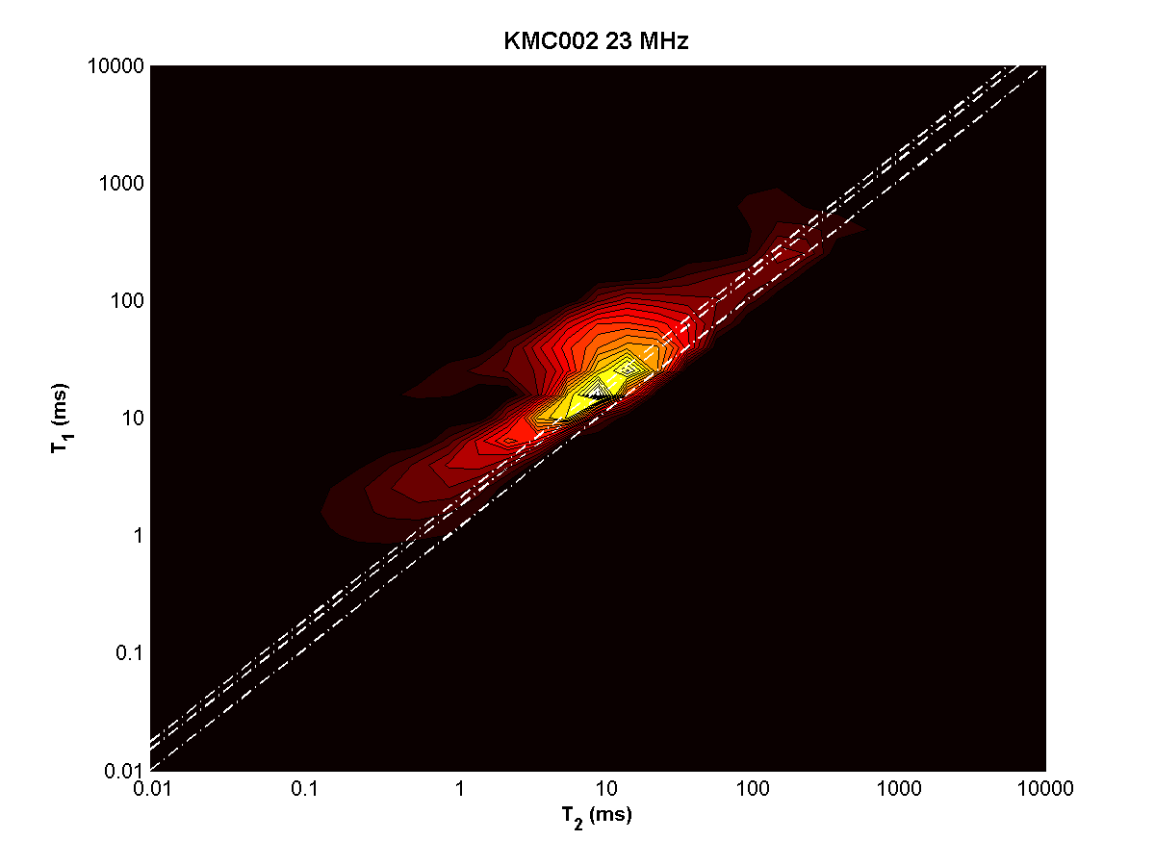
KMC002 – depth = 5908.9 ft

Slide 7
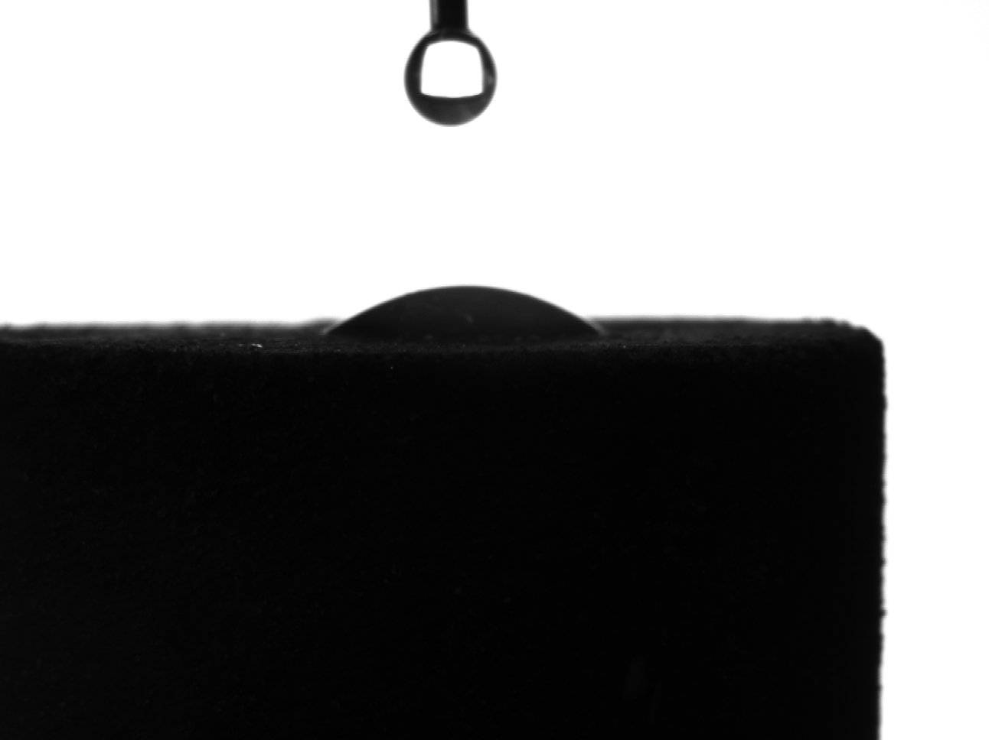
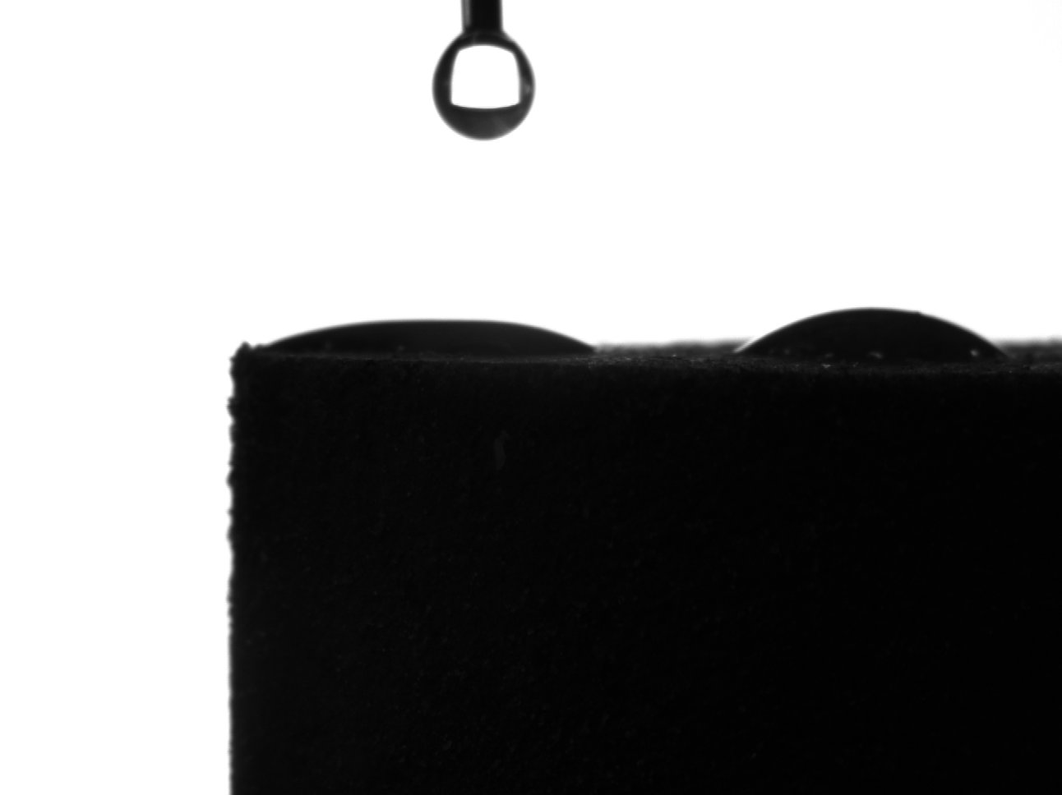
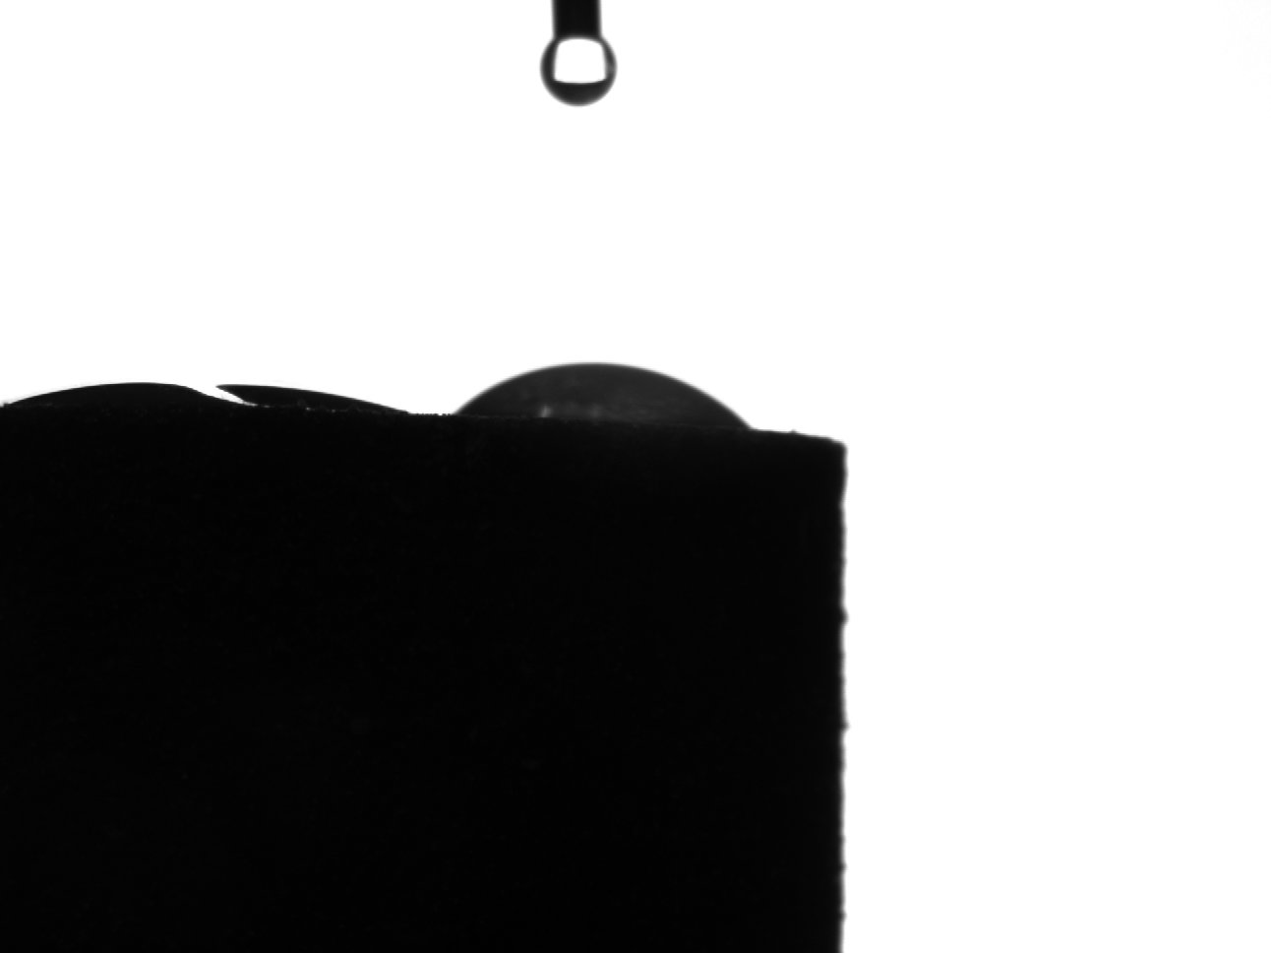
KMC002 – depth = 5908.9 ft
Top
Bottom

Slide 8
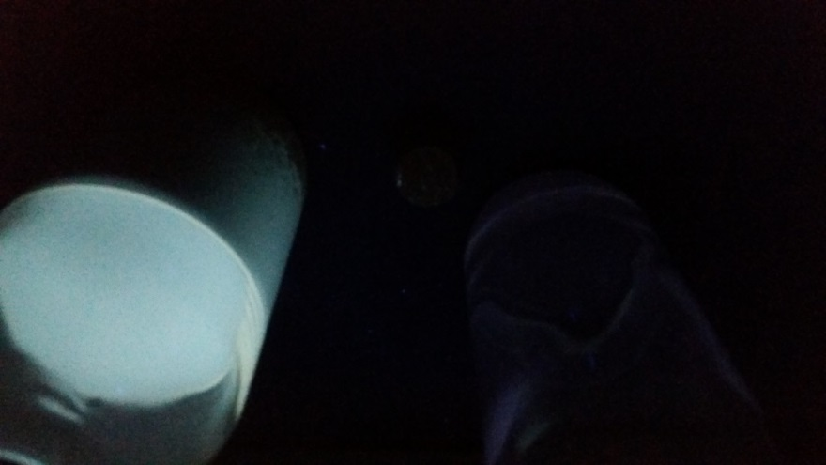
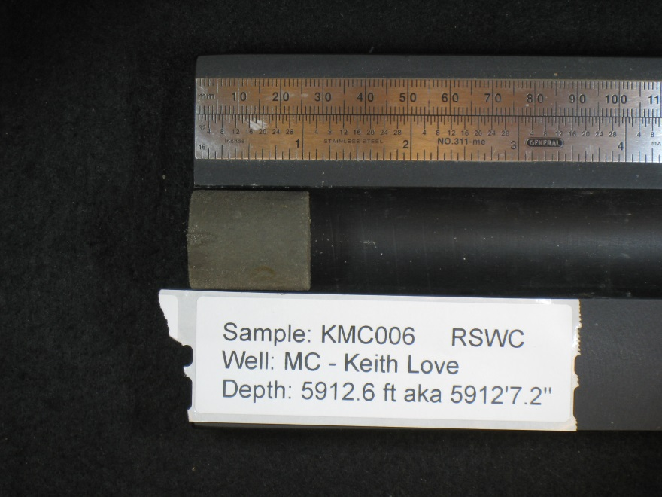
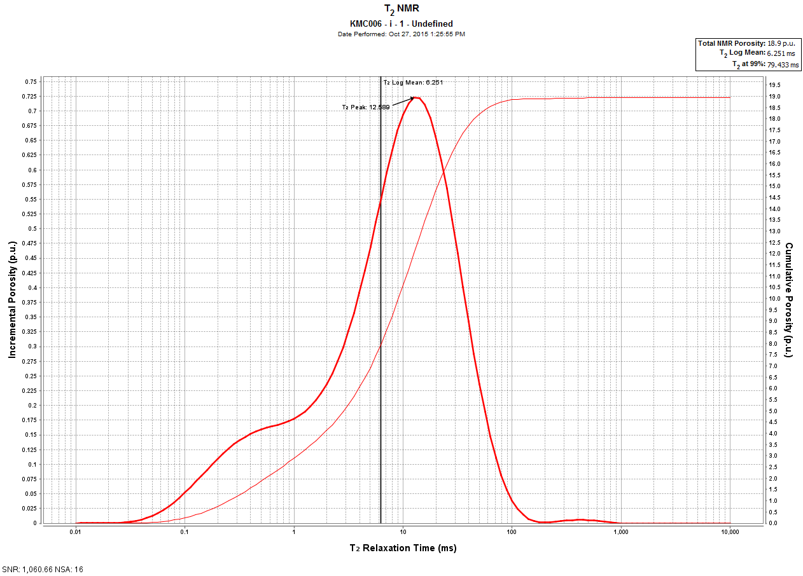
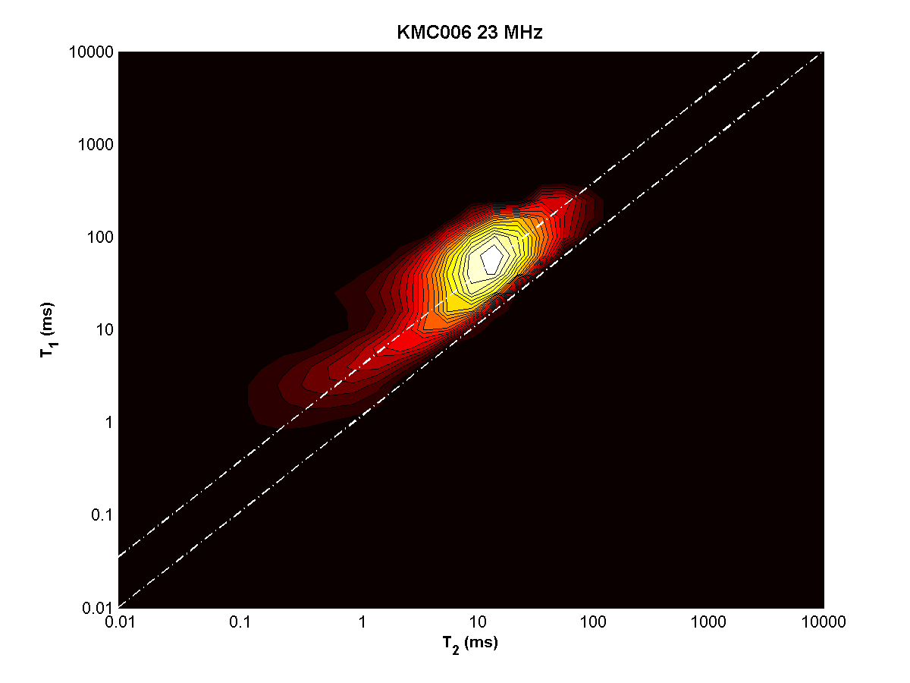
KMC006 – depth = 5912.6 ft

Slide 9
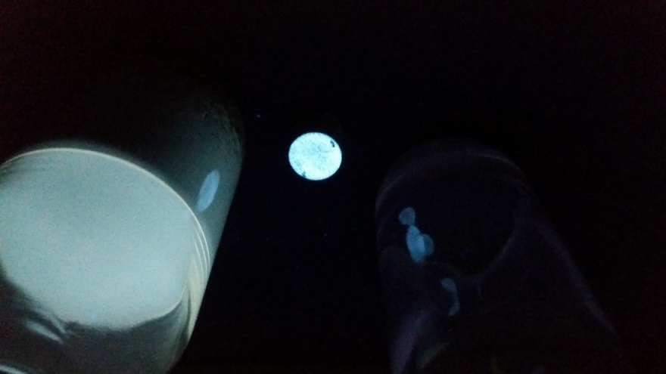
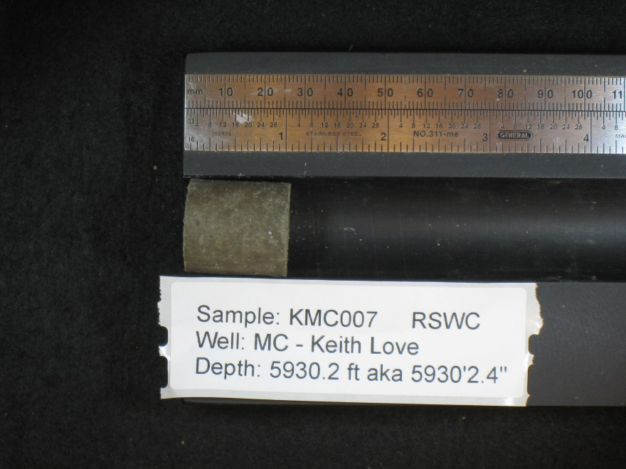
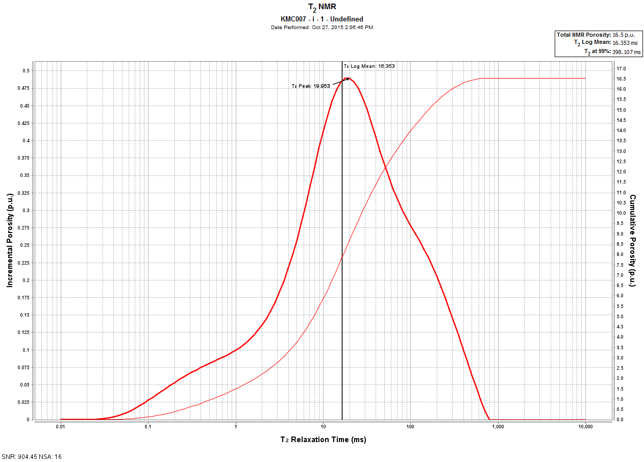
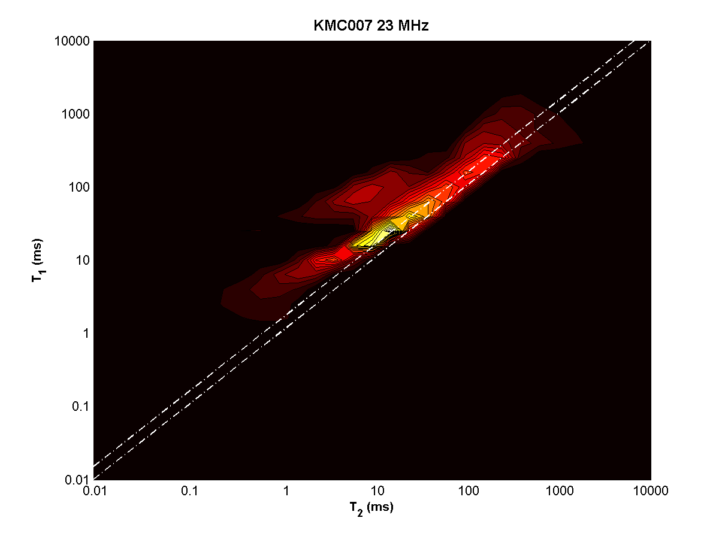
KMC007 – depth = 5930.2 ft

Slide 10
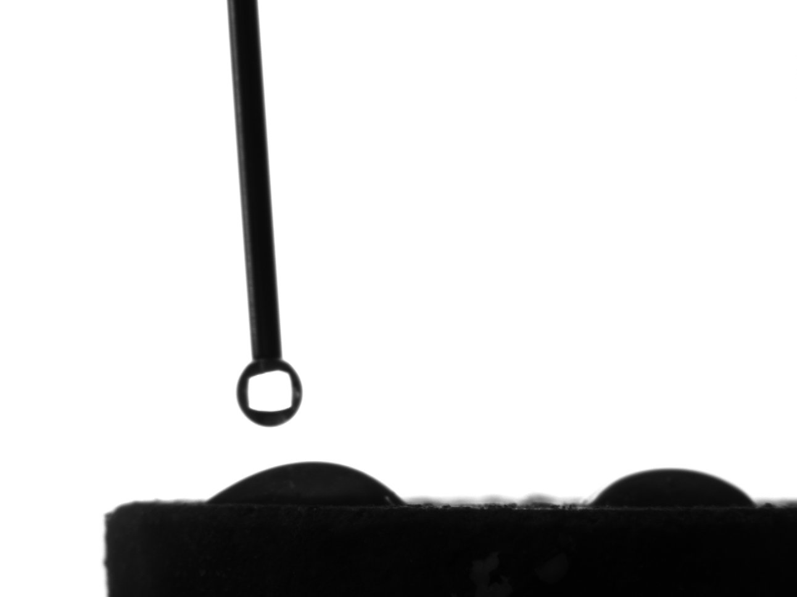
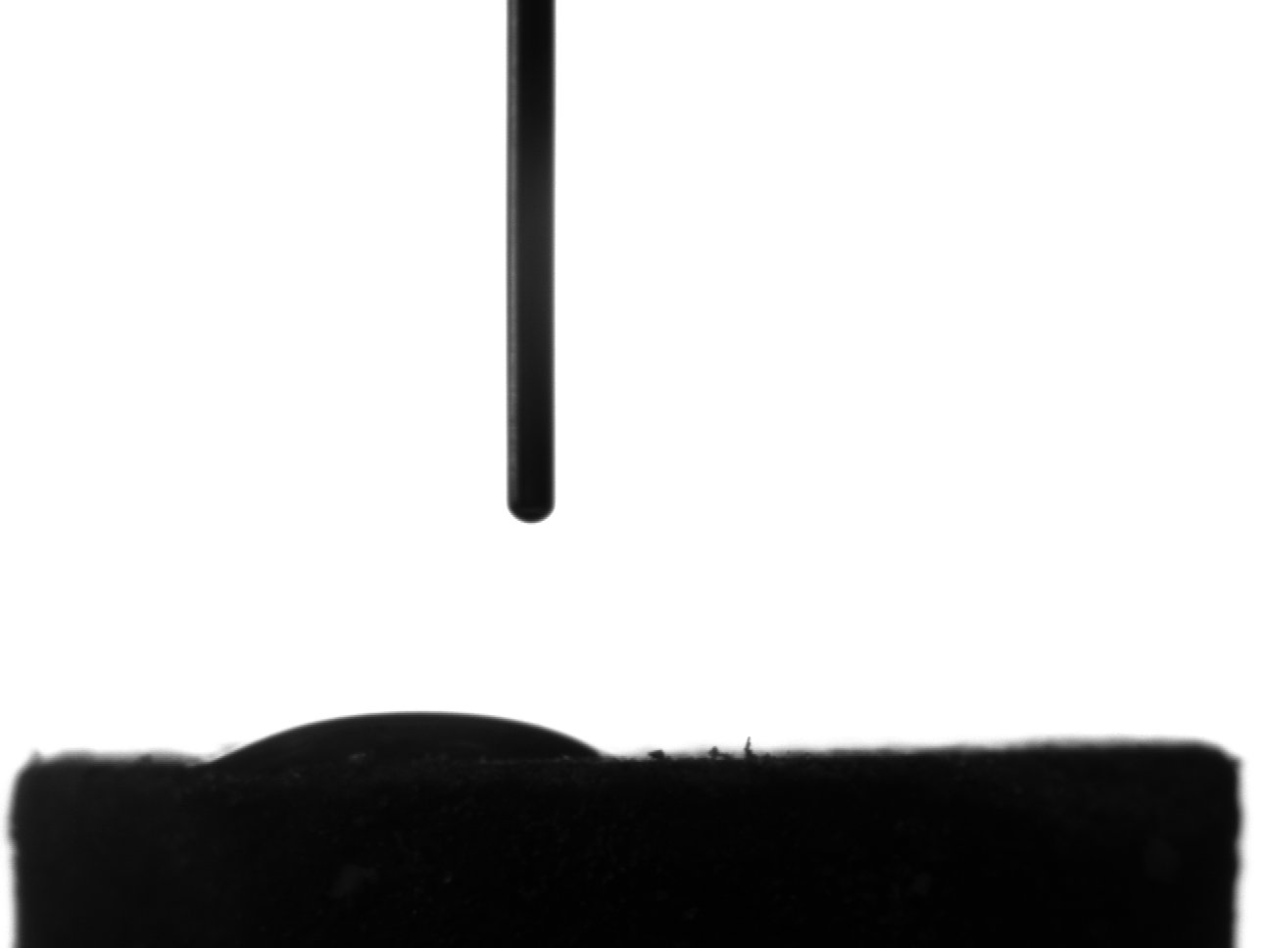
KMC007 – depth = 5930.2 ft
Top
Bottom

Slide 11
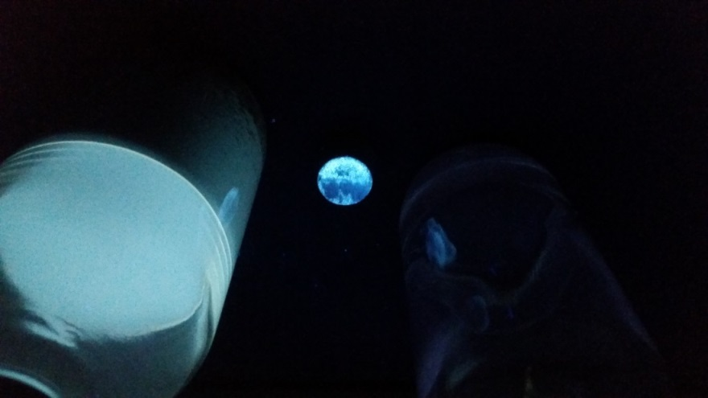
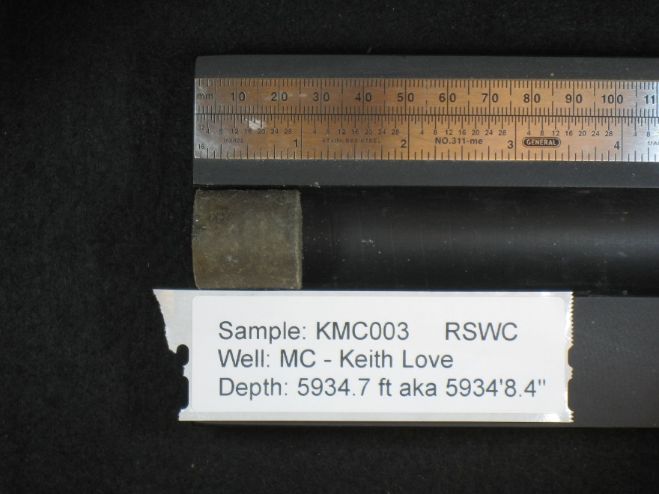
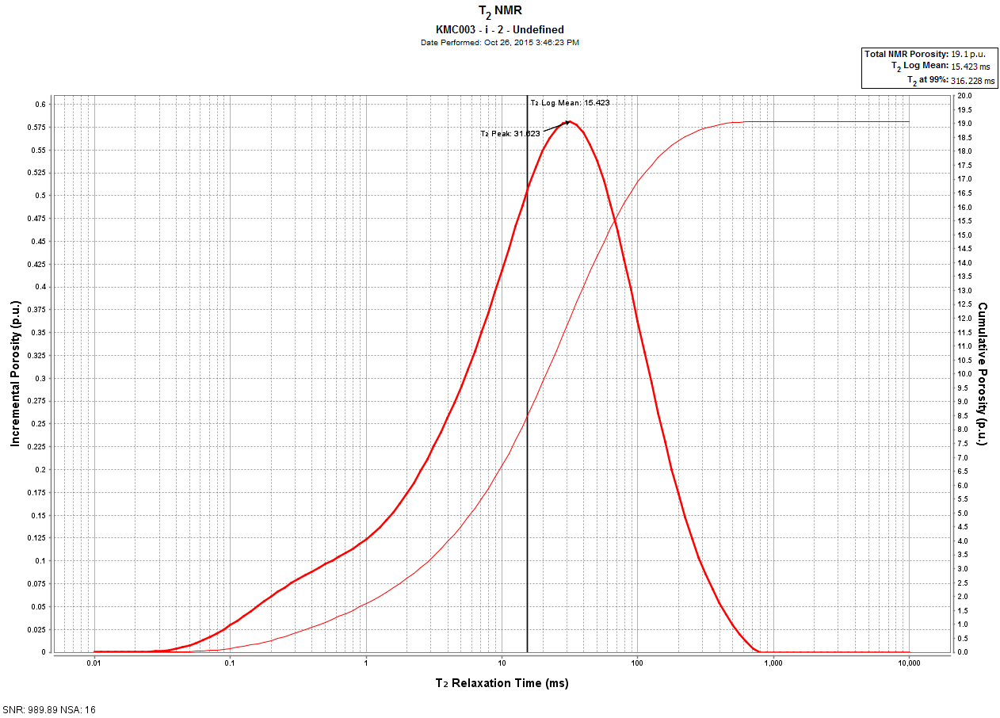
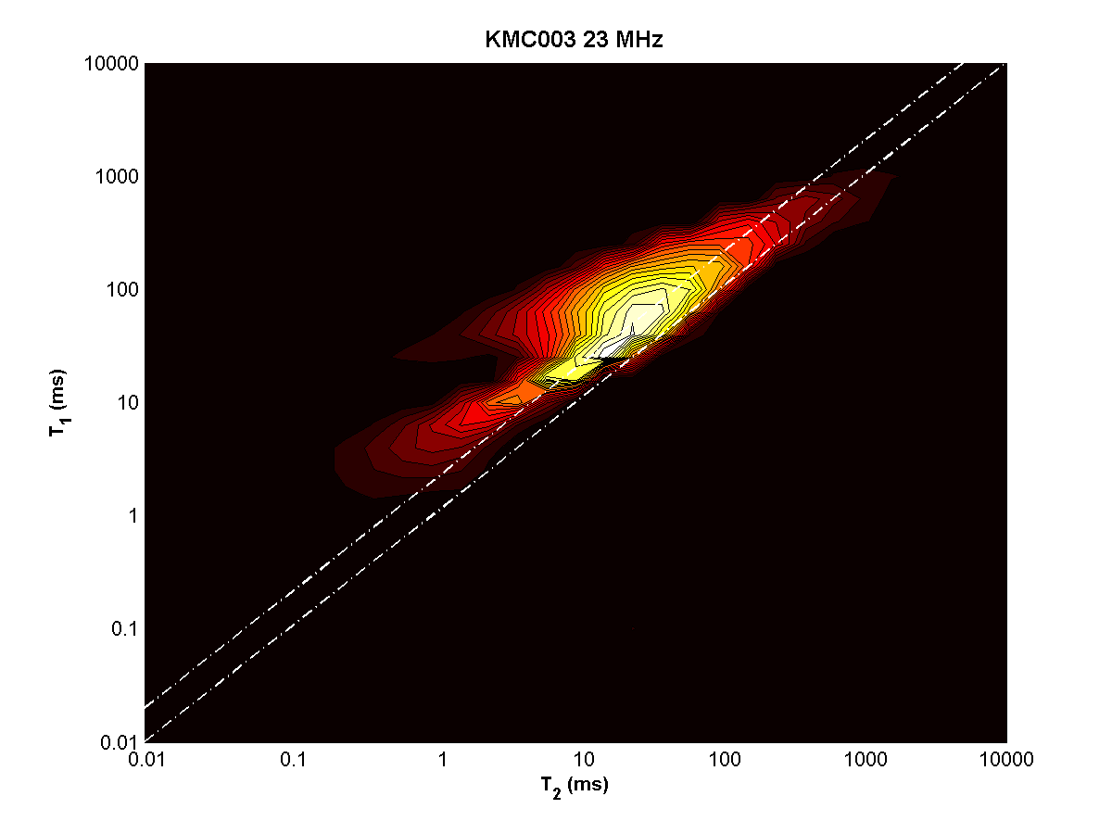
KMC003 – depth = 5934.7 ft

Slide 12
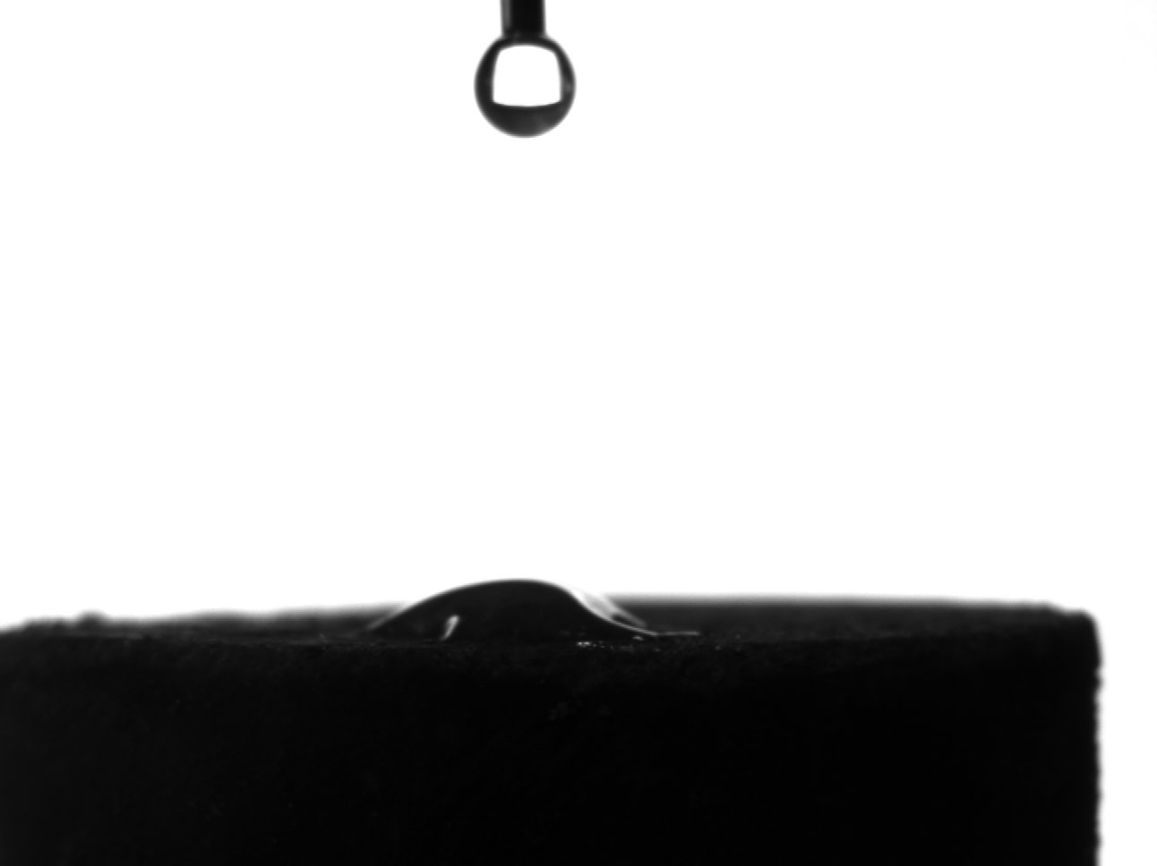
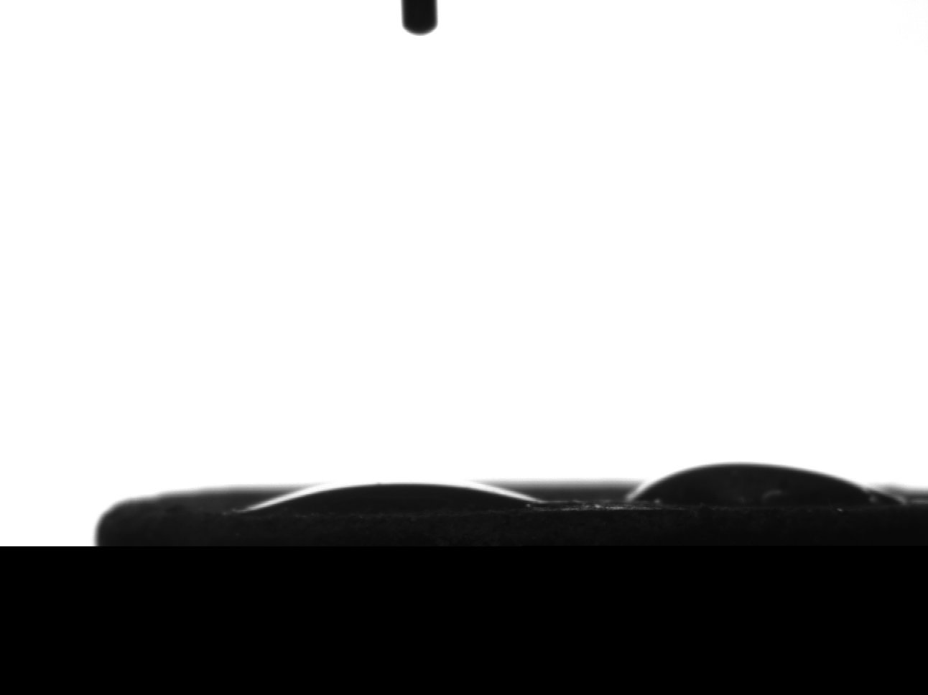
KMC003 – depth = 5934.7 ft
Top
Bottom

Slide 13
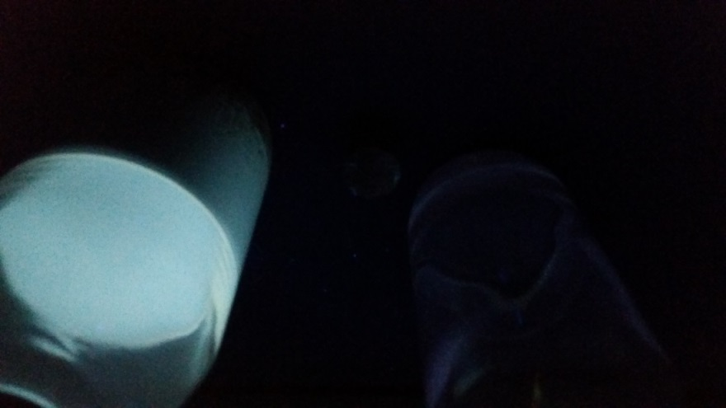
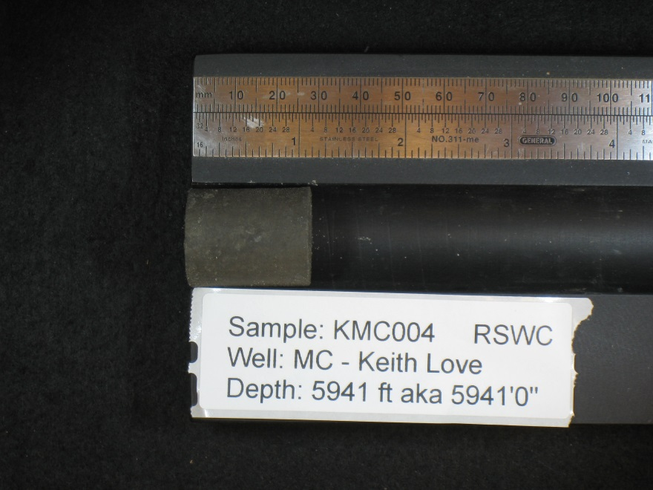
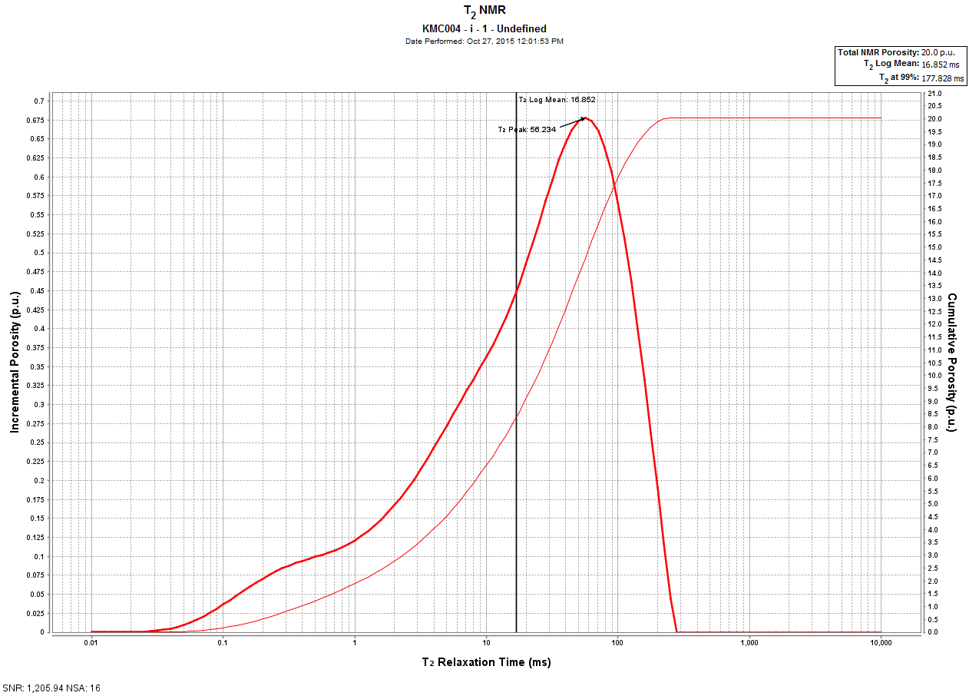
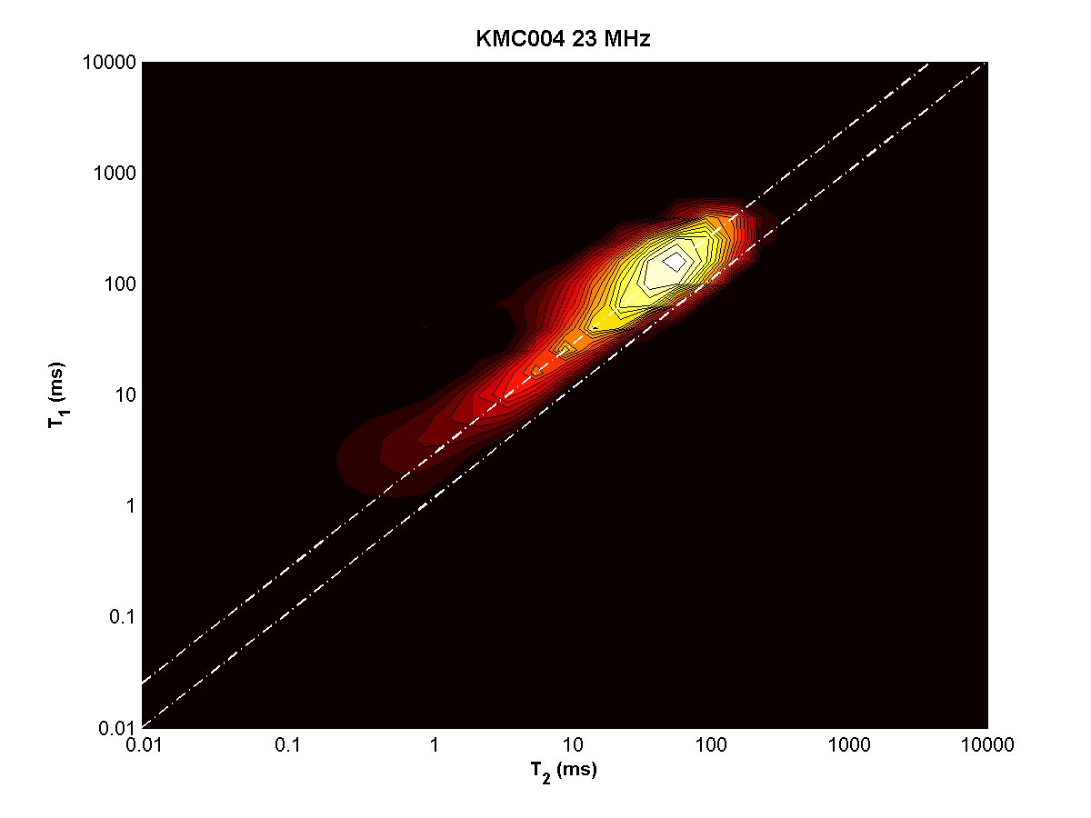
KMC004 – depth = 5941 ft

Slide 14
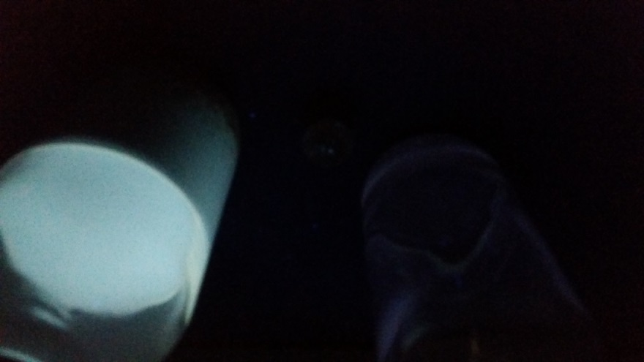
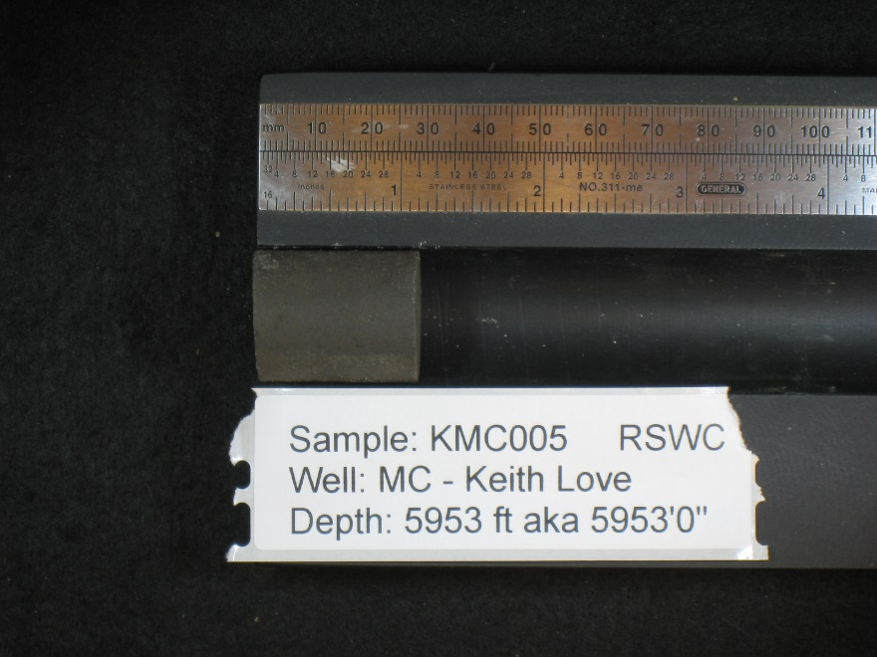
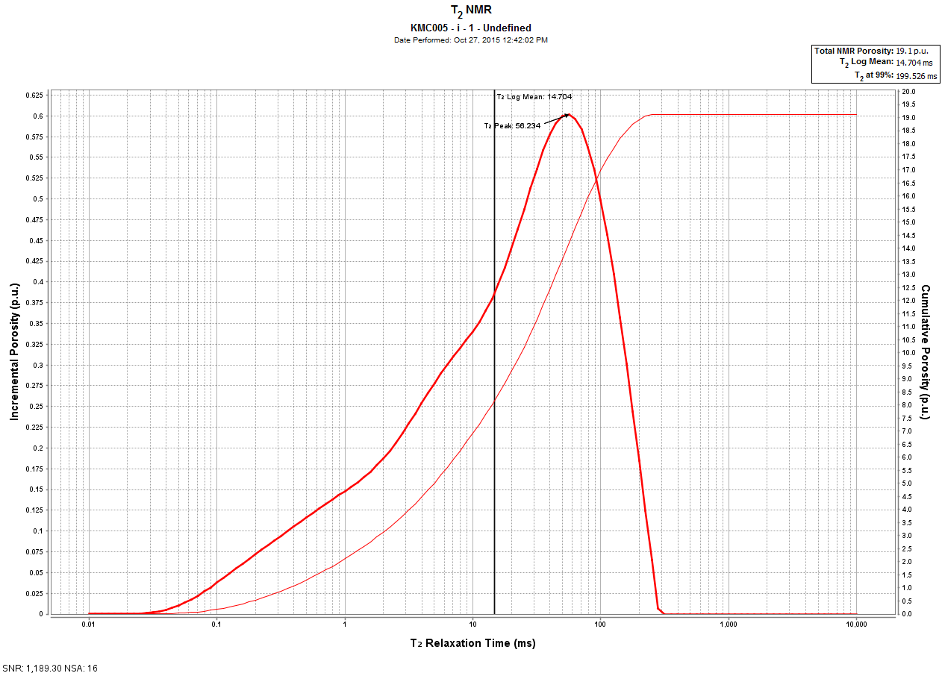
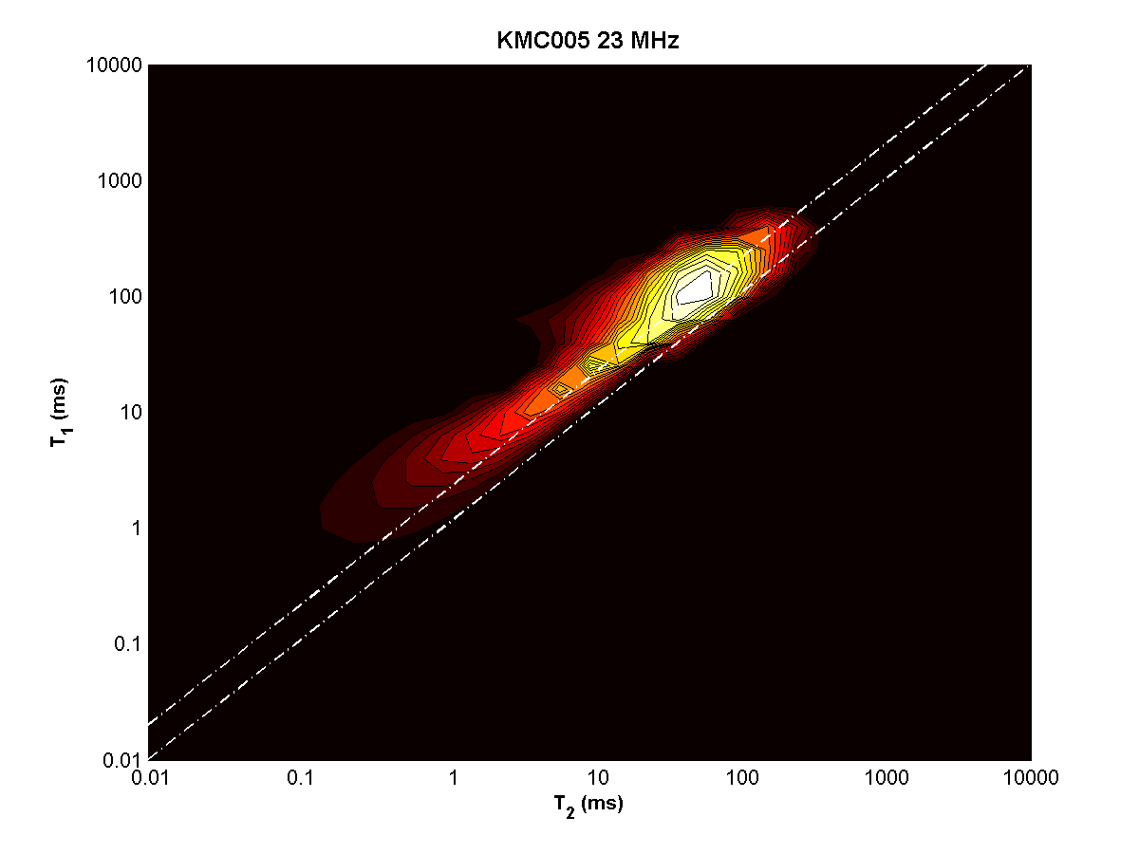
KMC005 – depth = 5953 ft

Slide 15
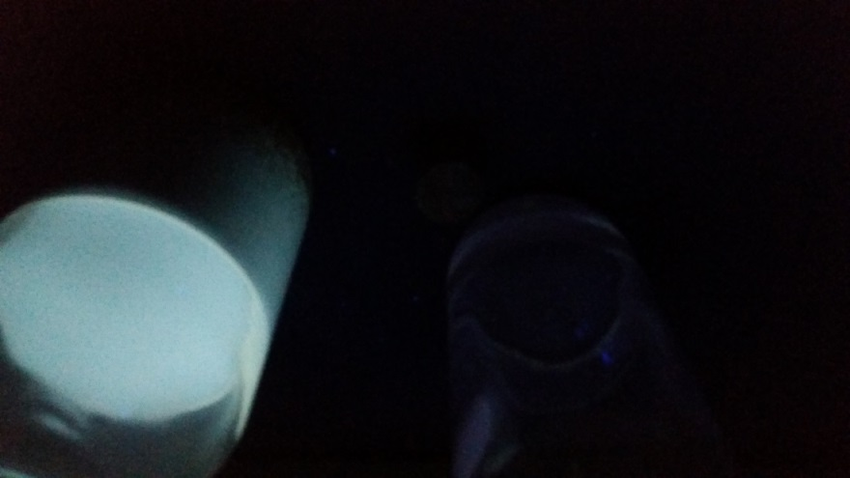
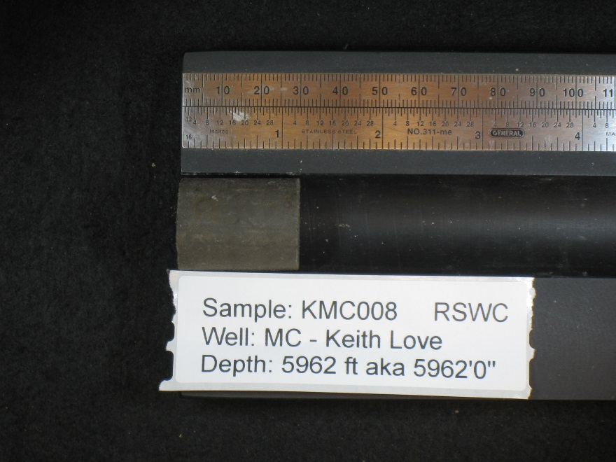
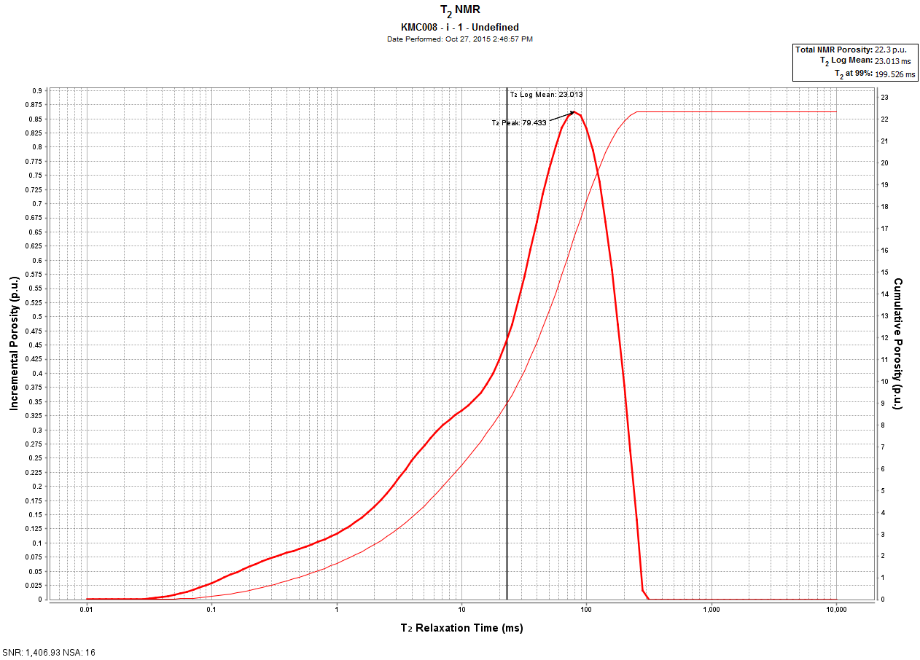
KMC008 – depth = 5962 ft

Slide 16
KMC008 – depth = 5962 ft
Top
Bottom

Slide 17
KMC009 – depth = 5968.1 ft

Slide 18
KMC013 – depth = 6460.8 ft

Slide 19
KMC013 – depth = 6460.8 ft
Top
Bottom

Slide 20
KMC014 – depth = 6472.5 ft

Slide 21
KMC014 – depth = 6472.5 ft
Top
Bottom

Slide 22
KMC015 – depth = 6481.5 ft

Slide 23
KMC015 – depth = 6481.5 ft
Top
Bottom

Slide 24
KMC016 – depth = 6492.5 ft

Slide 25
KMC016 – depth = 6492.5 ft
Top
Bottom

Slide 26
KMC018 – depth = 6500.5 ft

Slide 27
KMC018 – depth = 6500.5 ft
Top
Bottom

Slide 28
KMC017 – depth = 6521.3 ft

Slide 29
KMC017 – depth = 6521.3 ft
Top
Bottom

Slide 30
KMC data
KMC | Depth(ft) | T1/T2 | T2 main peak
1 | 5882.3 | 1.75 | 112.202
10 | 5886.3 | 2 | 14.125
11 | 5892.3 | 2 | 79.433
12 | 5895.3 | 2 | 17.783
2 | 5908.9 | 1.75 | 11.22
6 | 5912.6 | 3.5 | 12.589
7 | 5930.2 | 1.5 | 19.953
3 | 5934.7 | 2 | 31.623
4 | 5941 | 2.5 | 56.234
5 | 5953 | 2 | 56.234
8 | 5962 | 2.25 | 79.433
9 | 5968.1 | 2.25 | 17.783
13 | 6460.8 | 1.75 | 3.548
14 | 6472.5 | 2 | 4.467
15 | 6481.5 | 1.75 | 4.467
16 | 6492.5 | 2 | 7.079
18 | 6500.5 | 2 | 7.943
17 | 6521.3 | 1.75 | 5.623

