Slide 1
U. S. Nuclear Regulatory Commission
Baffle-Former Bolt Issues in Nuclear Power Reactors
Bureau of Safety and Environmental Enforcement
Critical Offshore Connector Safety Forum
August 29, 2016
Jack McHale
Chief, Vessels and Internals Integrity Branch
NRC Office of Nuclear Reactor Regulation

Slide 2
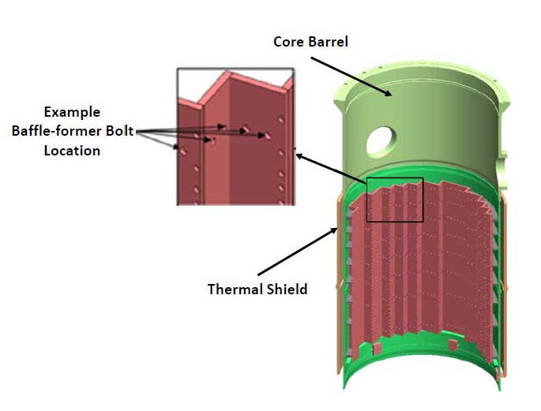
Baffle-former assembly
Function of baffle-former assembly is to direct coolant flow through the core. It also provides lateral support to the core during a seismic event or loss-of-coolant accident.

Slide 3
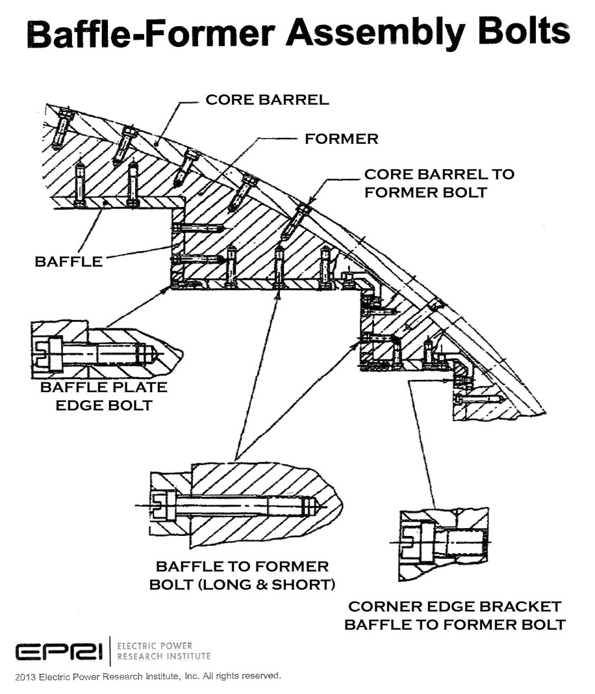
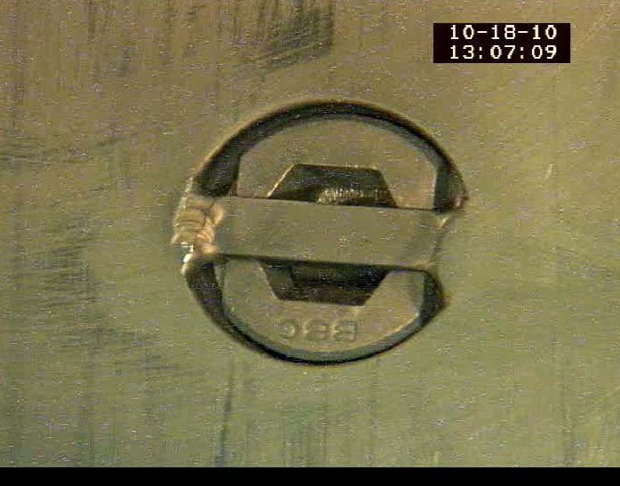
Baffle-former bolt details
Baffle-former bolt head
Tack weld
Locking tab
Stainless steel bolts are 5/8” dia. x ~2” long and attach the baffle plates to the former plates to form the baffle assembly

Slide 4
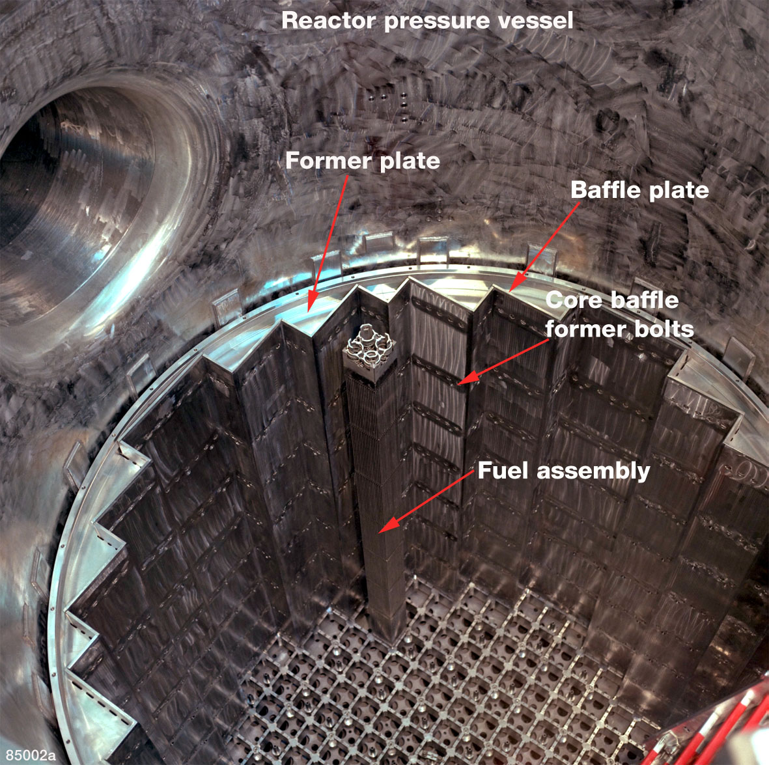
Reactor Internals Arrangement

Slide 5
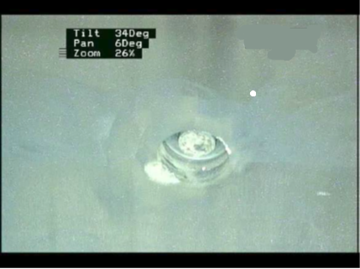
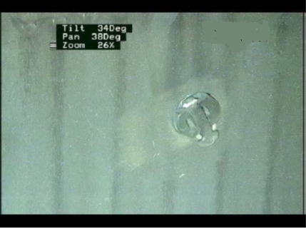
Visual Indications of Failures
Missing Bolt Head
Protruding Bolt Head

Slide 6
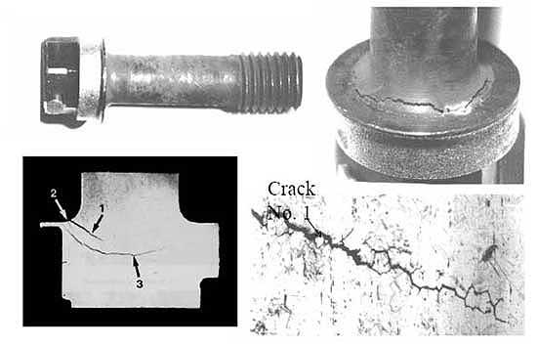
Observed Bolt Cracking
Irradiation Assisted Stress Corrosion Cracking (IASCC)

