Slide 1
Framing the Issue – Connector Reliability
Joseph Levine, ETB Chief
Dr. Candi Hudson, SRS Chief
August 29, 2016
Washington DC
“To promote safety, protect the environment and conserve resources offshore through vigorous regulatory oversight and enforcement.”

Slide 2
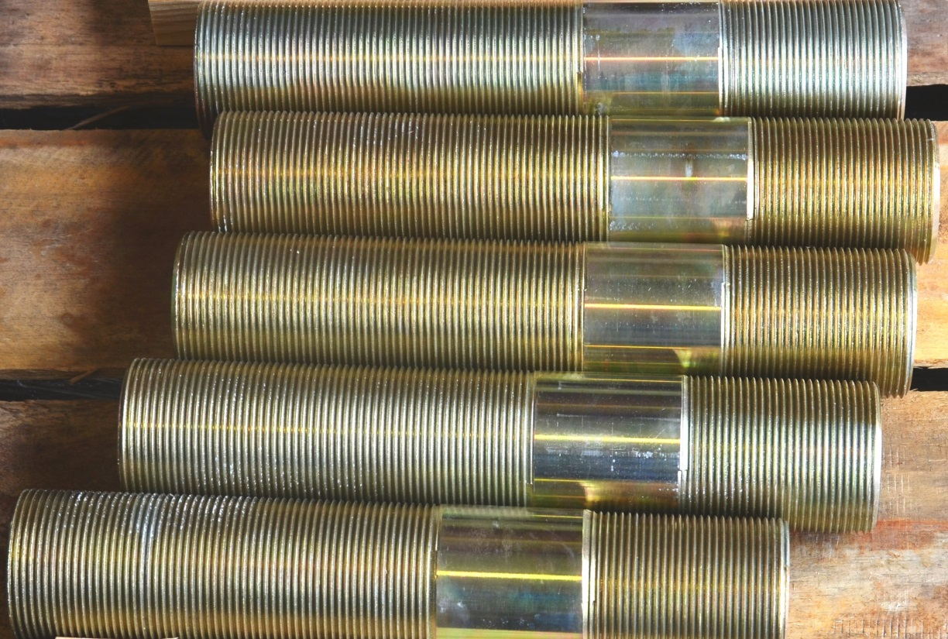
Framing the Issue – Connector Reliability
Today’s Discussion
  Systems Reliability Section (SRS)
  Quality Control Failure Incident Team (QC-FIT)
  QC-FIT connector evaluations
  Bolt studies
  QC-FIT findings
  Areas of concern

Slide 3
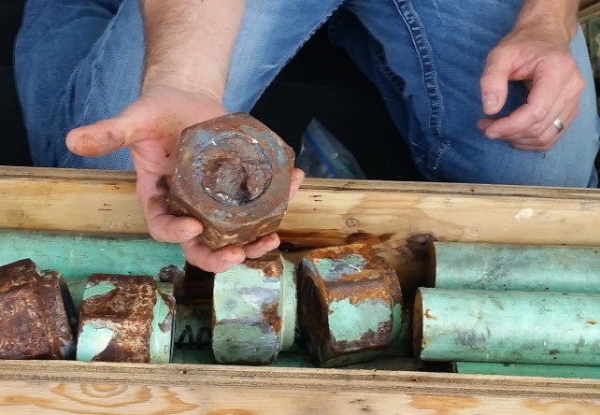
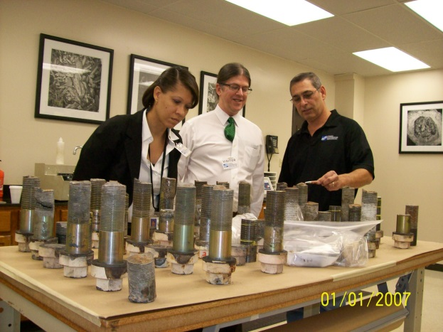
Framing the Issue – Connector Reliability
Systems Reliability Section: QC-FIT
  The Systems Reliability Section (SRS) conducts quality control failure incident team (QC-FIT) evaluations
    Failure of a piece of equipment or system – fitness for purpose
    Collaboration with industry
    Distinct from 2010 Incident Investigations or Regional panel investigations
      District/Regional investigations can result in enforcement actions (INC’s, Civil penalties)
      QC-FIT are fact finding evaluations

Slide 4
Framing the Issue – Connector Reliability
Systems Reliability Section: QC-FIT Goals
  Evaluate equipment's “life cycle” and if it is “fit for service”
  Provide an independent validation of manufacturer recommendations/specifications that impact QA/QC, performance, and reliability
  Provide recommendations
    Changes to BSEE policies, procedures, Notice to Lessees (NTLs), regulations
    Current/new industry standards
    Issuance of Safety Alerts
    Initiation of technical research studies

Slide 5
Framing the Issue – Connector Reliability
QC-FIT Connector Evaluations
  H4 Connector bolt failures
    Discovered following a release of synthetic-based drilling fluids into the Gulf of Mexico during drilling operations (December 2012)
  HC Connector bolt failures
    Discovered during between-well maintenance (July 2014)
  Blind Shear Ram (BSR) actuator bolt failures - ongoing
    Discovered during BOP high pressure stack testing (October 2015)

Slide 6
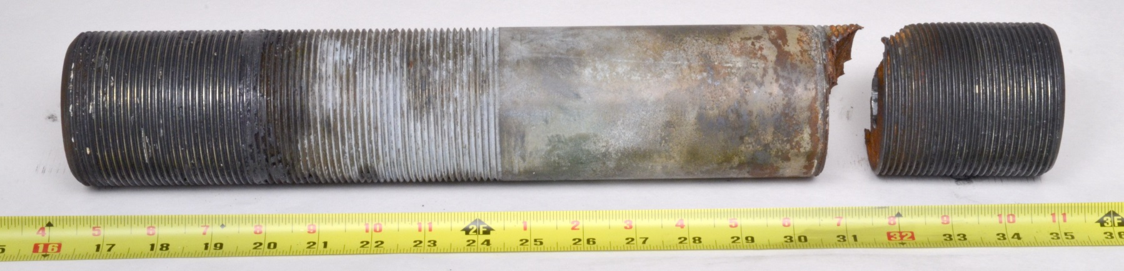
Framing the Issue – Connector Reliability
Published QC-FIT Connector Evaluations
  H4 Connector Bolt Failures
    https://www.bsee.gov/sites/bsee.gov/files/reports/drilling/bolt-report-final-8-4-14.pdf
  HC Connector Bolt Failures (addendum)
  https://www.bsee.gov/sites/bsee.gov/files/memos/public-engagement/qc-fit-bp-bolts-report-final.pdf

Slide 7
Framing the Issue – Connector Reliability
BSEE Funded Bolt Studies
Lawrence Berkeley National Laboratory (LBNL)
  Global standards evaluation/gap analysis
  Mechanical testing
  Coating/corrosion analysis
National Aeronautics and Space Administration (NASA)
  Quantitative Risk Assessments
  Best Available Safest Technology
  Failure analysis and testing services
Industry Bolt JIP (Spring 2015)
  Six industry participants and BSEE
  Industry withdrew

Slide 8
Framing the Issue – Connector Reliability
BSEE Funded Proposed Bolt Study
National Academy of Science (NAS) Bolts Root Cause Analysis (RCA) Workshop and Study (Fall 2016??)
  Evaluate connectors currently in use for offshore oil and natural gas operations
  Draw on bolt usage across other industries
  Focus on industry wide and global impacts
  Identify gaps in industry requirements, best practices, standards, and regulations
  Suggest alternatives to BSEE and the industry
    Onshore oil and gas
    Refineries
    Pipelines
    Civil aviation
    Nuclear
    Military
    Automotive

Slide 9
Framing the Issue – Connector Reliability
Areas of Concern
Design Standards
Manufacturing Processes/Procedures
Significant Gaps
Raw Material Processing
Inconsistencies
Harmonization
Machining
Heat Treatment
Coating
Quality Control/Auditing
Operational Procedures
Second/Third tier subcontracted vendor oversight
Assembly
Specification Compliance
MOC
Installation
Torque
Cathodic Protection
In-service Inspection

Slide 10
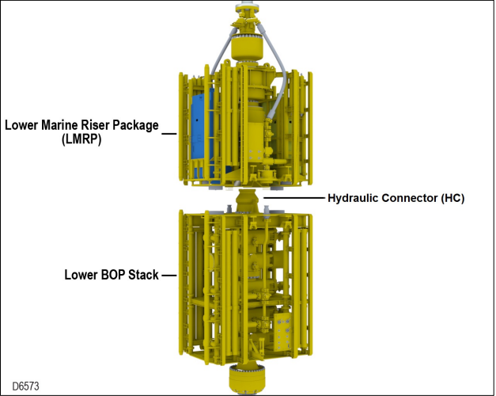
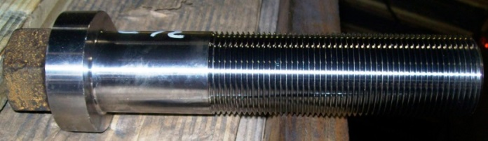
Framing the Issue – Connector Reliability
QC-FIT H4 Connector Evaluation – Bolt Failures
December 18, 2012, a lower marine riser package (LMRP) separated from the blowout preventer (BOP)
Release of approximately 432 barrels of synthetic drilling fluids
Approximately 11,000 connectors affected globally
Thirty-six connector bolt failures were discovered on the H4 connector

Slide 11
Framing the Issue – Connector Reliability
QC-FIT H4 Connector Evaluation – Key Findings
Environmentally-assisted cracking identified as failure mode
  Hydrogen embrittlement, hydrogen induced stress cracking
  Cathodic protection, coating concerns
Material properties
  High Material Hardness (>34 HRC), Yield Strength, Ultimate Tensile Strength
OEM Quality Control manufacturing process concerns
  Non-compliance to OEM manufacturing specifications
  Quality control oversight of second and third-tier subcontracted vendors
  No post-bake after coating

Slide 12
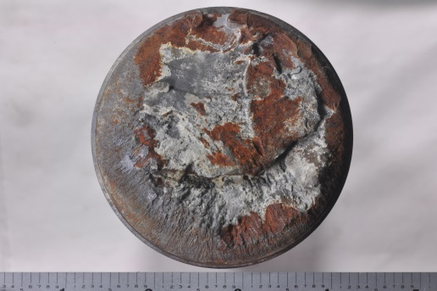
Framing the Issue – Connector Reliability
QC-FIT HC Connector Evaluation – Bolt failures
June 30, 2014 a subsea engineer discovered a loose bolt while conducting scheduled between-well BOP maintenance
Connectors were in service for four months
Nine of twenty connectors failed on a LMRP hydraulic connector flange
Considered a near miss event

Slide 13
Framing the Issue – Connector Reliability
QC-FIT HC Connector Evaluation – Key Findings
Environmentally-assisted cracking identified as failure mode
  Failure mechanism was not fully understood
Material properties
  High Material Hardness (>34 HRC), Yield Strength, Ultimate Tensile Strength
OEM Quality Control manufacturing process concerns
  Non-compliance to OEM manufacturing specifications
  Quality control concerns of second/third-tier subcontracted vendors
  Improper raw material casting
  Inadequate heat treatment
  Latest edition of ASTM B633 (2007) post bake requirements were not followed

Slide 14
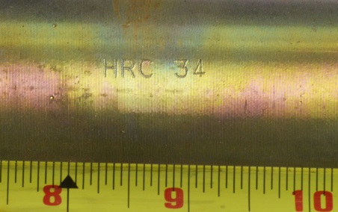
Framing the Issue – Connector Reliability
QC-FIT Ongoing Evaluation – BSR bolt failures
In-service connectors with high material hardness were identified
Material property concerns
Hydrogen embrittlement identified as possible failure mode
OEM Quality Control manufacturing process concerns
  Latest edition of ASTM B633 (2007) post bake requirements were not followed
DRAFT

Slide 15
Framing the Issue – Connector Reliability
Connector Design Standards
Inconsistent material property requirements in industry standards
  API 6A, API 16A, API 16F, API 17A
  NACE MR0175, NORSOK M-001, ASTM B633, ASTM B849, ASTM B850, ASTM 1137, ASTM F1941
  Need harmonized requirements across industry standards for bolts used for subsea service
    Hardness, yield/tensile strength
    Coating
    Cathodic protection

Slide 16
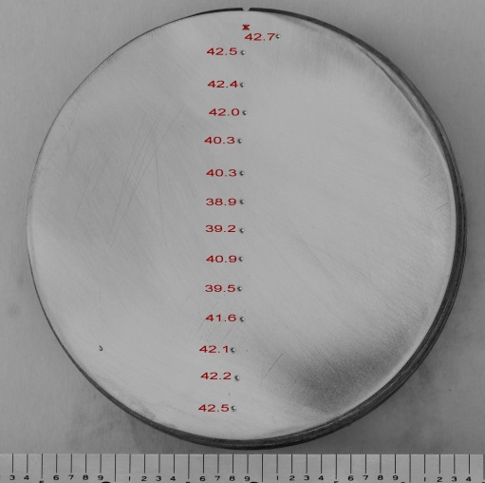
Framing the Issue – Connector Reliability
Connector Manufacturing
Need for improved control of connector manufacturing and material properties for critical subsea applications

Slide 17
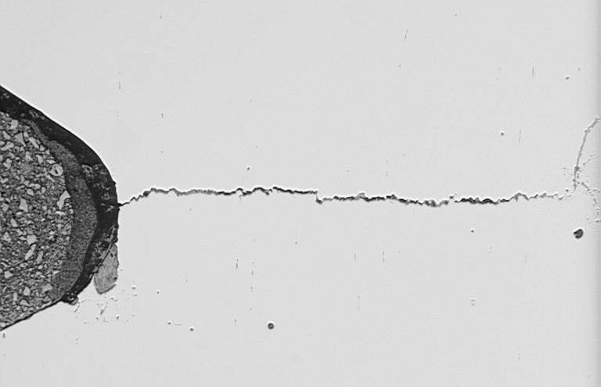
Framing the Issue – Connector Reliability
Connector Manufacturing – Reliability Impacts
Design factors
  Environment
  Fatigue loading
  Raw material selection
Manufacture processes/procedures
  Casting
  Machining
  Heat treatment
  Coatings
Material properties
  Mechanical properties (Material Hardness, Yield Strength, Ultimate Tensile Strength)
  Corrosion performance, cathodic protection
(Thread root crack)

Slide 18
Framing the Issue – Connector Reliability
Connector Quality Control/Auditing
Quality Control
  Non-compliance with OEM manufacturing specifications
  Use of older revisions of standards containing different requirements
  Subcontracted vendor manufacturing processes
    Heat treat
    Coating
Quality Auditing
  Currently auditing only first-tier subcontracted vendors
  Need for improved auditing of second/third-tier subcontracted vendors

Slide 19
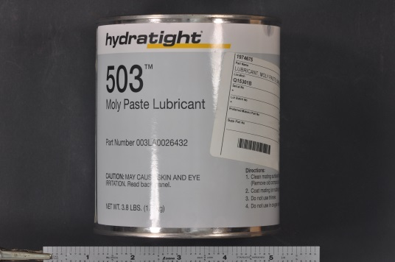
Framing the Issue – Connector Reliability
Operational Procedures
Connector installation
  Equipment assembly
  Required torque
  Torque procedure (pattern)
  Lubricant
  Torque gun calibration
Connector inspection
  Are BOP connector inspections periodic?
  Are bolts examined and/or replaced when stack is brought to surface?
Cathodic protection
  Can possibly contribute to connector corrosion and degradation
(Common lubricant)

Slide 20
Framing the Issue – Connector Reliability
Closing
Questions ???
Comments
Discussion

Slide 21
Framing the Issue – Connector Reliability
Contacts
  BSEE website
    https://www.bsee.gov/
  SRS page
    https://www.bsee.gov/whatwedo/regulatory-safety-programs/systems-reliability-section/goals-process
Contact
  joseph.levine@bsee.gov
  candi.hudson@bsee.gov

Slide 22


BSEE Website: www.bsee.gov
@BSEEgov
BSEEgov
Bureau of Safety and
Environmental Enforcement
BSEEgov
“To promote safety, protect the environment and conserve resources offshore through vigorous regulatory oversight and enforcement.”

