Slide 1

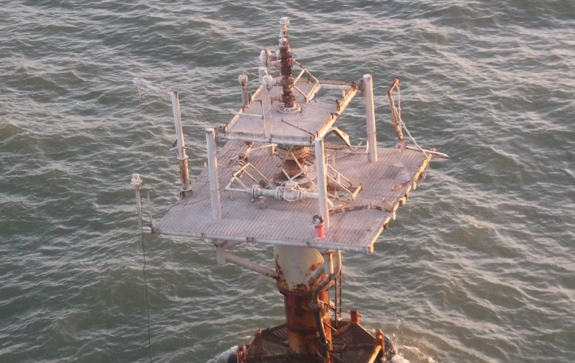
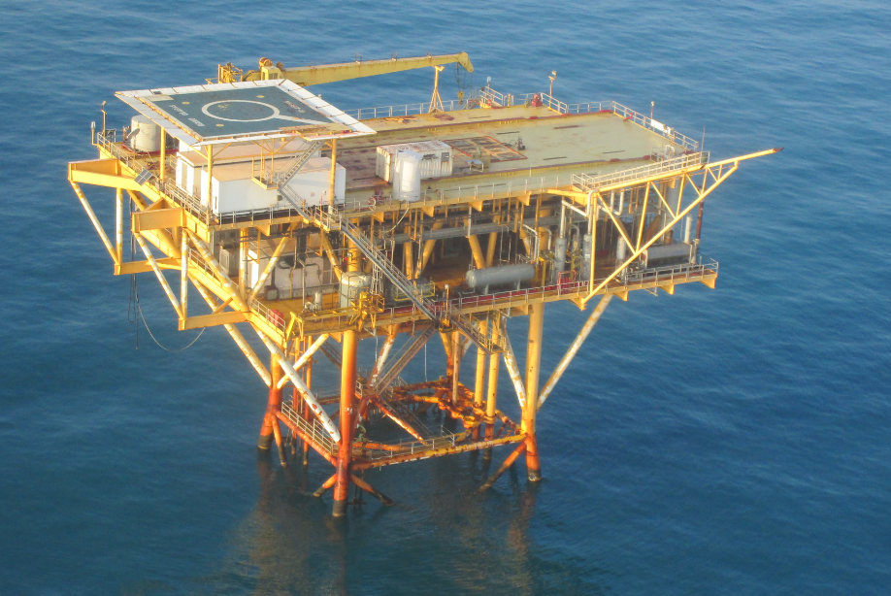

Decommissioning Orphaned Wells on the U.S. Outer Continental Shelf
RFP Solicitation No. 140E0122R0003
Thursday, March 24, 2022
“To promote safety, protect the environment and conserve resources offshore through vigorous regulatory oversight and enforcement.”

Slide 2

Presentation Overview
Email: bseeorphandecom2022@bsee.gov
Welcome
Introductions
Project Overview - Well Decommissioning
Data Package
Bidding and Contracting (Federal Government)
Small Business Office
Q & A - Contact Information

Slide 3
Government Project Stakeholders
Rudy Garza, Project Manager Team Lead, Petroleum Engineer, GOMR
Eric Hawkins, Contracting Officer’s Representative, Geologist, GOMR
Chrischanda Smith, Contracting Officer, Sterling, VA
District Offices
Support Sections: Decommissioning, Idle Iron, OSP, & OSM

Slide 4
PROCUREMENT MILESTONES
Solicitation Issuance Date: March 14, 2022
Amendment 1 Issuance: March 18, 2022
Revised Submission Due Date: April 29, 2022
    Time: 2:00 pm EST (Unchanged)
    Submission location: bseeorphandecom2022@bsee.gov (Unchanged)
Amendment 2 Issuance: Forthcoming
Provide Pre-Solicitation Power Point Presentation
Provide Revised Question & Answer cut off date
Instructions for Exceptions Submission

Slide 5
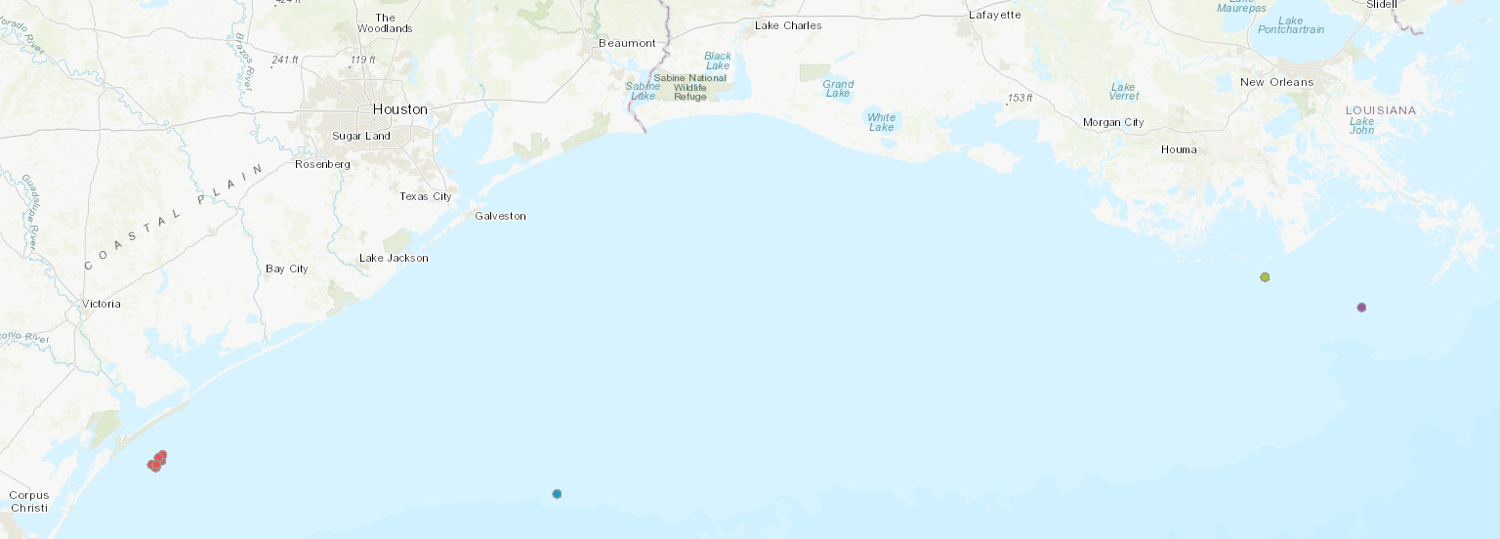
Project Overview
HI 589A
Wells = 2
Dist. to Shore = 93 mi
WD = 477’
1, 8-Pile Structure
WD 117H
Wells = 4
Dist. to Shore = 27 mi
WD = 199’
1, 4-Pile Structure
MI 632, 656, 657
Wells = 9 (1 TA status)
Dist. to Shore: 13 mi
WD = 77’
7 Caisson Type Structures
* Reference: RFP

Slide 6
Project Overview
Project Phases
Phase 1 - Well Decommission
          Well Temporary Abandonment (TA) * RFP Issuance
            Platform Boarding – Verification - Isolation - Make Safe Repairs
            Well, Single Isolation Plug vs. Full TA
          Well Permanent Abandonment (PA)
            Cut – Pull Well Casing(s) to -15’ BML
Phase 2 - Pipeline and Platform Decommission
        Pipeline Abandonment
          Isolation - Purge – Flush and Fill
          Cut – Cover – Bury to -3’ BML
        Platform Abandonment
          Isolate - Purge – Flush
          Removal to -15’ BML
Phase 3 - Site Clearance
          Trawl
          Sonar Scan– Diver Verification

Slide 7
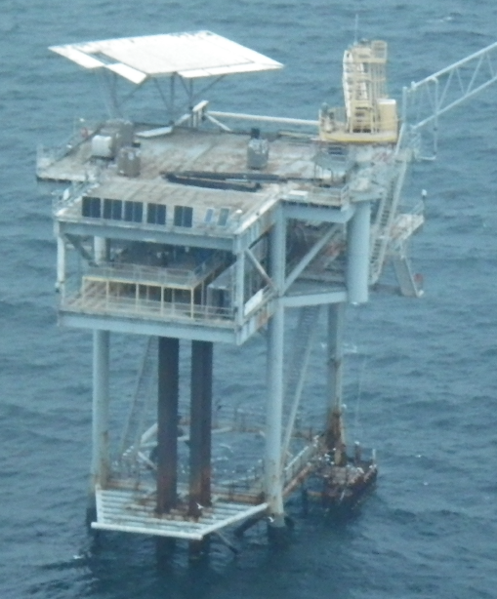
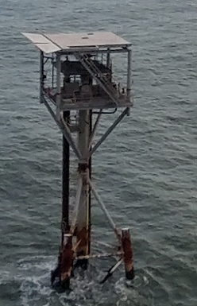
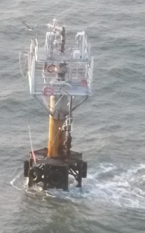
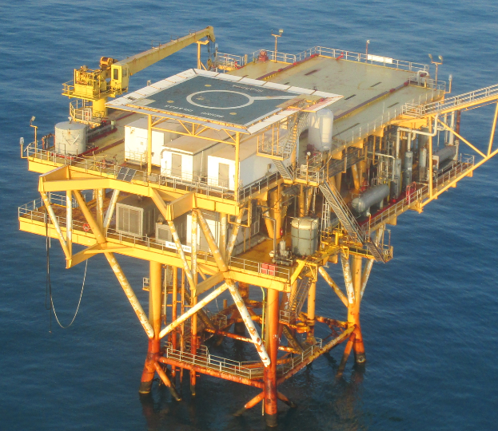
Well Decommissioning
MI 657
MI 632
HI 589 A
WD 117 H

Slide 8
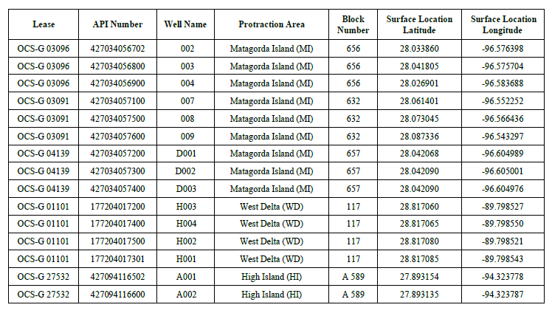
15 Wells, 1 TA Status (D002)
-Well depths = 2,350’ to 12,000’ MD.
-Water Depth = MI @ 77’ , WD @ 200’, HI @ 477’
-Gas = MI, Gas + Oil = WD, HI

Slide 9
Project Goal:
Safe and affective wellbore isolation. Elimination of risk from orphaned wells.
BSEE Fiduciary Statement:
BSEE has a fiduciary responsibility to the Public. BSEE reserves all rights to amend, on a lease or well basis, the scope
of work or work plan to meet budgetary constraints and/or other presented conditions. If changes in work scope require
modification, reference Federal Acquisition Regulation (FAR) clause 52.243-4 Changes (Section I).
Draft RFP Highlights:
Contract Type: Firm Fixed Price shall be provided for all work.
The Decommissioning Contractor shall provide all management, supervision, labor, materials, supplies, and equipment,
accommodations, communications, transportation, dock services, and shall plan, schedule, permit, coordinate, and assure
effective performance of all decommissioning activities to meet BSEE and BOEM requirements.
The Contractor shall identify and obtain all requisite precondition items applicable for each place of performance. Precondition items
include all permits, agreements, authorizations, notices, and stipulations from any BSEE, BOEM, other Federal, and/or State entity to
be affected.
The Contractor shall provide lodging for a maximum of two BSEE contracted personnel (day and night shifts) inclusive of separate sleeping
quarters (private/semi-private), laundry, meals, and communications (telephone and e-mail services).
The Contractor shall provide for services and materials to establish a functioning regulation-compliant Nav-Aid package and horn,
inspect, and replace swing rope (where feasible, pending the condition of boat landings), provide a minimum of two portable fire
extinguishers with appropriate rating, and inspect and repair/replace emergency water life saving equipment.

Slide 10
Draft RFP Highlights (cont) :
The Contractor shall provide services and materials to establish functional and regulation-compliant cranage on location. Existing cranes, where present, are available for use subject to inspection, repair, certification meeting current regulations. BSEE does not warrant the condition, history, nor structural condition of any crane.
The Contactor shall be responsible for all services, equipment, and materials to enter and/or gain access to each contracted wellbore for evaluation and to perform decommissioning operations.
The Contractor shall provide services to locate and close the primary departing pipeline riser valves for the facility to isolate the facility from the pipeline. The Contractor is to confirm that the valve is isolated and holding pressure. The Contractor shall then identify the valve as closed and tag.
The Contractor shall be responsible for providing all relevant well services, materials, and down-hole tooling customary to a rig-less operation, including but not limited to: dock services, marine vessels (equipment & crew transport, miscellaneous support, etc.); fluid mixing and handling; specialty tools for trouble shooting well condition and well work related to isolation of tubulars/casing, pressure testing, logging, bailing/dump-bailing, chemical tracing, perforating/cutting; locking out of SCSSV, pumping and cementing, wireline (electric, slickline, braided, HDWF), plug application, clearing hinderance(s) and/or blockage(s) for access, equipment associated to conveyance and recovery of well materials, pre- and post-inspection services, disposal, transportation, and consumables
For services deemed necessary by the Contractor to complete task, operations which fall outside the scope of a rig-less operation, require justification, work scope, and a detailed itemized cost estimate including but not limited to: milling, casing jacks, BOPs and associated systems, coiled tubing, snubbing, derrick barge, facility rig, lift-boat, DSV, on-site cranage (inspection/repair/rental), and MODU. Contract proposal submittal revisions, including changes to the general scope of well plugging operations and pricing, shall be submitted by the Contractor and approved by BSEE through a Change Order process as detailed in Section I, FAR Clause 52.243-4. Changes, prior to commencing or revising operations . Because these changes will be paid for via an equitable adjustment through the Changes Clause, offers should not include any price/cost or contingency for these items.

Slide 11
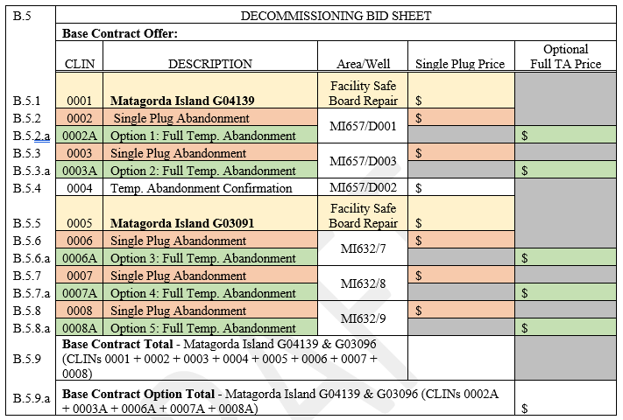
Supporting Documents for Bid Submittal:
Per Facility
(1) Safe Board Plan.
(2) CE for Safe Board & Make Safe Repairs.
Per Well
(3) CE for Single Plug Abandonment.
(4) CE for Full Well TA (multiple plugs).
(5) Scope of Work & Proposed Diagram (Full TA)
Reference: Draft RFP, Sec C.4.G. for bid guidelines.
Cost Estimate Templates Supplied.
Cost Estimate (CE)
Temporary Abandonment (TA)
Sample: Roll-up Bid Sheet

Slide 12
Well Decommissioning Data Package
Review of Materials included in the Statement of Work (Section C) and List of Attachments (Section J)
Review of BSEE Data Center (data.bsee.gov/data.boem.gov)
Overview of Additional Materials to be provided to bidders:
Well Data (Log Images, APDs, APMs, WARs, EORs, Completions, Directional Surveys, OGOR-As, etc.)
Structure Data (Structural Permits, Drawings, Renderings, Notifications, Reports, etc.)
Pipeline Data (Decommissioning Reports for Affected Pipeline Segments associated with Aforementioned Structures)
Facility Photographs

Slide 13
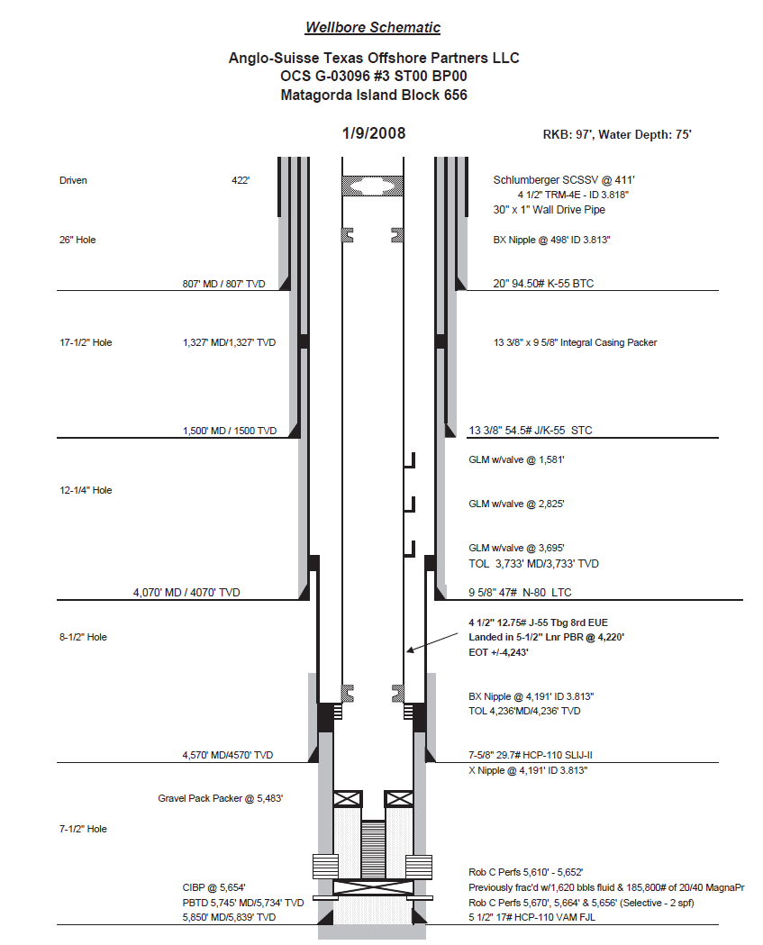
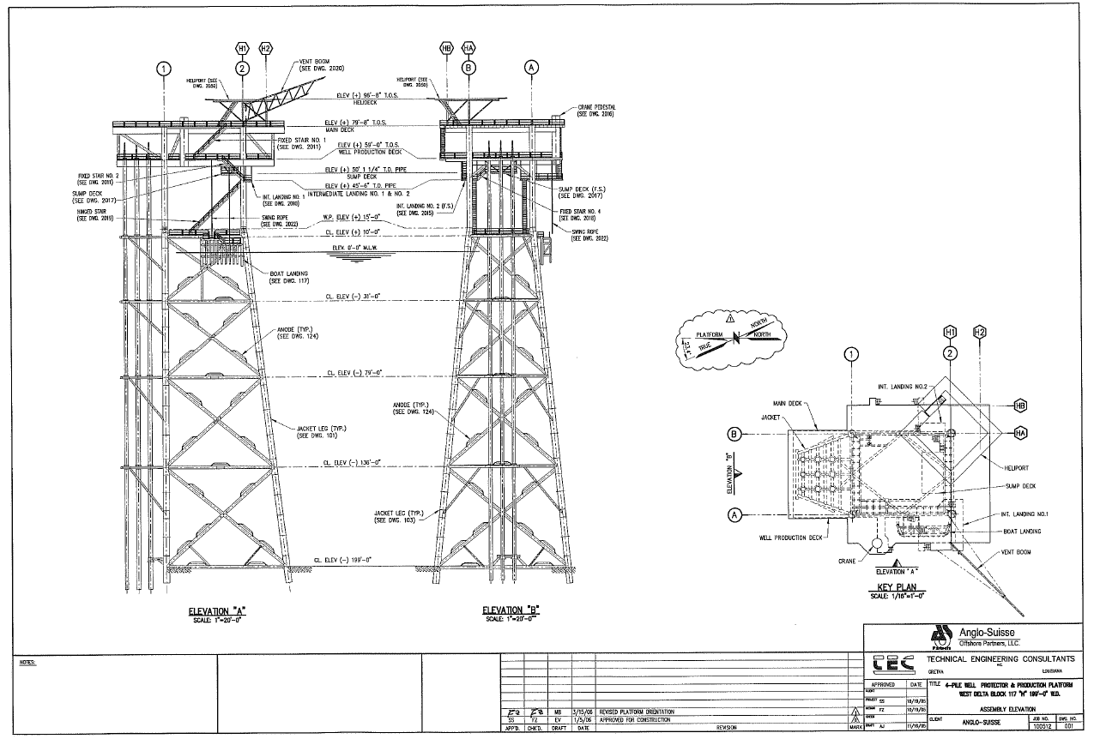
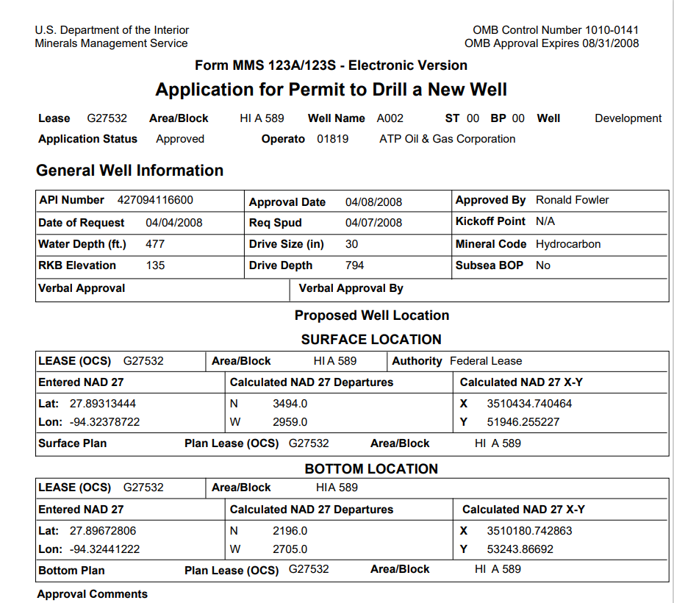
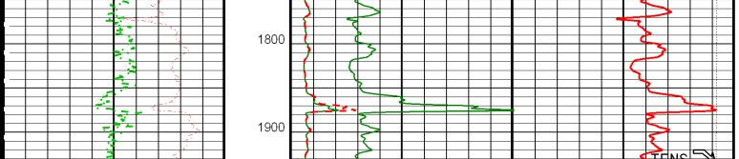
Well Decommissioning Data Package, cont.
Sand Top: 1850’ MD
Sand Base: 1879’ MD

Slide 14
Bidding and Contracting with the Federal Government

Slide 15
Bidding and Contracting with the Federal Government, cont.
Virtual Industry Day Presentation Links:
Live Event, click here: Offshore Decommissioning RFP Industry Day Live Event
View Presentation, click here: Offshore Decommissioning RFP Industry Day Presentation

Slide 16
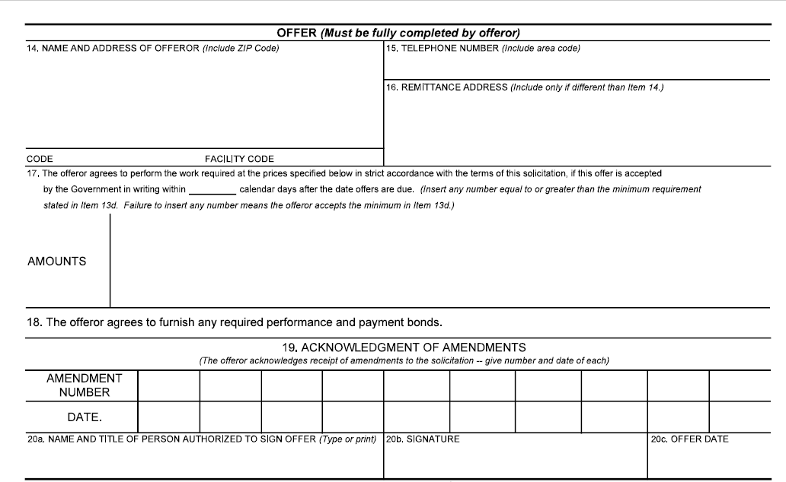
STANDARD FORM 1442 (Page 2)
Blocks 14 – 20c Must be fully completed by Offeror
when proposal is submitted

Slide 17
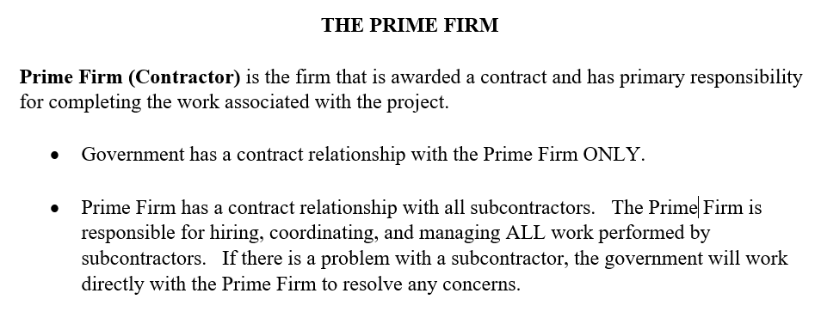
Bidding and Contracting with the Federal Government, cont.

Slide 18
Bidding and Contracting with the Federal Government, cont.

Slide 19
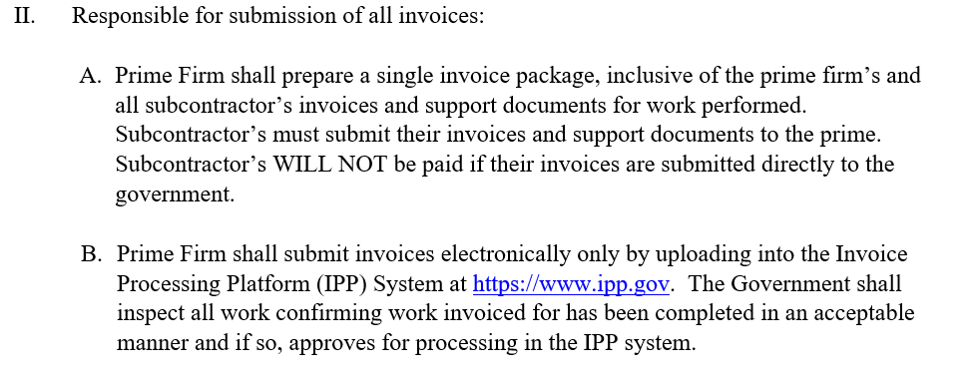
Bidding and Contracting with the Federal Government, cont.
PRIME FIRM RESPONSIBILITIES CONT’D

Slide 20
Bidding and Contracting with the Federal Government, cont.
PRIME FIRM RESPONSIBILITIES CONT’D

Slide 21
Bidding and Contracting with the Federal Government, cont.

Slide 22
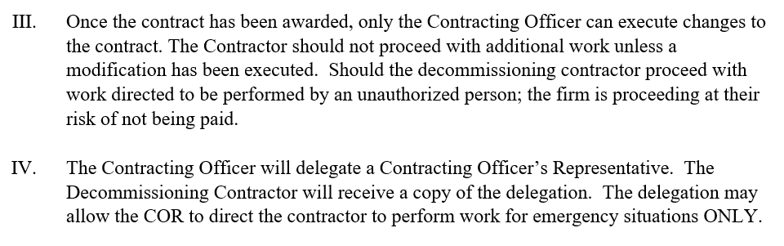
Bidding and Contracting with the Federal Government, cont.
PROCUREMENT INTEGRITY cont.

Slide 23


DOI’s Small Business Program
Department of the Interior
Office of Small and Disadvantaged Business Utilization

Slide 24
Small Business Participation as an Evaluation Factor
DOI has been utilizing Small Business Participation as an Evaluation Factor (SBPEF) on an optional basis since 2019
Key elements of SBPEF:
  Evaluates the extent of proposed participation/ commitment to use U.S. small businesses in the performance of this acquisition.
  Incentivize the diversification of large firm supply chains and the expansion of DOI’s small business vendor base.
  Strengthens small vendors through subcontracting.
Evaluate the proposal to determine which offeror proposes the best value in terms of Small Business Participation.
Offers submitted by a small businesses will also be evaluated and will receive the maximum score for the SBPEF.

Slide 25

Decommissioning Project
BSEE Small Business

Slide 26
Doing Business with BSEE
Small Business Program
  The Bureau of Safety and Environmental Enforcement (BSEE) Small Business Program was established to:
    Assist small, HUBZone small, small disadvantaged, women-owned small, veteran-owned small, and service-disabled veteran-owned small businesses (socioeconomic categories) by providing tools to help them maximize contract opportunities, compete successfully, to develop, and grow;
    Ensure large businesses are presenting maximum subcontracting opportunities for small businesses, when applicable.
Procurement Business Opportunities
  BSEE's Acquisition Office acquires the products and services required to support Agency mission goals. Open market opportunities are advertised on Government Opportunities (SAM.gov). Also, available at DOI.gov, is the Forecast of Contract Opportunities. Some of the products/services we purchase are:
    Engineering Services
    Oil Spill Technology Studies
    Information Technology
    Consulting Services
    Office Products

Slide 27
Q&A Opportunity
For more information, please email: bseeorphandecom2022@bsee.gov
RFP Solicitation No. 140E0122R0003
BSEE Website: www.bsee.gov
@BSEEgov
BSEEgov
Bureau of Safety and
Environmental Enforcement
BSEEgov
“To promote safety, protect the environment and conserve resources offshore through vigorous regulatory oversight and enforcement.”

