Slide 1
Critical Offshore Connector Safety Forum
National Materials and Manufacturing Board
National Academy of Engineering
Jim Lancaster, NMMB Director
August 29, 2016

Slide 2
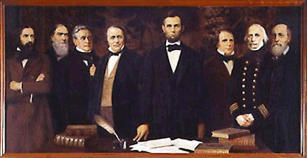
The National Academies of Sciences, Engineering, and Medicine are private, nonprofit institutions that provide expert advice on some of the most pressing challenges facing the nation and the world. Our work helps shape sound policies, inform public opinion, and advance the pursuit of science, engineering, and medicine.
President Lincoln signed a congressional charter forming the National Academy of Sciences in 1863 to "investigate, examine, experiment, and report upon any subject of science."
Notes:
Principal mission –
improve government decision making and public policy;
increase public education and understanding;
promote the acquisition and dissemination of knowledge in matters involving science, engineering, technology, and health.
Does not receive direct federal appropriations. Individual projects – funded by federal agencies, foundations, other governmental and private sources, and the institution’s endowment.

Slide 3

National Academy of Sciences
National Academy of Engineering
National Academy of Medicine
National Research Council
NAE Program Office
Division of Engineering and Physical Sciences
National Materials and Manufacturing Board
Notes:
7 program units in the NRC.

Slide 4
National Academy of Engineering Mission
The mission of the National Academy of Engineering is to advance the wellbeing of the nation by promoting a vibrant engineering profession and by marshalling the expertise and insights of eminent engineers to provide independent advice to the federal government on matters involving engineering and technology.
Notes:
As of end of 2015:
2206 Members
212 Foreign Members
Roughly half members from business sector
NAE Program —activities (studies, convening activities, resource websites) conducted either independently or in collaboration with other units of the National Academies of Sciences, Engineering and Medicine (~ $5 million/year)

Slide 5
Council of the National Academy of Engineering
Officers
Gordon R. England, Chair
C. D. (Dan) Mote, Jr., President
Corale L. Brierley, Vice President
Julia M. Phillips, Home Secretary
Ruth A. David, Foreign Secretary
Martin B. Sherwin, Treasurer
Marcia McNutt, NAS President (ex officio)
Councillors
John L. Anderson Arunava Majumdar
Wanda M. Austin Richard A. Meserve
Josephine Cheng H. Vincent Poor
David E. Daniel C. Paul Robinson
Anita K. Jones Alan I. Taub
Frances S. Ligler Richard H. Truly
Executive Officer– Alton Romig; Program Director - Proctor Reid
Notes:
18 Councillors + 1 ex officio member (NAS President)
Among other responsibilities the Council provides oversight to all NAE program activities.

Slide 6
National Materials and Manufacturing Board Mission
In recognition of the increasing importance of materials science to innovations in engineering and manufacturing, National Materials and Manufacturing Board (NMMB) is to provide independent assessments of the current state of materials and manufacturing research- including at the atomic, molecular, and nano scales - and the applications of new and existing materials in innovative ways, including pilot-scale and large-scale manufacturing, the design of new devices, and disposal.

Slide 7
NATIONAL MATERIALS AND MANUFACTURING BOARD (NMMB)
Celia Merzbacher, Chair Semiconductor Research Corporation
Jim Lancaster, Director
Erik Svedberg, Senior Program Officer
Rodney C. Adkins, NAE IBM Corporate Strategy - retired
Michael I. Baskes, NAE Bagley College of Engineering
Jim C.I. Chang NC State University
Leo Christodoulou Boeing, Inc.
Jack Hu, NAE University of Michigan
Sandra L. Hyland Consultant
Michael F. McGrath McGrath Analytics LLC
Robert Miller IBM Almaden Research Center
Edward Morris NCDMM, NAMII
Nicholas A. Peppas, NAE & NAM University of Texas, Austin
Tresa Pollock, NAE University of California, Santa Barbara
F. Stan Settles USC
Haydn Wadley University of Virginia
Ben Wang Georgia Institute of Technology
Steve Zinkle, NAE University of Tennessee, Knoxville

Slide 8
Summary of Academies Activities
Consensus Studies
Typically – 18-24 month ad hoc projects
Variations: fast track studies, letter reports
Convening Activities
Workshop, Meeting of Experts, Focus Sessions
Continuing Activities
Board or Standing Committee
Roundtable

Slide 9
Convening Activity - Workshops
Conference or symposium - invited individuals meet to discuss topics of mutual interest and to share their expertise.
Many possible purposes –provide input for consensus study, frame a future study.
Requires an approved planning committee.
Several product options – workshop report, workshop summary, workshop proceeding.

Slide 10
Consensus Study
Task developed in collaboration with study’s sponsor;
Carried out by volunteers with requisite expertise, lack of conflicts of interest;
Information gathered from many sources in public meetings; deliberations take place in private;
Committee works independently to come to consensus on questions raised;
All reports undergo independent external review by second group of experts; reviewer comments addressed by the committee prior to final report release.

Slide 11
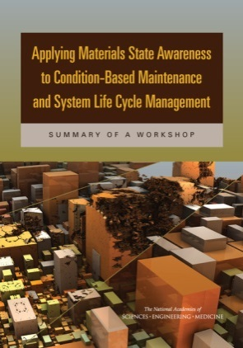
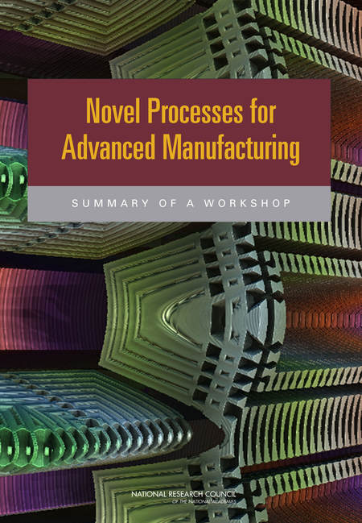
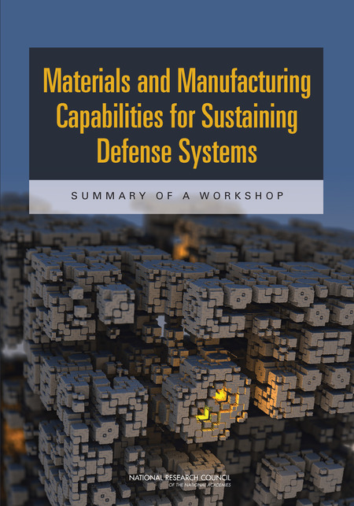
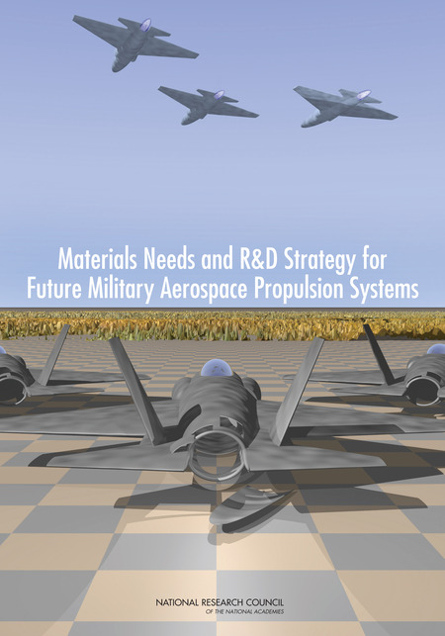
Recent NMMB Workshop Summaries
Applying Materials State Awareness to Condition-Based Maintenance and System Life Cycle Management (2016)
Novel Processes for Advanced Manufacturing (2013)
Materials and Manufacturing Capabilities for Sustaining Defense Systems (2013)
Materials Needs and R&D Strategy for Future Military Aerospace Propulsion Systems (2012)

Slide 12
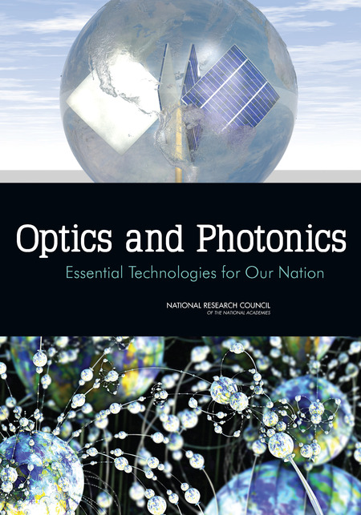
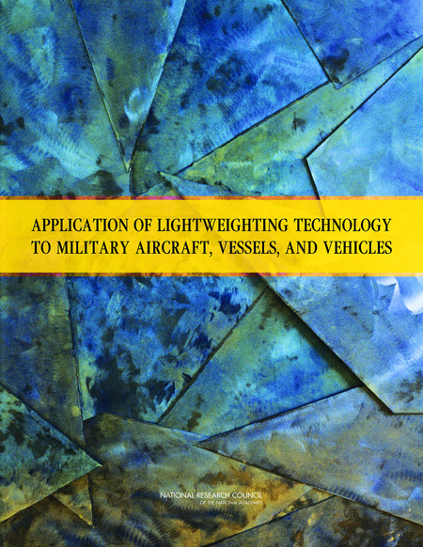

Recent NMMB Reports
Optics and Photonics: Essential Technologies for Our Nation (2012)
Application of Lightweighting Technology to Military Aircraft, Vessels, and Vehicles (2011)
Research Opportunities in Corrosion Science and Engineering (2009)

Slide 13
Thank you for your Attention
Jim Lancaster
JLancaster@nas.edu
202-334-1936

