Slide 1
Subsea Bolts Performance and Critical Drill-through Equipment Fastener Study
Haimei Zheng
Lawrence Berkeley National Laboratory

Slide 2
Outline
Background
LBNL bolt research goals
      Standard review and gap analysis
      Materials corrosion under subsea environment
Overview of current progress
Future work

Slide 3
Background
Over the past decade, a number of fastener/bolt failures on OCS associated with
    - LMRP
    - Subsea BOP components
It is needed for an independent assessment of critical drill through equipment fasteners in offshore oil and gas operations
    Identify fastener systems currently in use
  (offshore & onshore; domestic & global)
  Assess design, manufacture, installation, maintenance & inspection processes
  Evaluate the performance of current fastener systems
  Identify similarities & differences in industry standards & regulations globally

Slide 4

LBNL Project Research Goals
      Standard review and gap analysis
      Lab experiments:
        Bolting materials corrosion under subsea environment
Review industry codes & identify existing standards or regulations underlying failure mechanisms
Evaluate performance of existing fastener systems
manufacturing, corrosion protection, installation, maintenance, inspection
Identification of similarities & differences in industry standards & regulations
Evaluation of alternative fastener designs used by global industries
Recommendation -
  Methodology for the selection for material properties & other critical parameters
  Modification & improvement of existing industry standards
Notes:
LBNL is being proactive assisting BSEE with addressing the bolts concerns
Review the industry codes and identify any existing standards or regulations with underlying failure mechanisms for subsea bolt technology.
Make a recommendation on the methodology for the selection for material properties (e.g. hardness, YS, UTS) and other critical parameters in accordance with the subsea bolt application and operating environment.
Make a recommendation to BSEE on how existing industry standards should be modified to address findings from the industry code review.
Evaluate performance of existing fastener systems, including: manufacturing, corrosion protection, installation, maintenance and inspection processes.
Identification of similarities and differences in industry standards and regulations as related to fastener systems worldwide.
Evaluation of alternative fastener designs used by global industries.

Slide 5
Industry Standards Review
American Petroleum Institute - 17
American Society of Mechanical Engineers (ASME) - 1
American Society for Testing Materials (ASTM) - 47
Bolt Council – 2
British Standards Institution (BSi) - 10
Desalinization Industry – 1
DNV-GL – 11
Dept. of Energy-Sandia – 1
Federal Standards – 3
Industrial Fasteners Institute – 4
Int’l Organization for Standardization (ISO) – 31
Japanese Industrial Standard (JIS) – 1
Military Standards – 10
Nat’l Association of Corrosion Engineers (NACE) – 21
NASA – 1
Navy Standards – 8
NORSOK – 1
Nuclear Regulatory Commission – 7
Society of Automotive Engineers (SAE) – 4
United States Coast Guard (USCG) – 2
Biomedical Industry Standards:
Dental Industry Standards – 3
Bone and Joint Substitute Standards - 10
…. ....
Total over 200 items ...
International Regulators’ Forum (IRF) member country regulations on bolts (a specific requirement or a referenced standard)
http://www.irfoffshoresafety.com/

Slide 6
Industry Standards & Gap Analysis
Critical Attributes for Subsea Bolts
Material Specifications
    Hardness
    Yield Strength (YS)
    Ultimate Tensile Strength (UTS)
    Elongation
  Procurement
    Heat treatment
    Coatings (thicknesses)
    Shear stress
    Fatigue Life
    Threading
Corrosion Treatment
    Cathodic Protection (CP)
Installation
Quality Analysis/Control
In Service Inspection (ISI)
Human Factors

Slide 7

Industry Standards & Gap Analysis
Conventional way of reading & making notes is not going to work …

Slide 8

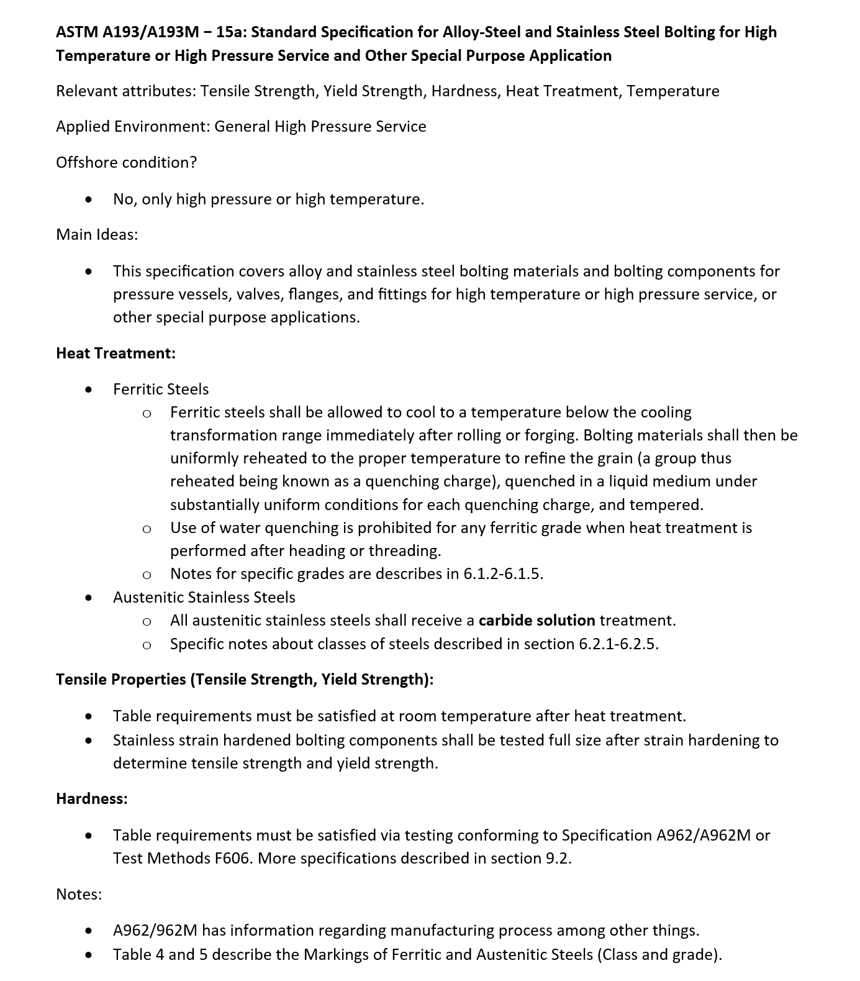
A Data Base
Gap Analysis Methodology
An efficient and robust method of cataloguing industry standards
Microsoft Access RDS and SQL programming queries
Library of Industry Standards
Need to Identify
  Relevant Attributes
  Applied Environment
  Main Ideas (Abstract)
  Review of Relevant Attributes (Specific)
  Notes
Used as a resource for Gap Analysis
Example – ASTM A193/A193M – 15a
Notes:
An efficient and robust method of cataloguing industry standards is necessary in order to quickly reference and substantiate any claims made in the gap analysis report.
Using Microsoft Access RDS and SQL programming queries, we are able to modularize each industry standard’s data relevant to subsea bolting to quickly compare and contrast.

Slide 9
Industry Standards & Gap Analysis
Hydrogen Embrittlement – Hardness Threshold
Discrepancies in hardness threshold to avoid hydrogen embrittlement (examples).
    NACE MR0175/ISO 15156 has the most strict regulations. Specific to sour service environments. The maximum allowed hardness is 22 HRC.
    vs. Industrial Fasteners Institute – “Susceptible fastener products have specified hardness above 39 HRC”
    vs. NORSOK – “In marine/subsea applications, acceptable hardness range is 32-39 HRC.”
    vs. API 17A – “Resistance against hydrogen embrittlement should be controlled by specifying that the actual hardness of the material is less than 300 HV10 [31 HRC]…”
    vs. API 17A – “Section 6.4: Bolting materials for subsea applications includes ASTM A320 L7, ASTM A320 L43, ASTM A193 B7, and ASTM A193 B8M Class 1”; none match MR0175/ISO 15156

Slide 10
Industry Standards & Gap Analysis
Hydrogen Embrittlement – Hardness Threshold
Discrepancies in hardness threshold to avoid hydrogen embrittlement (cont.)
    API 17A: Recommended Practice for Design and Operation of Subsea Production Systems (2002).
    “For stainless steels and non-ferrous materials, resistance against hydrogen embrittlement should be controlled by specifying that the actual hardness of the material is less than 300 HV10 [31 HRC] for the base material…
    API 16F: Specification for Marine Drilling Riser Equipment (2010)
    Maximum hardness for primary load-carrying components shall not exceed 35 HRC without approval from the purchaser.
    …..

Slide 11
Industry Standards & Gap Analysis
Corrosion Protection – Heat Treatment
Discrepancies in heat treatment for corrosion protection.
NACE MR0175/ISO 15156: All parent materials must undergo heat treatment.
ISO 21457: Hydrogen embrittlement may occur on fasteners caused by hydrogen introduced from chemical cleaning related to coating operations, e.g. electrolytic plating and HDG. Baking in accordance with ISO 9588 should be performed for chemical cleaned fasteners with an actual tensile strength greater than 1 000 MPa or hardness greater than 31 HRC.
ASTM F1941/F1941M (ED Coating on Mechanical Fasteners) – 15:
6.4.1 Baking is not mandatory for fasteners with specified maximum hardness 39 HRC and below.

Slide 12
Industry Standards & Gap Analysis
Corrosion Protection – Heat Treatment
Discrepancies in heat treatment for corrosion protection (cont.)
ASTM B633 Service Condition 4 (very severe) – “Exposure to harsh conditions, or subject to frequent exposure to moisture, cleaners, and saline solutions, plus likely damage by denting, scratching, or abrasive wear. Examples are: plumbing, pole line hardware.”
      ASTM B633 – 15 (ED Coating of Zn on Fe/Steel): Pre/post treatment for the purpose of reducing risk of HE – all parts having an UTS > 31 HRC …shall be heated for stress relief.
      Many do not include subsea conditions

Slide 13
Industry Standards & Gap Analysis
Bolting Materials for Sour Service
There is only one internationally recognized standard for materials to be used in sour service environments:
    NACE MR0175/ISO 15156 – petroleum and natural gas industries; Materials for use in H₂S-containing environments in oil and gas production
        Defines sour water as containing at least 0.05 psi of H₂S
        Section A.2.2.4: Bolt materials must be either sulfide corrosion resistant materials or ASTM A193 B7M and ASTM A320 L7M overlayed with below materials.
        Nitriding to a max depth of 0.15mm is acceptable if conducted at a temperature lower than critical temperature
Austenitic stainless steels | Martensitic stainless steels | Duplex stainless steels | Precipitation-hardened stainless steels | Cobalt-based alloys | Titanium alloys
S31600, S31603, S20910, J93254, N08926, J95370, N04400, N04405, N10276 | S41000, S41500, S42000, J91150, J91151, J91540, S42400, S41425 | S31803 | N07031, N07048, N07626, N07716, N07725, N07773, N07924, N09777, N09925, N09935, N09945, S66286 | R30003, R30004, R30035, BS HR.3, R30605, R31233 | R50400, R56260, R53400, R56323, R56403, R56404, R58640, R05200

Slide 14
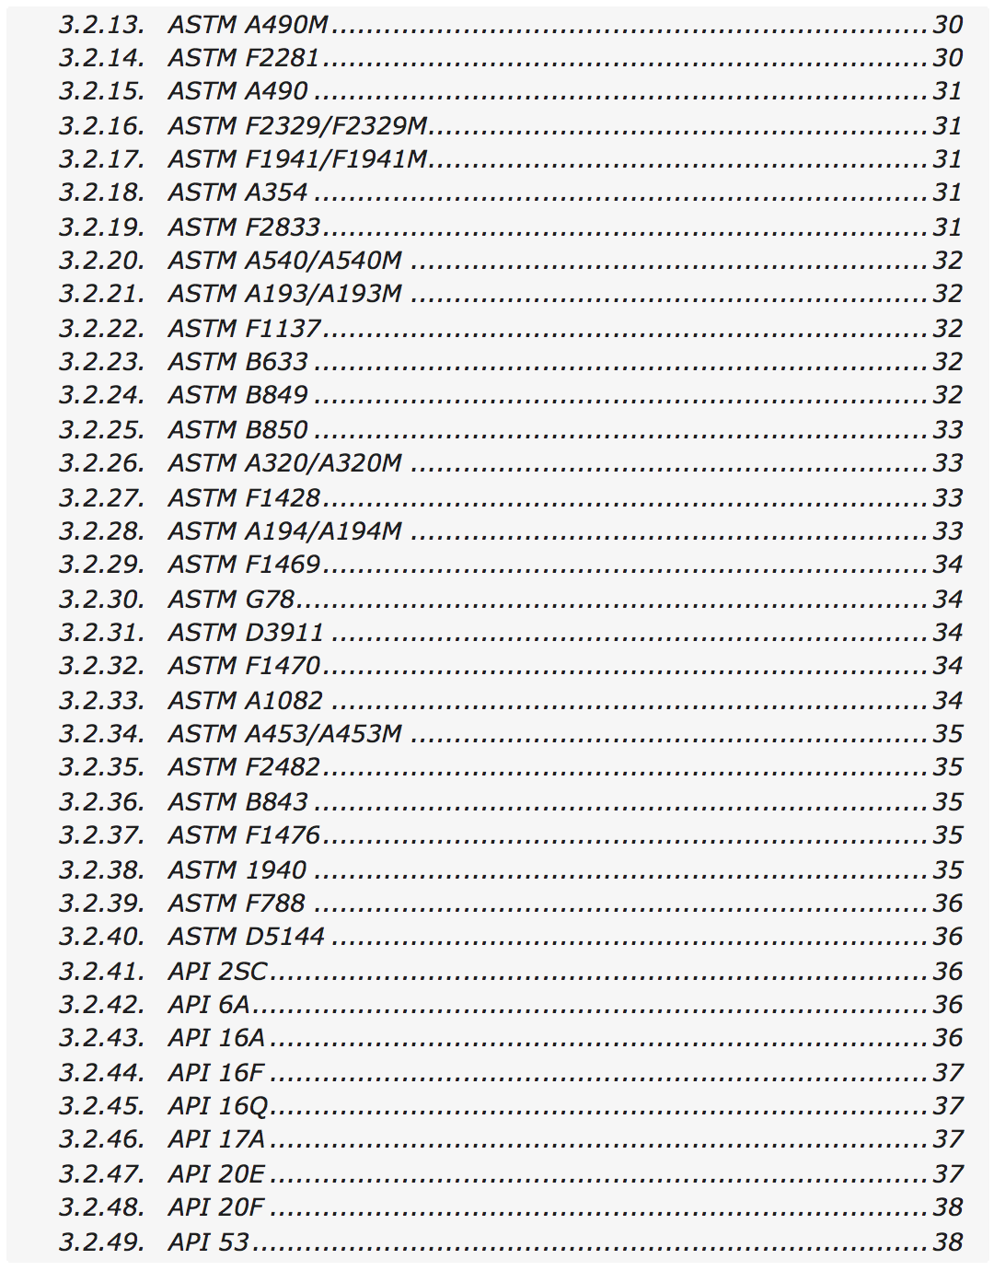
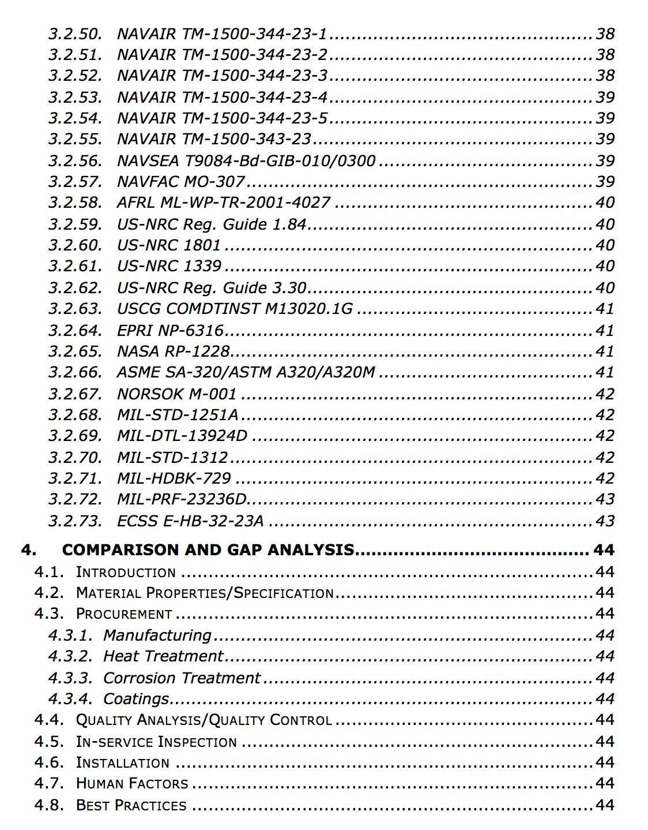
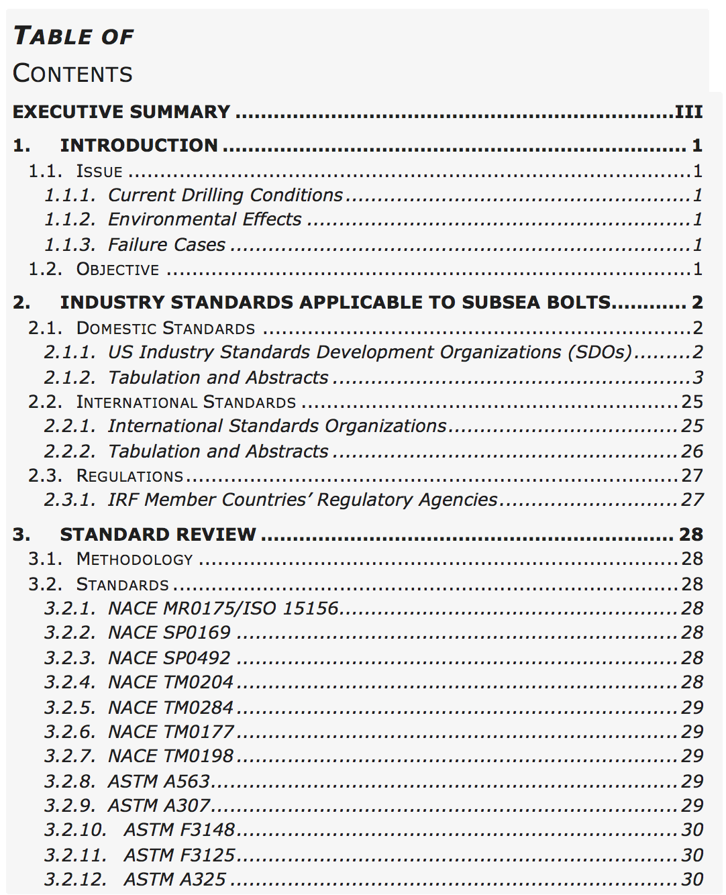
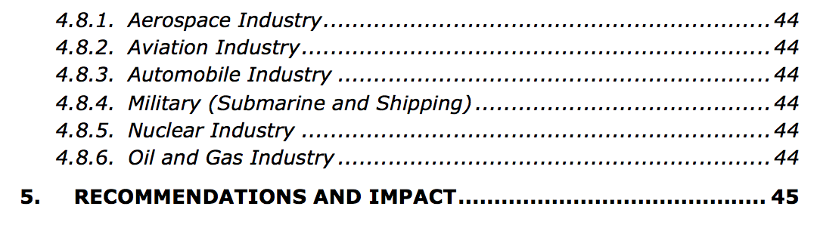
Industry Standards Gap Analysis:
Report TOC

Slide 15
Corrosion Tests
Subsea environment:
◼ High pressure
◼ Media with CO₂, Cl⁻, or H₂S
◼ Other – T, O₂, etc.
Total pressure dependence measurements
Oxygen partial pressure dependence measurements
Temperature dependence measurements

Slide 16
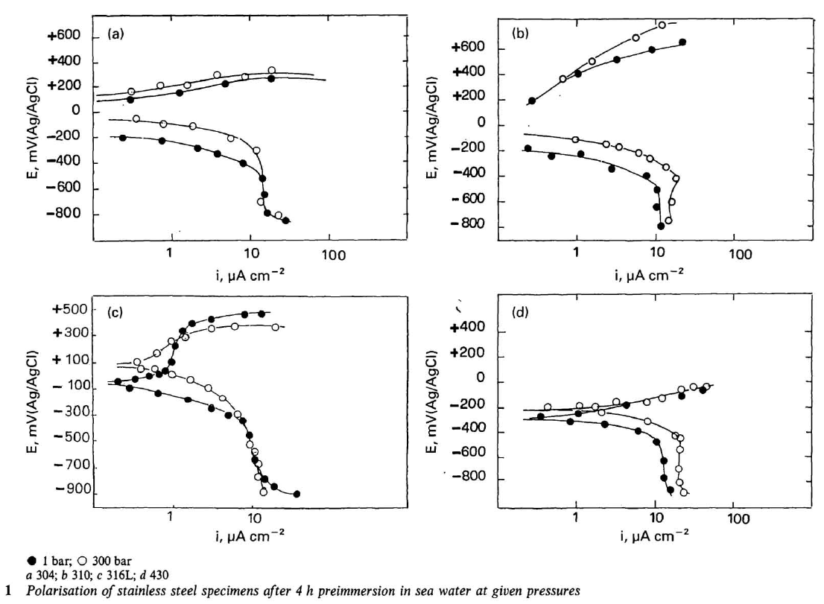
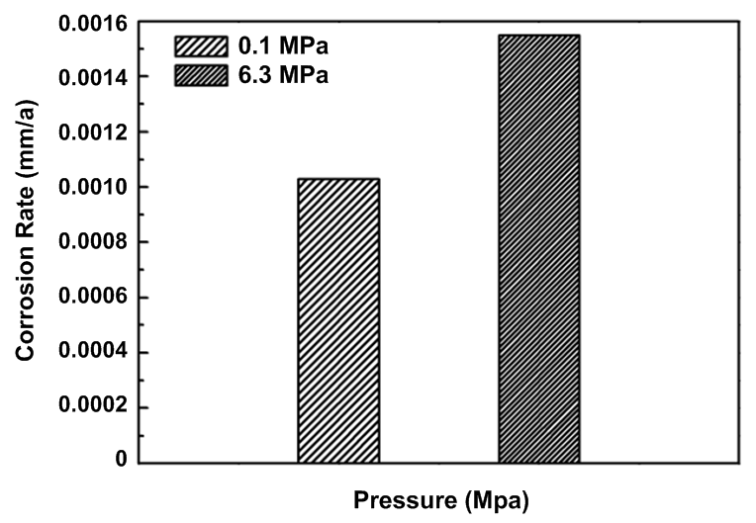
Influence of Total Pressure
With increasing pressure, 316L and 430 stainless steels exhibit moderately larger corrosion current (higher corrosion rate); pressure shows no distinct effect on 304 and 310 SS.
Pressure corrosion rate
304 SS
310 SS
316L SS
430 SS
Corrosion rate of X60 pipeline steel under different pressures.
X. Fang, et al., Corrosion Science and Protection Technology, 25 (2014) 431-435.
A. M. Beccaria, et al., British Corrosion Journal, 30 (2013) 283-287

Slide 17
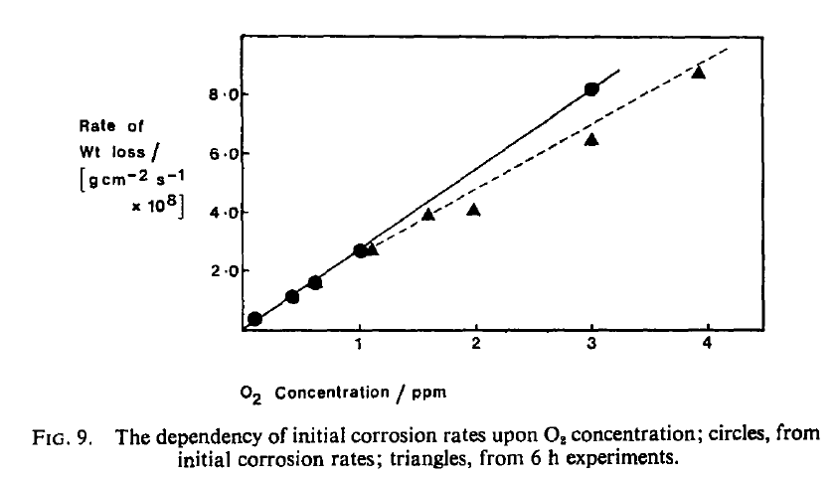
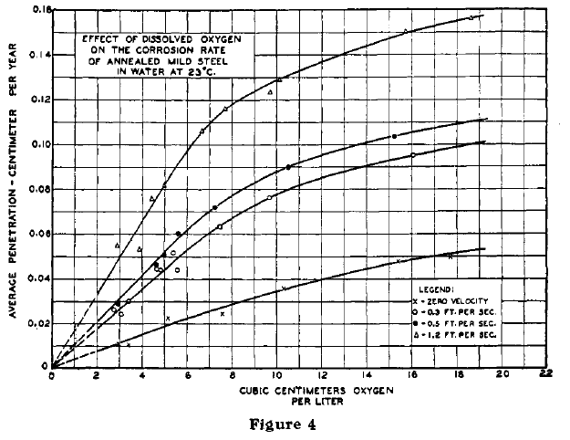
Influence of Oxygen Concentration
Cast Iron
Low Carbon Steel
G. L. Cox, et al., Industrial & Engineering Chemistry, 23 (1931) 1012-1016
D. C. Smith, et al., Corrosion Science, 19 (1979) 379-394
The corrosion rate increases with the increasing oxygen concentration.

Slide 18
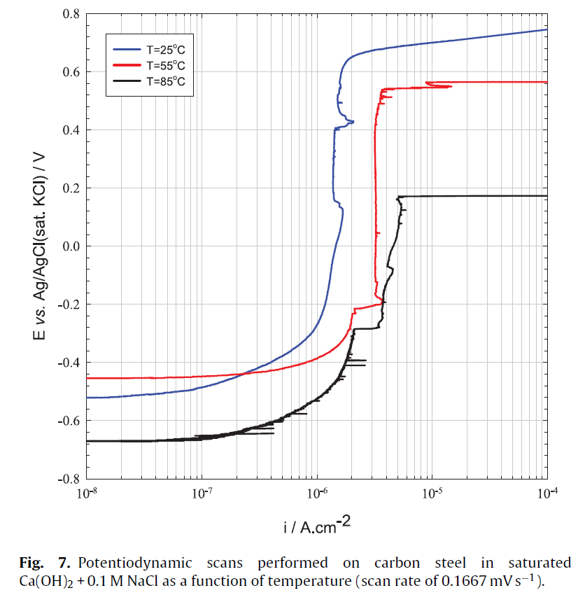
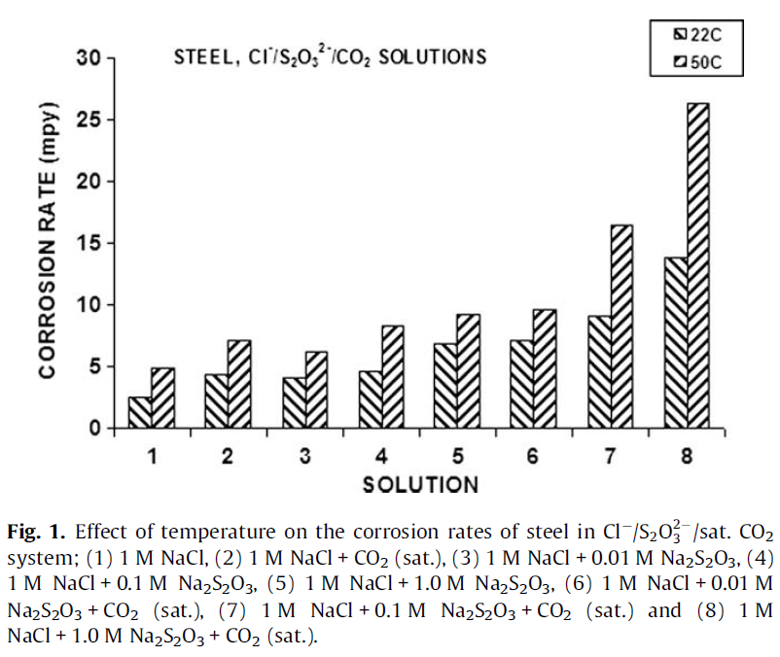
Influence of Temperature
With increasing temperature, the pitting potential and passive current density increased.
Pitting potential
Carbon Steel
S. Sharifi-Asl et al., Corrosion Science, 98 (2015) 708-715
H.M. Ezuber et al., Materials and Design, 30 (2009) 3420–3427

Slide 19
Corrosion Study Timeline
Timeline | Months
Task | 09/2016 | 10/2016 | 11/2016 | 12/2016 | 01/2017 | 02/2017 | 03/2017 | 04/2017
Sample production (US Bolts)
Experiment preparation and set up
Ambient total pressure test (4 ºC) *
5000 psi total pressure test (4 ºC)
Oxygen partial pressure ≤ 0.4ppb (25 ºC) *
Oxygen partial pressure ~ 21% (25 ºC)
Mechanical test & SEM, XRD analysis
Summary and Report
* Temperature dependence results will be obtained from the data based on these tests.

Slide 20
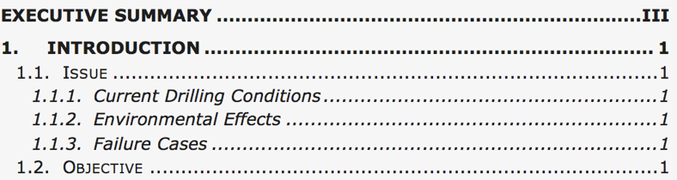
Subsea Bolts Performance and Critical Drill-through Equipment Fastener Study
Part I
Industrial Standard Review and Gap Analysis
--- ---
Part II.
Materials corrosion under subsea environment
6. --- ---

Slide 21

Acknowledgements
    Roy A. Lindley (ANL)
    Joseph Lee (LBNL/UCB)
    Xiaowei Lei (LBNL/UCB)
    Kaiyang Niu (LBNL/UCB)
    … ...

