Slide 1
BSEE Update – SEMS & Performance
Jason P. Mathews
RFO - Office of Safety Management
7 June 2018
“To promote safety, protect the environment and conserve resources offshore through vigorous regulatory oversight and enforcement.”

Slide 2
BSEE Safety Alert 336
Properly identify risk(s) for the hazard workers exposed to and that special attention is given to mitigate those risk using hierarchy of controls
  PPE
  Adminstrative Controls
  Engineering Controls
  Substitution
  Elimination
Offshore personnel always wear appropriate hand protection
Review alert with offshore crews

Slide 3
SEMS Data – Actionable Findings
Notes:
41% of audits conducted found issue with - Do the facility’s written operating procedures include instructions that are consistent with the safety and environmental information and address the following
(a) initial startup? Y__N__N/A__
(b) normal operations? Y__N__N/A__
(c) all emergency operations (including, but not limited to, medical evacuations, weather-related evacuations and emergency shutdown operations)? Y__N__N/A__
(d) normal shutdown? Y__N__N/A__
(e) startup following a turnaround, or after an emergency shutdown? Y__N__N/A__
(f) temporary operations? Y__N__N/A__
(g) simultaneous operations? Y__N__N/A__
(h) bypassing and flagging out-of-service equipment? Y__N__N/A__
(i) operating limits, and safety and environmental consequences of deviating from equipment operating limits and steps required for correcting or avoiding this deviation? Y__N__N/A__
(j) properties of, and hazards presented by, the chemicals used in the operations? Y__N__N/A__
39% of audits conducted found issue with - Do the written management of change (MOC) procedures address the following issues, as applicable:
(a) the technical (process and mechanical design) basis for proposed changes? Y__N__N/A__
(b) impact of a change on safety, health, and the coastal and marine environments, including as appropriate a hazards analysis? Y__N__N/A__
(c) the effects of proposed changes on separate but unrelated upstream or downstream facilities and on area wide emergency plans? Y__N__N/A__
(d) necessary time period to implement changes? Y__N__N/A__
(e) management approval procedures for changes? Y__N__N/A__
(f) necessary revisions of the operating procedures, safe work practices, and training program? Y__N__N/A__
(g) communication of a proposed change and the consequences of that change to appropriate personnel? Y__N__N/A__
(h) the necessary revisions of the safety and environmental information? Y__N__N/A__
(i) the duration of the change, if temporary? Y__N__N/A_
37% of audits conducted found issue with - Does the SEMS program require that the commissioning process include a pre-startup safety and environmental review for new and significantly modified facilities to confirm that the following criteria are met:
(a) construction and equipment are in accordance with applicable specifications? Y__N__N/A__
(b) safety, environmental, operating, maintenance, and emergency procedures are in place and are adequate? Y__N__N/A__
(c) safety and environmental information is current? Y__N__N/A__
(d) hazards analysis recommendations have been implemented as appropriate? Y__N__N/A__
(e) training of operating personnel has been completed? Y__N__N/A__
(f) programs to address management of change and other elements of this publication are in place? Y__N__N/A__
(g) safe work practices are in place? Y__N__N/A__

Slide 4
SEMS Data – Actionable Findings
Notes:
As described in the first sentence of the SEMS regulation (30 CFR 250.1900), there are three basic expectations for SEMS.
When we talk about “develop” we refer to the written design of a SEMS element and whether it covers all of the risk areas in which it needs to be applied.
When we talk about “implement” we refer to whether an element is being applied as designed and is being applied everywhere and every time it is intended to be applied.
When we talk about “maintain” we refer to the action of determining whether the element as designed and as implemented is effective; also, when an element is not as effective as intended, are steps being taken to improve its design or its implementation.
Overall, slightly more than 40% of all deficiencies reflected a need to improve the design of an element, slightly fewer than 40% reflected implementation inconsistencies, and approximately 20% noted lapses in finding and fixing design and implementation inconsistencies.

Slide 5
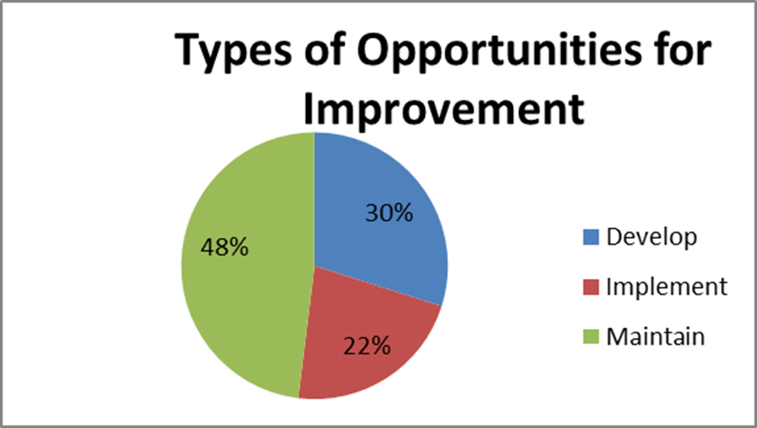
What have prior audits shown us?
We often have questions about OFI’s
  Does it reflect a condition that truly doesn’t matter if it is “fixed?”
BSEE has at times required OFIs be included in a CAP
In future, BSEE will explore with operators whether and
how they considered OFIs, as part of our developing
CAP Verification Process

Slide 6
SEMS – Moving Forward
CAP Verification
Element Evaluations
Subpart O Audits

Slide 7
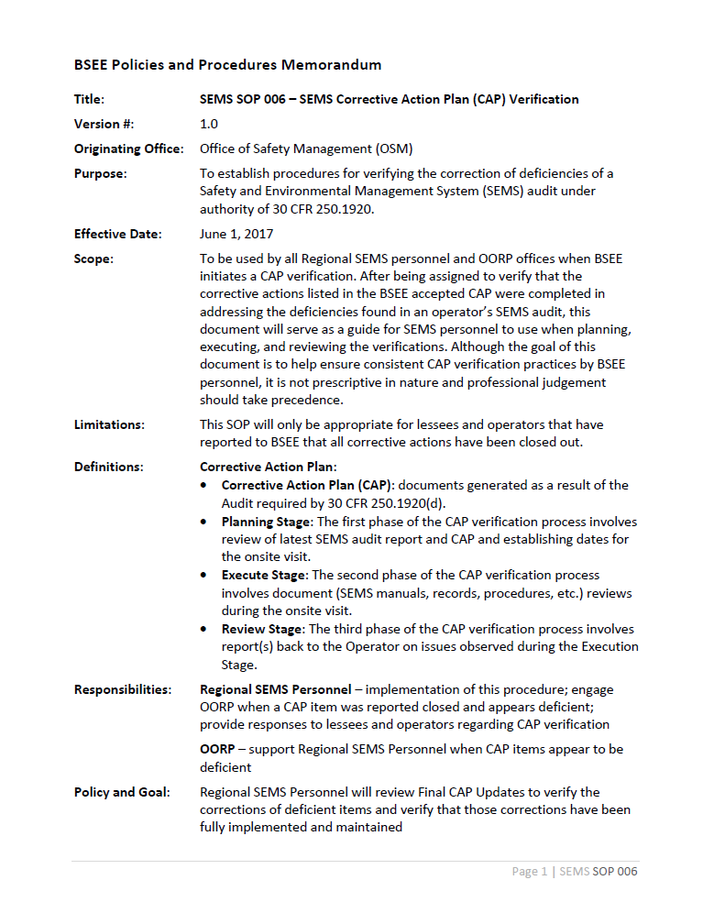
SEMS – CAP Verification
Reported to BSEE all actions closed
Office and onshore verification
All findings
Verifying the correction of deficiencies of a SEMS audit
S-105

Slide 8
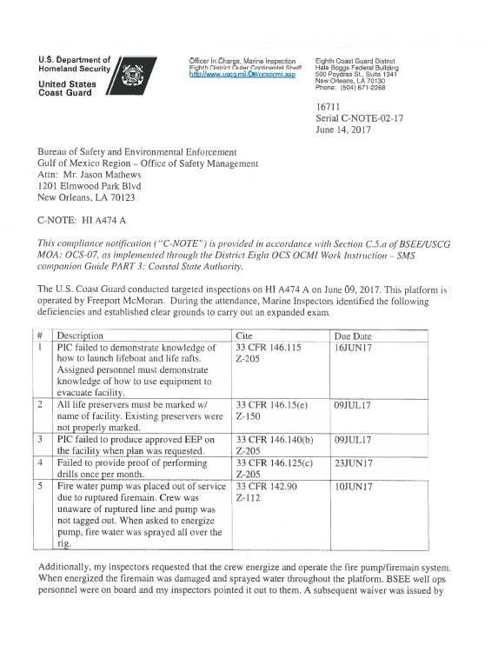
SEMS – Element Evaluations
Incident driven findings
USCG C-Notes
Poor Inspections – beyond IOL
New Operator
Focused vs. Comprehensive

Slide 9
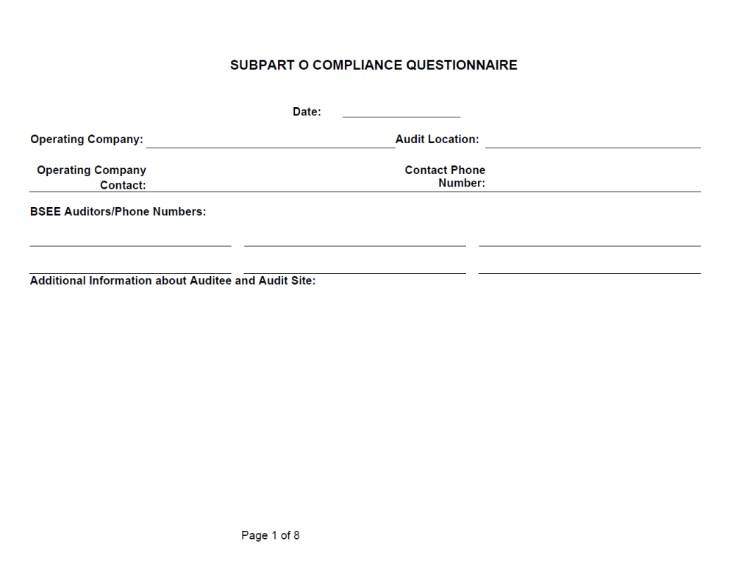
SEMS – Subpart O Audits
10-15 a year by OSM Staff
Well Control and Production Safety
Contractor Evaluations
Personnel Assessments
Compliance with own plan

Slide 10
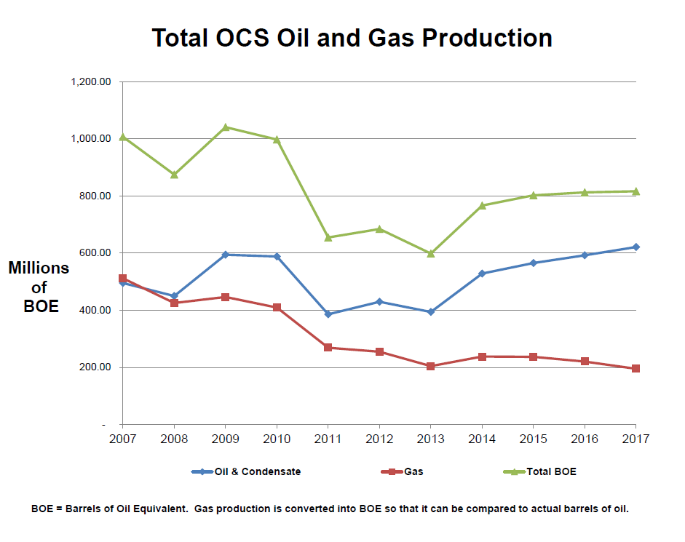
Notes:
Number of active companies and total work hours continue to decline while total production continues to increase

Slide 11
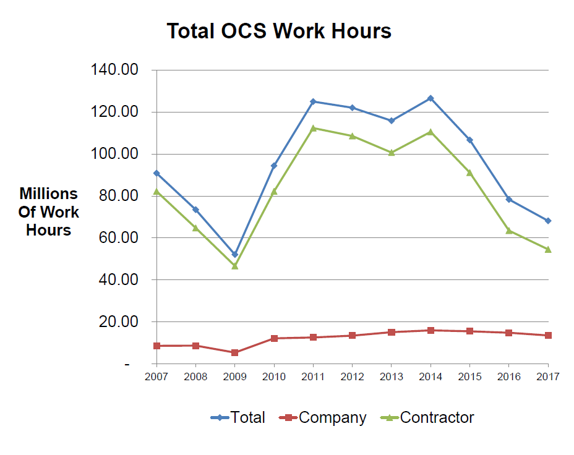
Notes:
The number of contractor work hours in production, drilling and construction continues to decline, while company work hours are more stable (slide 8)

Slide 12
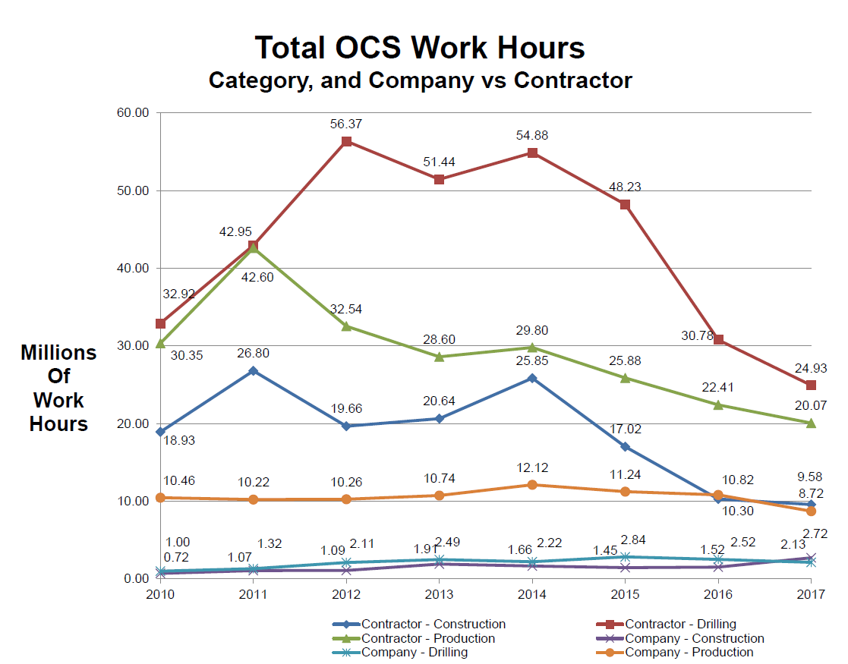
Notes:
Hours: 80% contract (70% Production / 90% Drilling)
Overall Recordable: 81% contract
Overall DART: 79% Contract

Slide 13
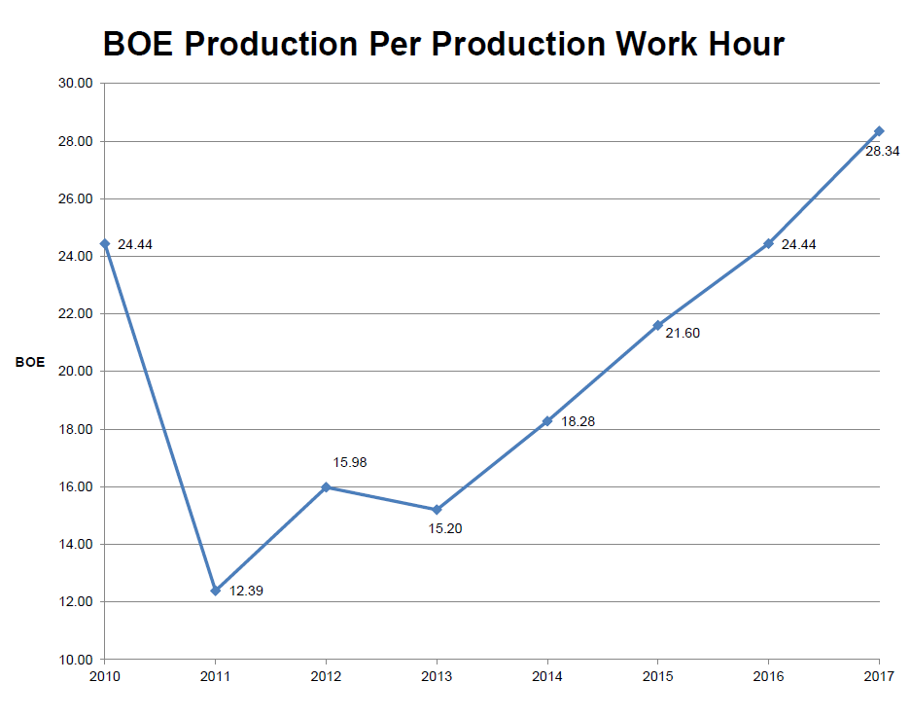
Notes:
A slight increase in production volume per year (slide 6) and the continuing reduction in contractor work-hours (slides 7-8) leads to a continuing trend of more BOE produced per work-hour (slide 9)

Slide 14
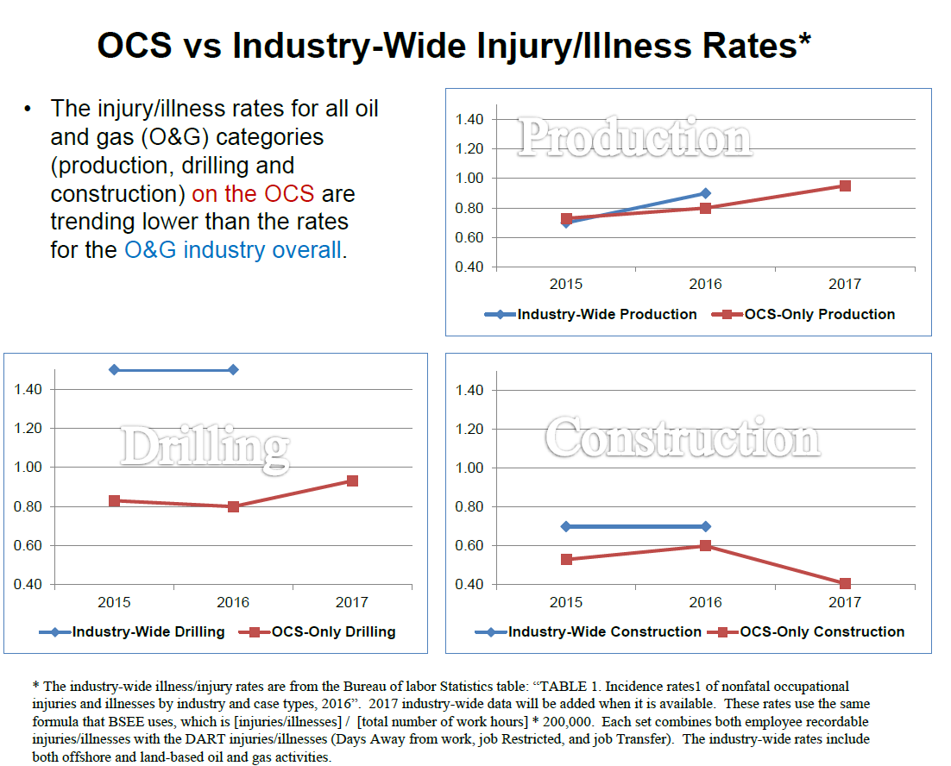
Notes:
Safety statistics are still tracking near their multi-year averages on the OCS The Injury/Illness rate for drilling on the OCS appears to track significantly lower than the injury/illness industry-wide (slide 5)
The injury/illness rate for production activities on the OCS appears similar to the rate recorded industry-wide (slide 5)
There are slight increases in both the Injury/Illness rate and Lost Workday / DART Case incident rate since 2015 for the production and drilling categories (slide 5 and slides 12-14)

Slide 15
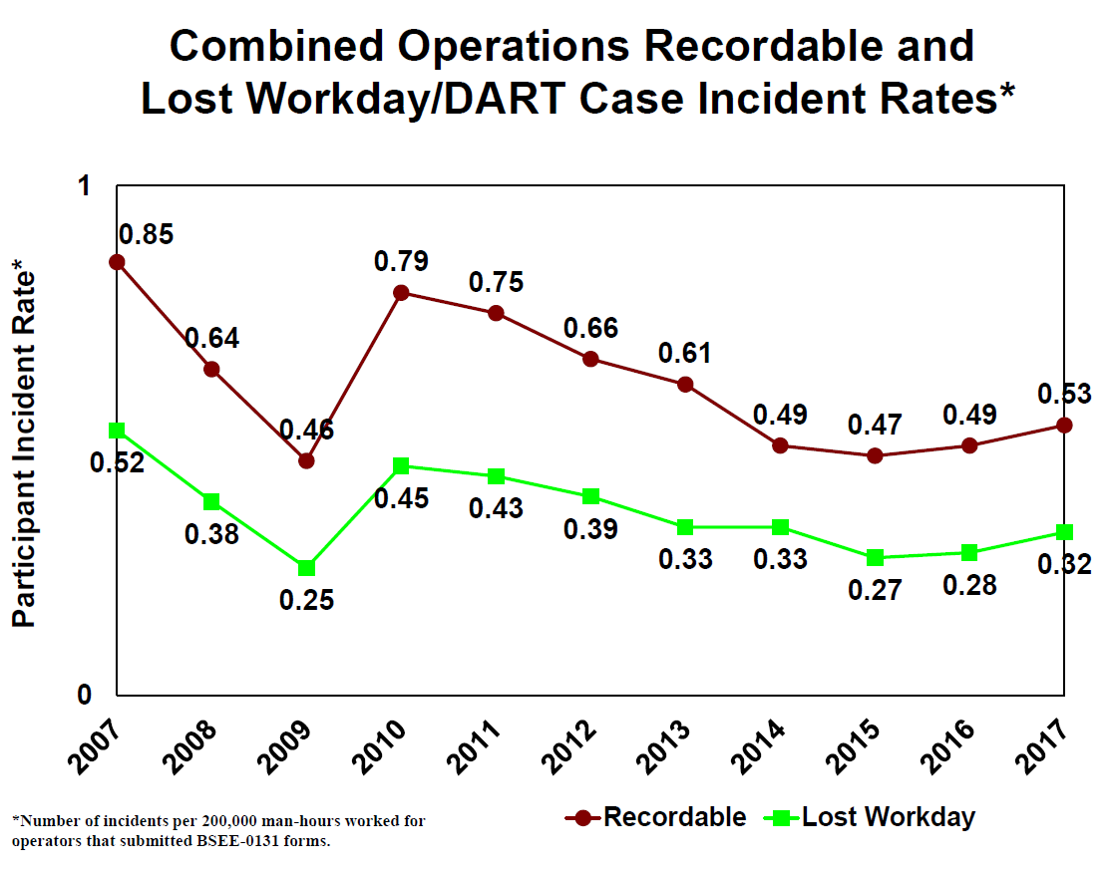
Notes:
There are slight increases in both the Injury/Illness rate and Lost Workday / DART Case incident rate since 2015 for the production and drilling categories (slide 5 and slides 12-14)

Slide 16
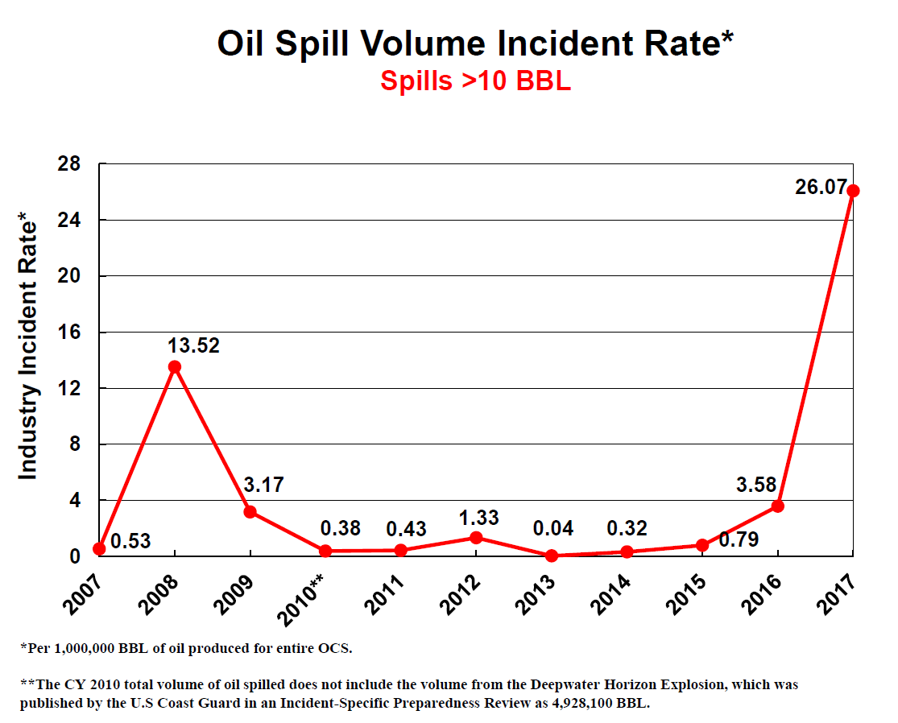
Notes:
Oil Spill Volumes have increased The large volume (> 10 BBL) oil spill incident rate continues to increase in 2017, primarily due to two large volume spills (38 BBL and 16,152 BBL) (slide 23)
The largest spills since 2015 came from compromised subsea infrastructure (2,100 BBL in 2016 and 16,152 BBL in 2017)
While the number of spills >10 bbl stayed flat (2 spills in 2016 and 2 in 2017), the following shows the volume of those two spills in 2017. This was sent to me by Mike Tolbert in the Oil Sill Preparedness Division. Regarding the rate calculation: (16,190 / 621,119,521)*1,000,000 = 26.07.

Slide 17
API RP 75 – Table from Committee
Item | Start Date | End Date | Comment
1st Draft Complete | Dec 12, 2017 | - | Complete
Context & HP | Dec 18, 2017 | Jan 26, 2018 | Added and finalized context sections Reviewed the added HP language
Harmonization | Feb 16, 2018 | Apr 23, 2018 | Clean up document, strategic review to daylight significant issues
Comment only Review | Apr 29, 2018 | Jun 29, 2018 | NOT a ballot; for detailed organizational review and comment
Comment Response | Jul 2, 2018 | TBD | Schedule to be adjusted based on # and substance of comments received
Balloting | TBD | TBD | Will be adjusted depending on number and substance of comments received; may require 2nd ballot
Publication Goal – End of 2018

Slide 18



BSEE Website: www.bsee.gov
@BSEEgov
BSEEgov
Bureau of Safety and
Environmental Enforcement
BSEEgov
https://www.facebook.com/BSEEgov/
“To promote safety, protect the environment and conserve resources offshore through vigorous regulatory oversight and enforcement.”

