Slide 1
Royalty Relief Workshop
End-of-Life & “Special Case”
January 31, 2020
Hyatt Regency Hotel
Houston, Texas
“To promote safety, protect the environment and conserve resources offshore through vigorous regulatory oversight and enforcement.”
1

Slide 2
Agenda
9:00 Registration
9:30 Introduction
Scott Angelle
10:00 End-of-Life Royalty Relief
Rebecca Rich & Lauren Woitha
12:00 Lunch Break (on your own)
1:30 “Special Case” Royalty Relief
Andrew Cambus & Daniel Dauterive
4:00 Wrap up

Slide 3

Royalty Relief
New leases, automatic royalty relief = BOEM
Need-based, discretionary royalty relief = BSEE
  End of Life
  “Special Case”
New BSEE policies
  Announced Nov 2019
    Houma & Lafayette
    Director memo
  Discount rate
    Up to 25% for shallow water GOM
    10-15% elsewhere
  Exploration
    Promote development
  Project scope

Slide 4
Few Historical Applications
GOM SCRR Applications
Fiscal Year | Received | Approved | Denied | Withdrawn | Pending
2004 | 2 | 2 | 0 | 0 | 0
2006 | 1 | 1 | 0 | 0 | 0
2007 | 2 | 2 | 0 | 0 | 0
2008 | 2 | 1 | 1 | 0 | 0
2009 | 1 | 1 | 0 | 0 | 0
2018 | 2 | 1 | 0 | 0 | 1
2019 | 3 | 1 | 0 | 1 | 1
TOTAL | 13 | 9 | 1 | 1 | 2

Slide 5

Royalty Relief
End of Life Royalty Relief
  Prescriptive by regulation
  Lease or unit
Special Case Royalty Relief
  Relief necessary to become economic (no more, no less)
  Lease or project
BSEE Role
  Protect interests of American public
  Perform independent analyses
Workshop length depends on questions

Slide 6
Discretionary Royalty Relief Workshop:
End-of-Life Royalty Relief
January 31, 2020
Hyatt Regency Hotel
Houston, Texas
Rebecca Rich – Petroleum Engineer
Lauren Woitha – Petroleum Engineer
GOMR Production & Development
Development Unit
“To promote safety, protect the environment and conserve resources offshore through vigorous regulatory oversight and enforcement.”

Slide 7
Agenda
Purpose & Authority
Regulations
Process
Example Case
Helpful Tips
Q&A
This presentation involves regulations (30 CFR Part 203.50 through 203.56 and 203.81 through 203.84) which establish the terms and conditions for granting reductions in royalty rates to end of life leases under the Outer Continental Shelf (OCS) Lands Act.

Slide 8
Introduction to End-of-Life Royalty Relief
Royalty Relief program:
  Extends the life of the lease or unit
  Demonstrate need through use of historical data
  Upon evaluation, BSEE may reduce the royalty rate by one half
  Suspension of relief due to commodity pricing and production volumes

Slide 9
Purpose & Authority
You have a lease with earnings that cannot sustain production.
And you would abandon otherwise potentially recoverable resources but seek to increase production by operating beyond the point at which the lease is economic under the existing royalty rate.
Under 43 U.S.C. 1337(a)(3)(A), BSEE may reduce or eliminate any royalty or a net profit share specified for an OCS lease to promote increased production.
BSEE may modify the royalty rate where sound engineering and economic principles indicate that this change will extend the productive life of your lease.
30 CFR 203.1 and 2

Slide 10
Agenda
Authority & Purpose
Regulations
Process
Example Case
Helpful Tips
Q&A

Slide 11
End-Of-Life Royalty Relief
Regulations & NTL
30 CFR 203.50-56 and 203.81-84
NTL No. 2010-N03 Appendix II

Slide 12
Regulations for End-of-Life Royalty Relief
§203.50 - Who may apply for end-of-life royalty relief?
§203.51 - How do I apply for end-of-life royalty relief?
§203.52 - What criteria must I meet to get relief?
§203.53 - What relief will BSEE grant?
§203.54 - How does my relief arrangement for an oil and gas lease operate if prices rise sharply?
§203.55 - Under what conditions can my end-of-life royalty relief arrangement for an oil and gas lease be ended?
§203.56 - Does relief transfer when a lease is assigned?
§203.81 - What supplemental reports do royalty-relief applications require?
§203.82 - What is BSEE's authority to collect this information?
§203.83 - What is in an administrative information report?
§203.84 - What is in a net revenue and relief justification report?

Slide 13
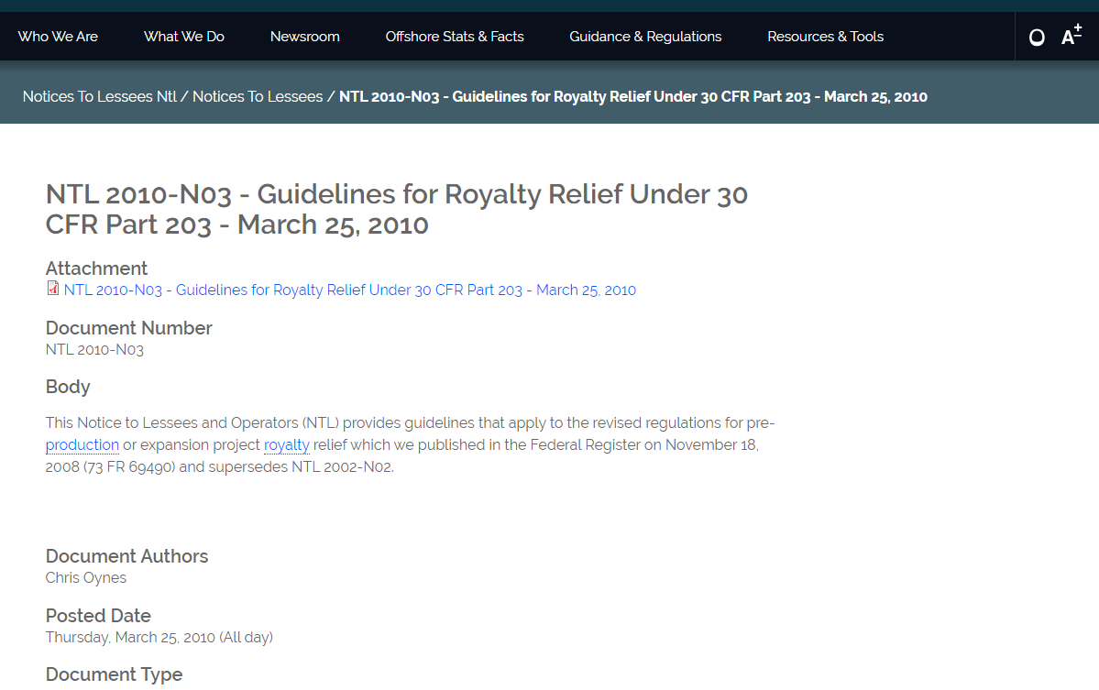
Appendix II in NTL No. 2010-N03 found on www.bsee.gov

Slide 14
Agenda
Purpose & Authority
Regulations
Process
Example Case
Helpful Tips
Q&A

Slide 15
End-of-Life Process
Qualification
Submit Application
Administrative Information Report
BSEE Evaluation
Check for $≥$ 0.75
Check for ≥ 0.75
Compare to records
EOL Relief Granted
½ Royalty Rate
Production & Price Thresholds
Qualifying Period ≥ 100 BOEPD
Consistent Operating Conditions
Net Revenue & Relief Justification Report
Becoming Uneconomic
Pay.gov Receipt
CPA Certification

Slide 16
End-Of-Life Process
Qualification

Slide 17
Qualification
Your End-of-Life (EOL) lease has an average production of at least 100 barrels of oil equivalent (BOE) per day in at least 12 of the last 15 months.
The most recent 12 months are the qualifying months/period.
Based on 2019 production, 378 shallow water leases meet the production criteria.
    Production: Sum of dispositions for oil and gas reported by you on ONRR-4054 form (OGOR-B report).
30 CFR 203.50/Appendix II to NTL No. 2010-N03

Slide 18
Qualification Example
Application Submitted by 12/29/2018
The 15-month qualifying period may end 120 days prior to submittal of the application
15 Months
Month | June 2017 | July 2017 | Aug 2017 | Sept 2017 | Oct 2017 | Nov 2017 | Dec 2017 | Jan 2018 | Feb 2018 | Mar 2018 | Apr 2018 | May 2018 | June 2018 | July 2018 | Aug 2018 | Sept 2018 | Oct 2018 | Nov 2018 | Dec 2018
BOEPD | 300 | 275 | 315 | 265 | 100 | 225 | 245 | 215 | 250 | 0 | 275 | 300 | 85 | 200 | 215
1
2
3
4
5
6
7
8
9
10
11
12
30 CFR 203.50/Appendix II to NTL No. 2010-N03

Slide 19
Qualification
Lease becoming uneconomic
  You must demonstrate that the sum of royalty payments (ROY) over the 12 qualifying months exceeds 75 percent of the sum of net revenues (NR).
The qualifying period you choose should represent the basic operations you intend to use until resources are depleted.
  If you change your operation significantly during the qualifying months, or if you do so while we are processing your application, we may defer action on your application until you revise it to show the new circumstances.
30 CFR 203.50/Appendix II to NTL No. 2010-N03

Slide 20
End-of-Life Process
Qualification
Submit Application
Administrative Information Report
BSEE Evaluation
Check for $≥$ 0.75
Check for ≥ 0.75
Compare to records
EOL Relief Granted
½ Royalty Rate
Production & Price Thresholds
Qualifying Period ≥ 100 BOEPD
Consistent Operating Conditions
Net Revenue & Relief Justification Report
Becoming Uneconomic
Pay.gov Receipt
CPA Certification

Slide 21
End-Of-Life Process
Application

Slide 22

Application Requirements
Required Fee
Administrative Information Report
Net Revenue & Relief Justification Report
CPA Certification
30 CFR 203.51 and 203.81/Appendix II to NTL No. 2010-N03

Slide 23
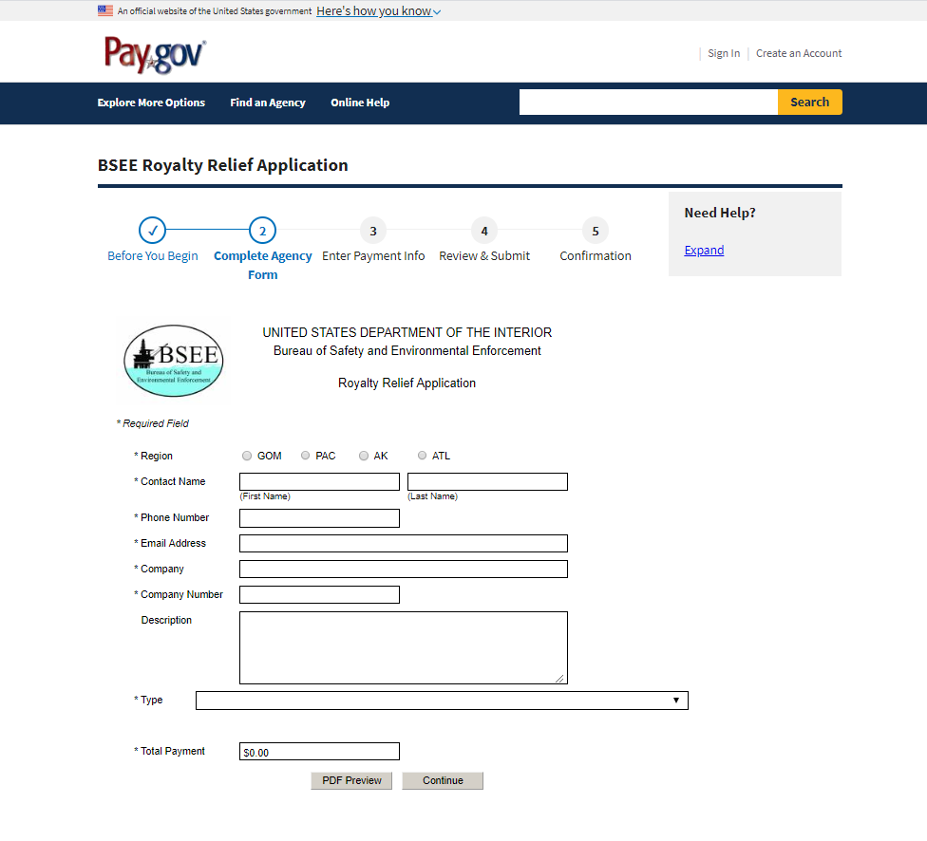
  1) Required Fee
Type of Request/Audit | Request Fee
End-of-life relief for marginal leases | $8,000
File all payments electronically through the Fees for Services page on the BSEE Web site at http://www.bsee.gov.
Include a copy of the Pay.gov confirmation receipt page with your application or assessment.
NTL No. 2009-N08

Slide 24
2) Administrative Information Report
Lease name
Serial number of leases we have assigned to the field, names of the lease title holders of record, the lease operators, and whether any lease is part of a unit
Well number, API number, location, and status of each well that has been drilled on the lease
Location of any new wells proposed under the terms of the application
Description of lease history
Type of royalty relief requesting
30 CFR 203.83/Appendix II to NTL No. 2010-N03

Slide 25
3) Net Revenue and Relief Justification Report
Cash flow data for your 12 qualifying months using the format specified by BSEE.
The cash flow table you submit must include historical data for:
    Lease production subject to royalty
    Total revenues
    Royalty payments
    Total allowable costs
30 CFR 203.84/Appendix II to NTL No. 2010-N03

Slide 26
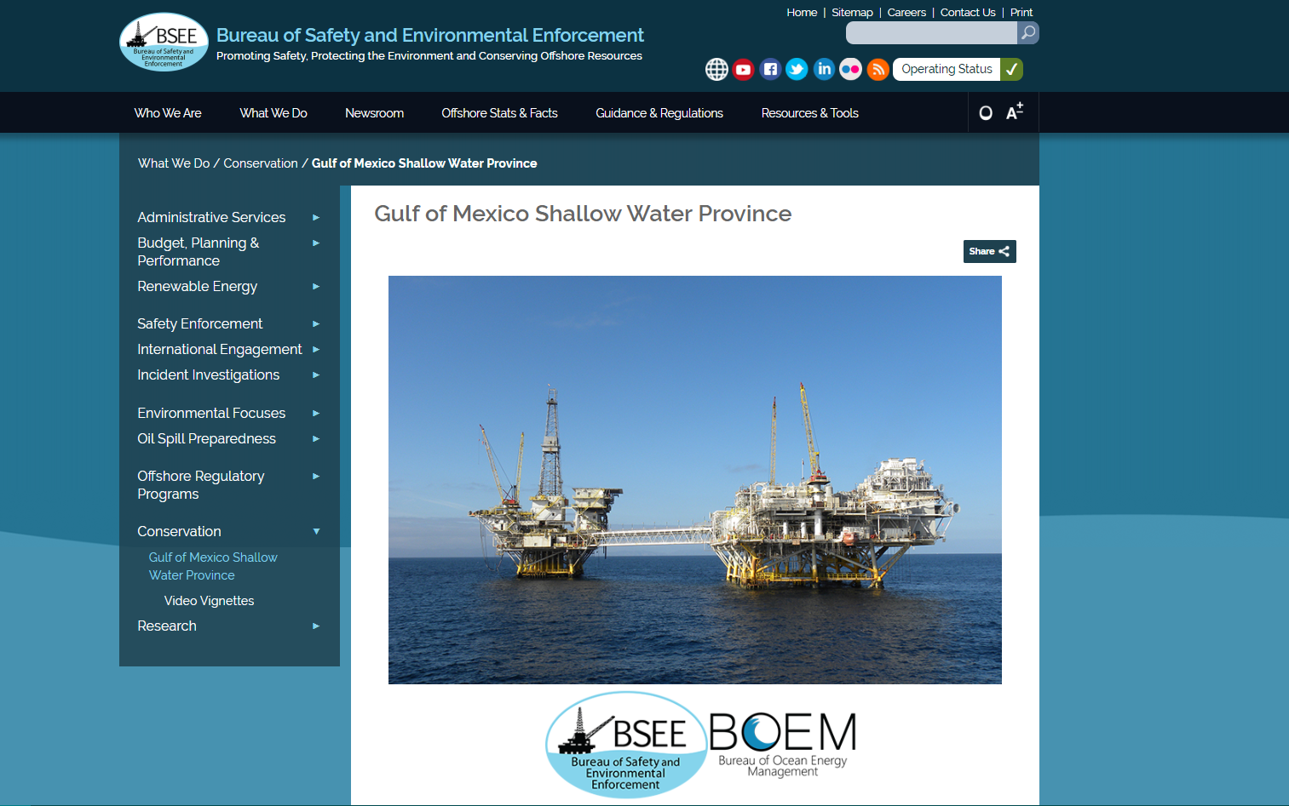
Where’s the Spreadsheet?

Slide 27

Where’s the Spreadsheet?

Slide 28
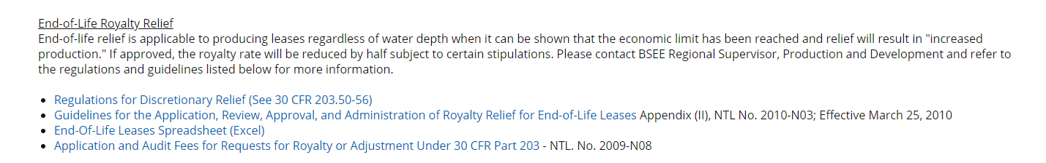
Where’s the Spreadsheet?

Slide 29
Allowable Costs Tab
Allowable Costs (AC): A variable representing the sum of your expenses during the qualifying months that are necessary for the continued operation of your lease.

Slide 30
What Allowable Costs to Include?
Only costs or portions of costs that you can validate as necessary for the proper conduct of your lease operations.
  Generally allowed:
    Expenses for operating and maintaining the existing wells and facilities.
    Costs for replacement or side track wells completed in the same producing reservoir.
Do not submit costs for any obligation you incurred before the qualifying period.
We may disallow certain costs.
30 CFR 203.84/Appendix II to NTL No. 2010-N03

Slide 31
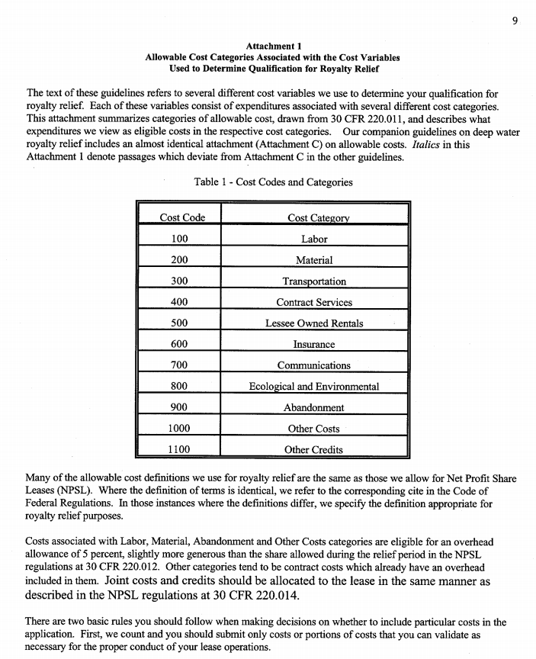
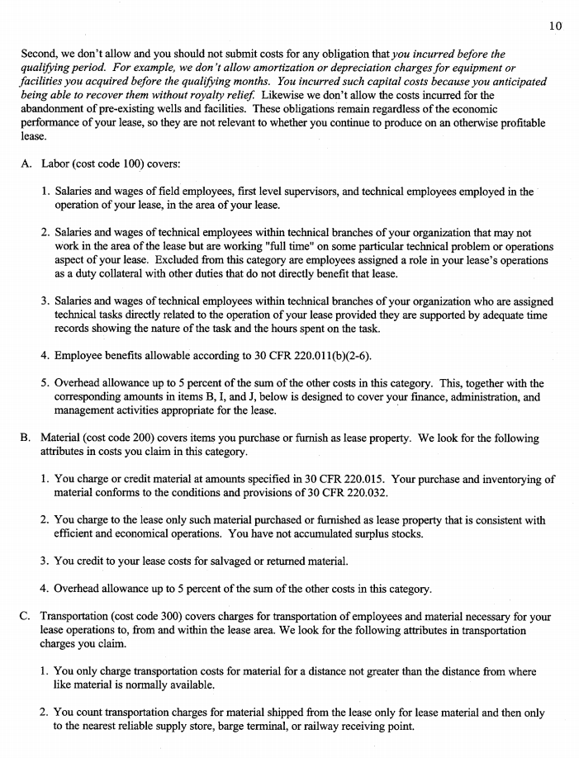
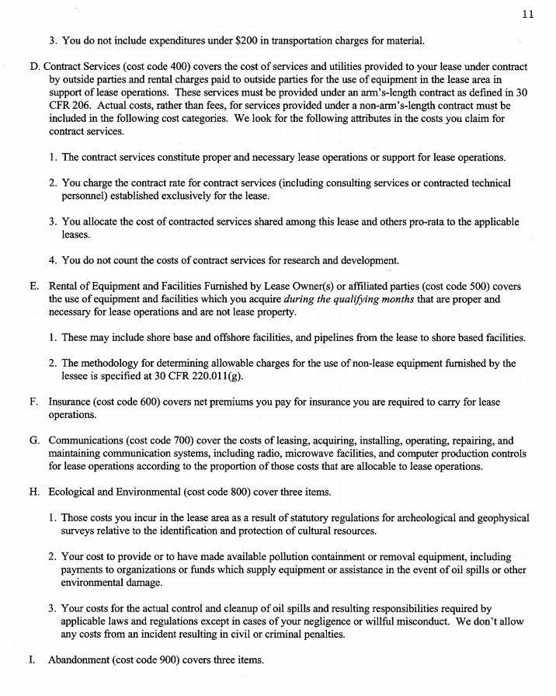
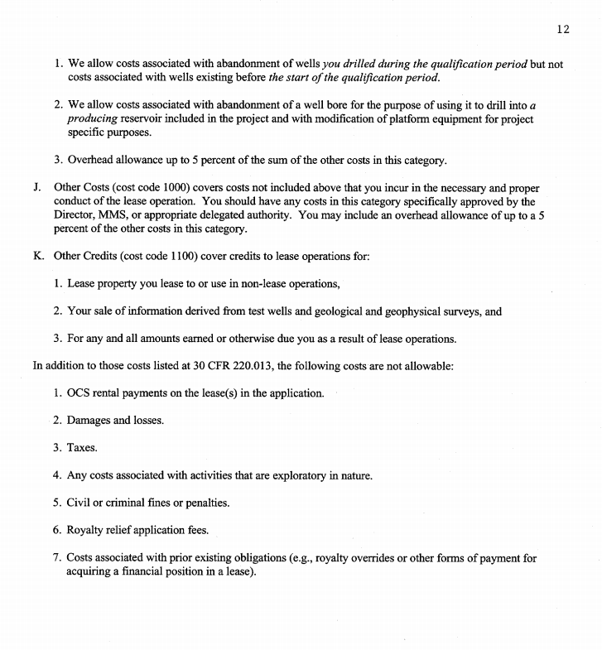
Allowable Cost Breakdown
Attachment 1 in NTL No. 2010-N03 summarizes costs we consider allowable for end-of-life royalty relief applications.
Appendix II to NTL No. 2010-N03

Slide 32
AC - Allocation & Joint Costs
You are expected to inform BSEE how you actually allocate production & costs for your internal accounting purposes.
  In some cases, the actual method you use internally may not be an appropriate allocation method for purposes of royalty relief applications.
  However, you are expected to use a method that’s proper and consistent.
  For example, we’ve seen cases where there’s a certain fixed cost to tie back each well regardless of production, plus an additional cost per barrel or MCF for each well.

Slide 33


Revenues Tab
Gross Value of Products (GVP): Gross proceeds all lease owners receive under arm’s-length contracts for sale of production in marketable condition.
Transportation and Processing Costs (TPC): A variable representing the sum of your reasonable, actual costs for transporting and processing associated with the oil and gas from your lease.
Royalties (ROY): Net royalty that you have paid under the existing royalty arrangement after deducting transportation and processing allowances (TPA) that you are permitted.

Slide 34

Results Tab
Net Revenue (NR):
Royalty Share (RS):

Slide 35
  4) Acceptable CPA Certification
An independent CPA needs to:
  Assess the accuracy of the historical financial information in your report
  Certify that the content and presentation of the financial data and information meet our most recent guidelines on royalty relief.
You must identify the CPA firm who prepared the reports and make them available to us for questions.
30 CFR 203.81

Slide 36
End-of-Life Process
Qualification
Submit Application
Administrative Information Report
BSEE Evaluation
Check for $≥$ 0.75
Check for ≥ 0.75
Compare to records
EOL Relief Granted
½ Royalty Rate
Production & Price Thresholds
Qualifying Period ≥ 100 BOEPD
Consistent Operating Conditions
Net Revenue & Relief Justification Report
Becoming Uneconomic
Pay.gov Receipt
CPA Certification

Slide 37
End-Of-Life Process
BSEE Evaluation

Slide 38
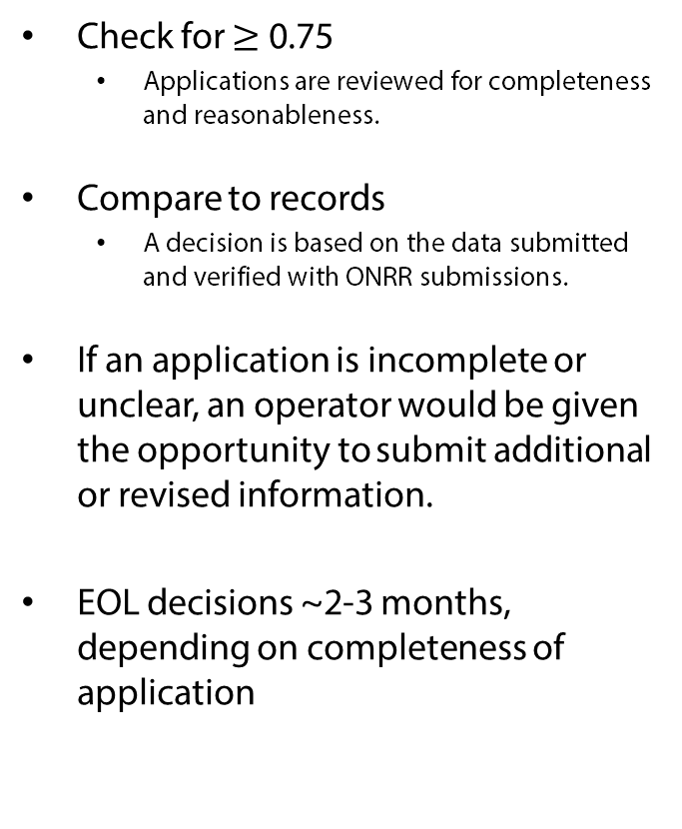
BSEE Evaluation
Check for $≥$ 0.75
  Applications are reviewed for completeness and reasonableness.
Compare to records
  A decision is based on the data submitted and verified with ONRR submissions.
If an application is incomplete or unclear, an operator would be given the opportunity to submit additional or revised information.
EOL decisions ~2-3 months, depending on completeness of application

Slide 39
End-of-Life Process
Qualification
Submit Application
Administrative Information Report
BSEE Evaluation
Check for $≥$ 0.75
Check for ≥ 0.75
Compare to records
EOL Relief Granted
½ Royalty Rate
Production & Price Thresholds
Qualifying Period ≥ 100 BOEPD
Consistent Operating Conditions
Net Revenue & Relief Justification Report
Becoming Uneconomic
Pay.gov Receipt
CPA Certification

Slide 40
End-Of-Life Process
Post-Decisional

Slide 41
Royalty Relief Rate
Upon approval, we will reduce the royalty rate to a fixed royalty relief rate.
  Royalty relief rate = ½ of the lease’s effective royalty rate.
    Effective royalty rate: the average royalty rate applied to the gross production volume during the 12 qualifying months.
30 CFR 203.53/Appendix II to NTL No. 2010-N03

Slide 42
Royalty Relief Volume
The royalty relief rate will apply up to the royalty relief volume.
  Royalty relief volume: monthly average number of barrels of oil equivalent (BOE) produced over the 12 months in the qualification period.
30 CFR 203.53/Appendix II to NTL No. 2010-N03

Slide 43



Suspension of Relief
You owe royalties at the effective royalty rate on all production during any month in which the rolling weighted average oil and natural gas prices increase by more than 25 percent.
Should an operator produce more than the royalty relief volume in a single month, additional royalties are due on an increasing scale.
Base reference price, suspension threshold price, and royalty relief volume will be stated in decision letter.
30 CFR 203.54/Appendix II to NTL No. 2010-N03

Slide 44
Termination of Relief
Operator may renounce via written notification
Relief ends when the average royalty rate equals the effective royalty rate for 12 consecutive months.
  Prices more than 25%
  Production more than double the qualifying months’ averages
Conditions of approval
Royalty relief will NOT terminate when a lease is assigned (transfers upon lease assignment).
30 CFR 203.55 & 56/Appendix II to NTL No. 2010-N03

Slide 45
End-Of-Life Process
Questions?

Slide 46
Agenda
Purpose & Authority
Regulations
Process
Example Case
Helpful Tips
Q&A

Slide 47
End-Of-Life Example
Net Revenue and Relief Justification Report
Walk Through

Slide 48
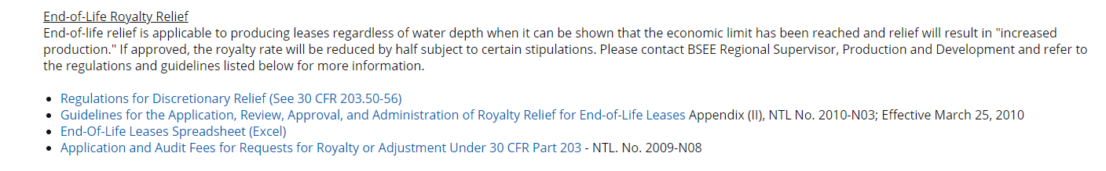
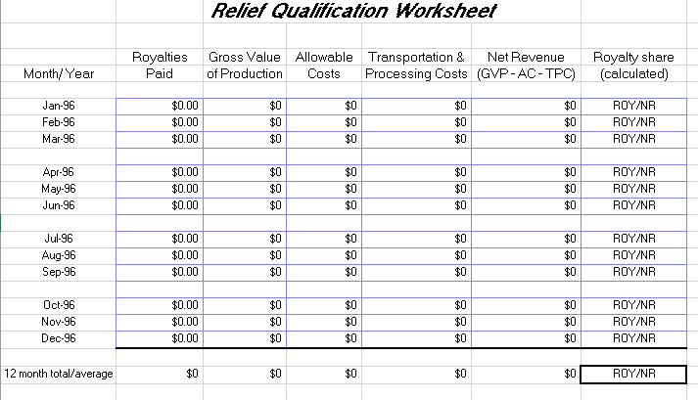
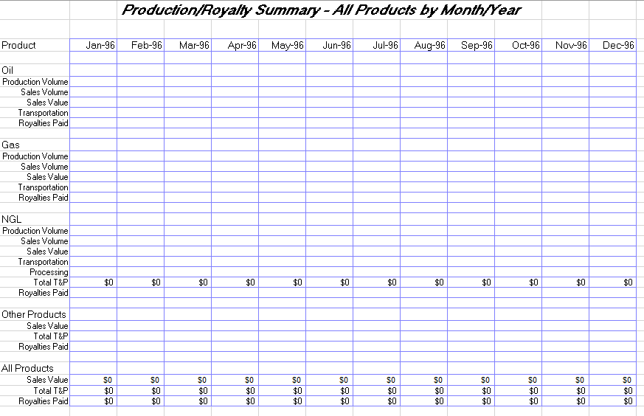
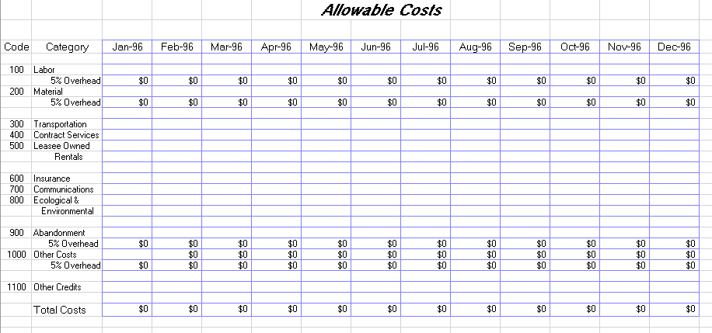
End-of-Life Royalty Relief Spreadsheets

Slide 49
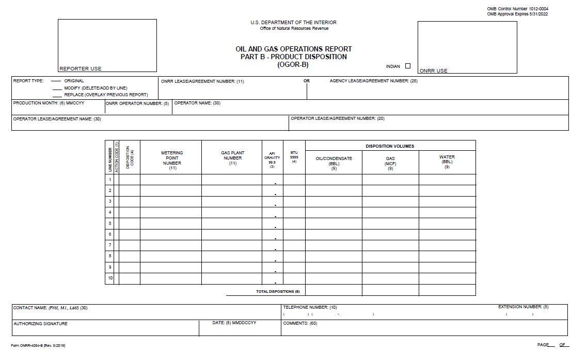
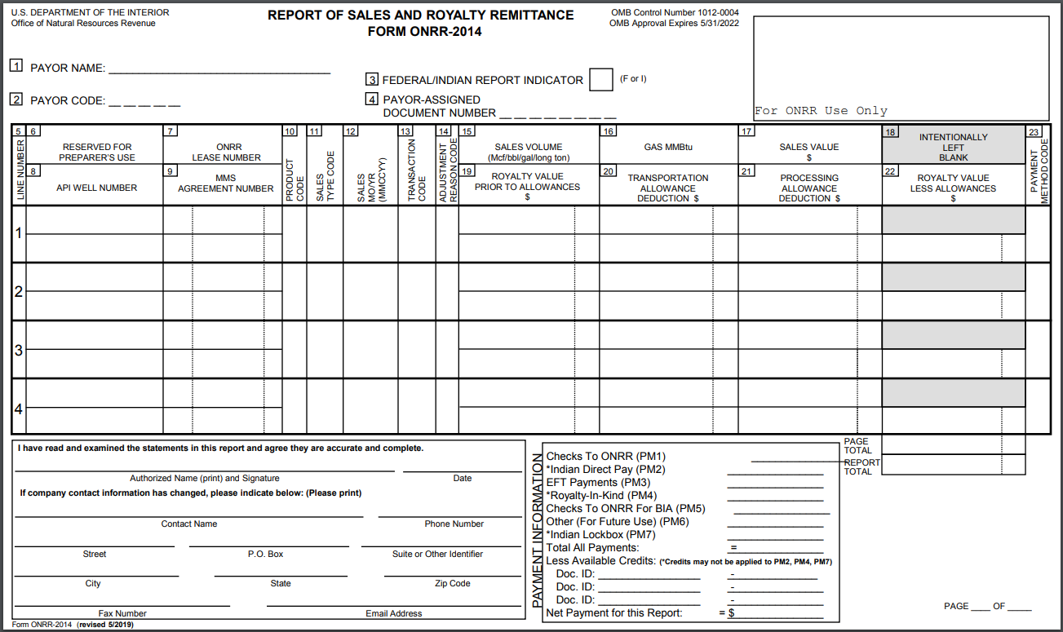
Example Inputs
Production:
  7,500 bbl oil/month
  10,000 MCF/month
  = 9,279 BOE/month
    BOE conversion: 5,620 scf/bbl
    Heat Content: 1.032 MMBtu/Mcf
Current Royalty Rate = 16.67%
Qualifying Months:
  January – December 2018
NYMEX prices from eia.gov
ONRR-4054 & ONRR-2014 for Qualifying Months
 | NYMEX OIL ($/bbl) | NYMEX GAS ($/MMBtu)
Jan-18 | 63.70 | 3.87
Feb-18 | 62.23 | 2.67
Mar-18 | 62.73 | 2.69
Apr-18 | 66.25 | 2.80
May-18 | 69.98 | 2.80
Jun-18 | 67.87 | 2.97
Jul-18 | 70.98 | 2.83
Aug-18 | 68.06 | 2.96
Sep-18 | 70.23 | 3.00
Oct-18 | 70.75 | 3.28
Nov-18 | 56.96 | 4.09
Dec-18 | 49.52 | 4.04
Average | 64.94 | 3.17
*All production information is theoretical and does not represent an actual OCS Lease.

Slide 50
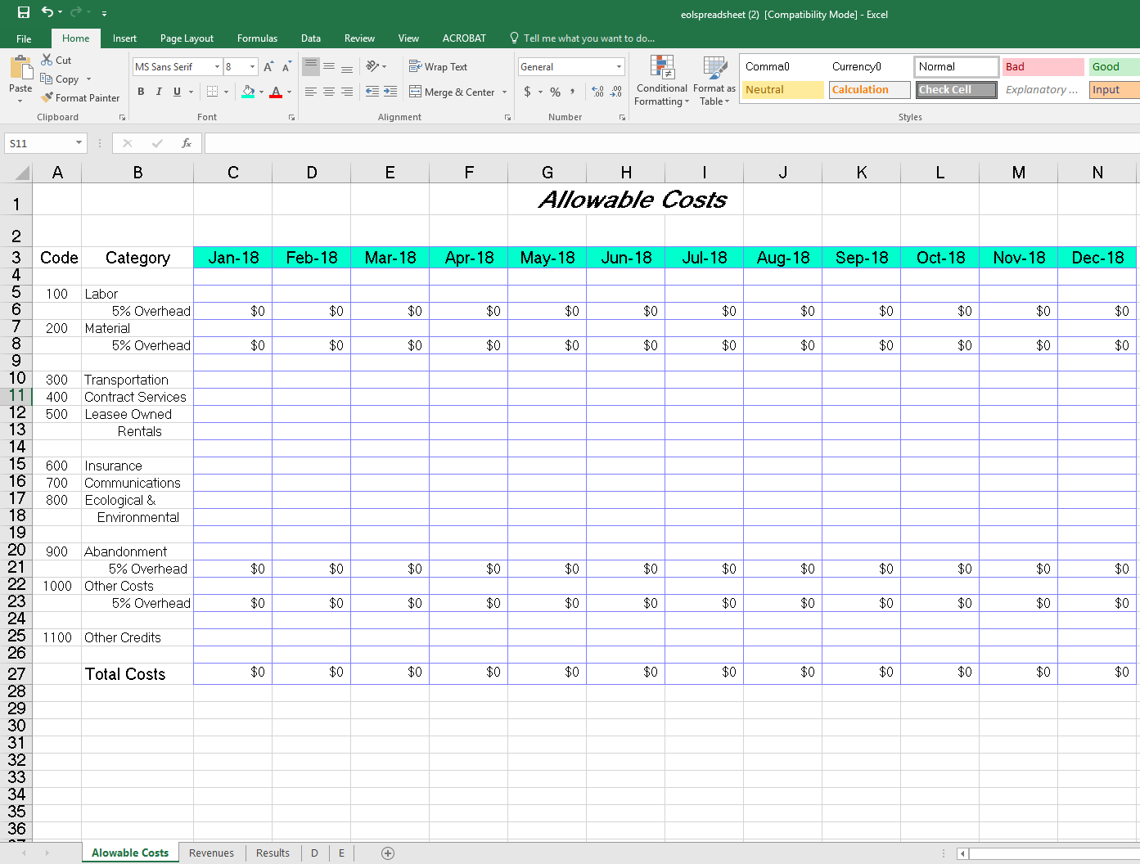
Update months for Qualifying Period
Allowable Costs

Slide 51
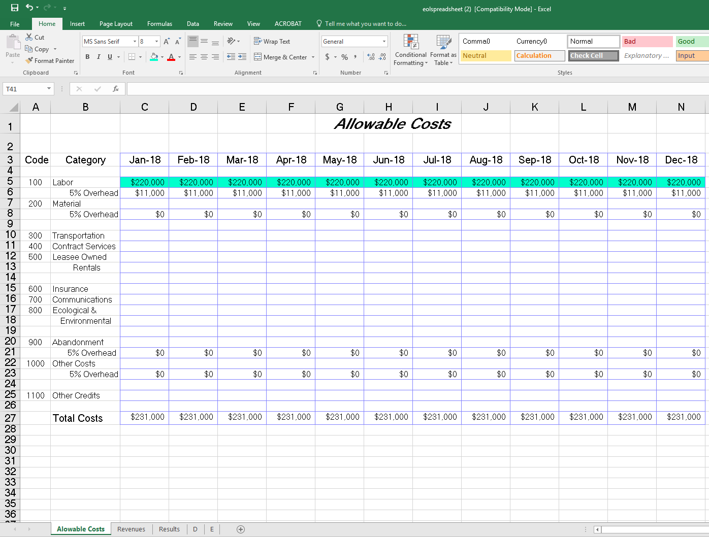
Add monthly labor costs
5% overhead autocalculates
Allowable Costs

Slide 52
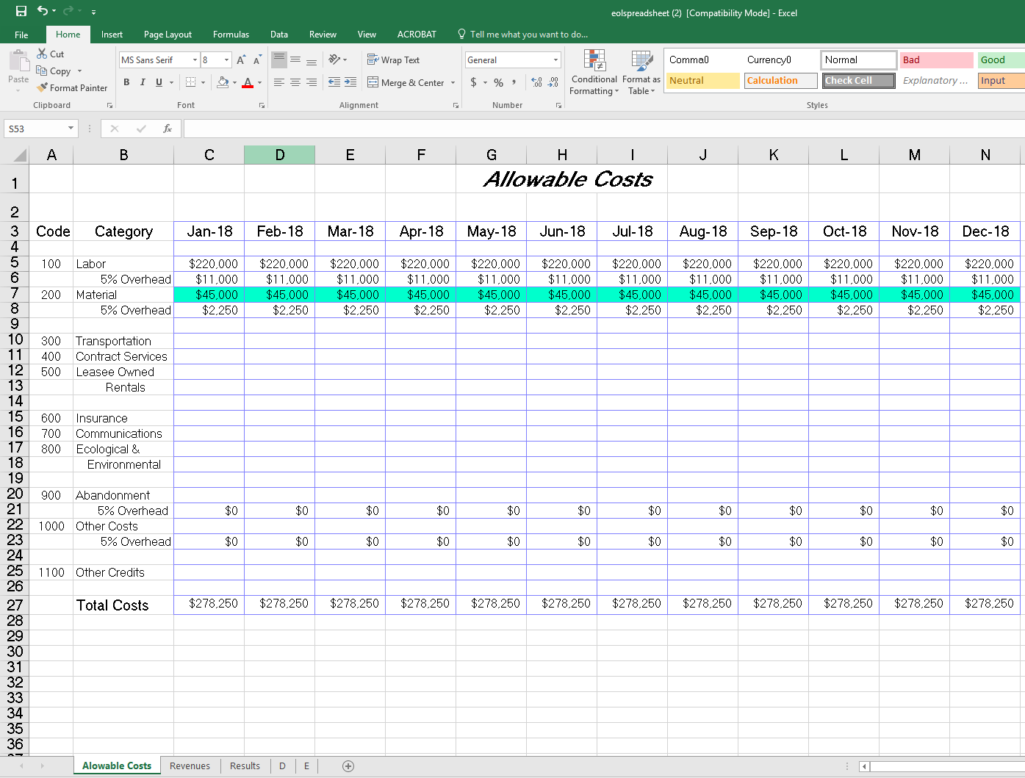
Add monthly material costs
5% overhead autocalculates
Allowable Costs

Slide 53
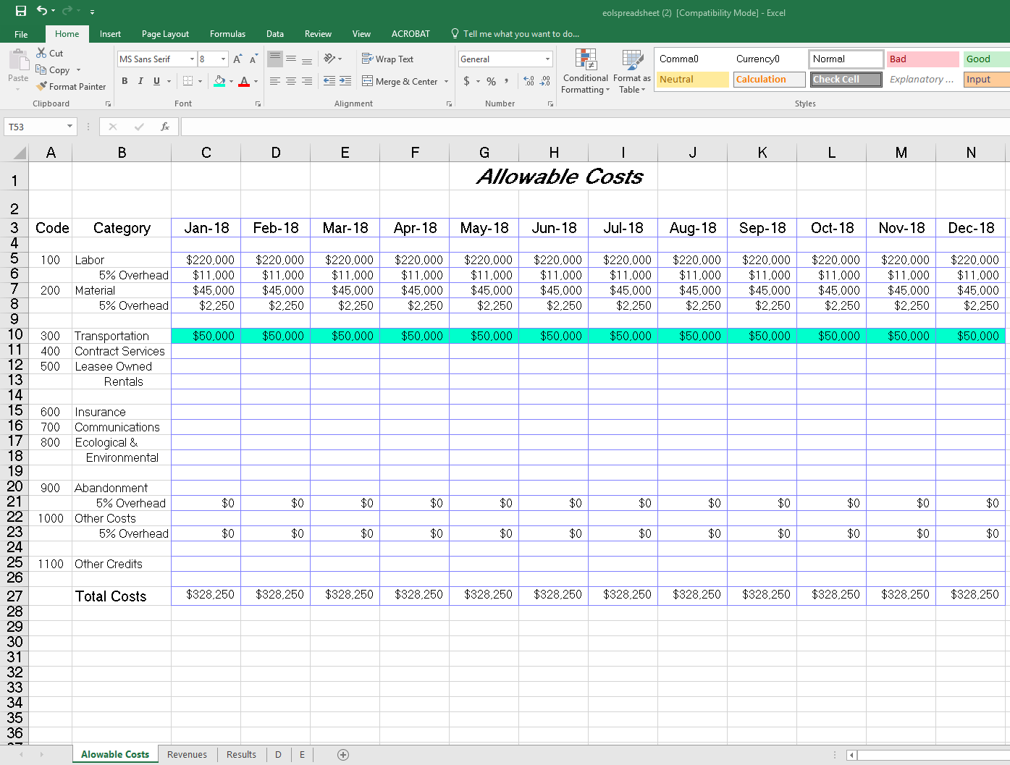
Add monthly transportation costs
(people/materials within, to, and from the lease)
Allowable Costs

Slide 54
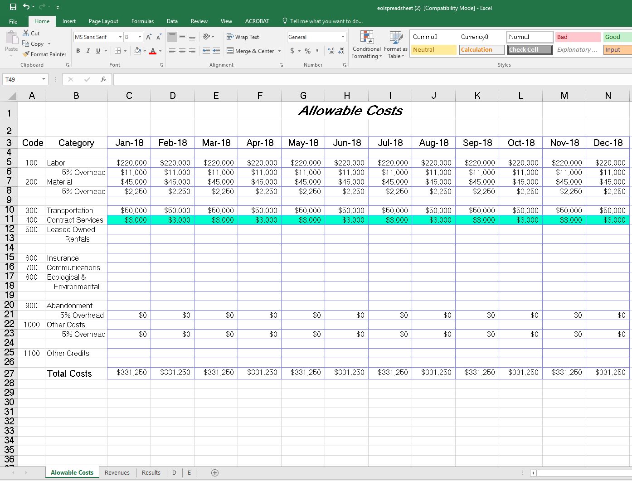
Add monthly contract service costs
Allowable Costs

Slide 55
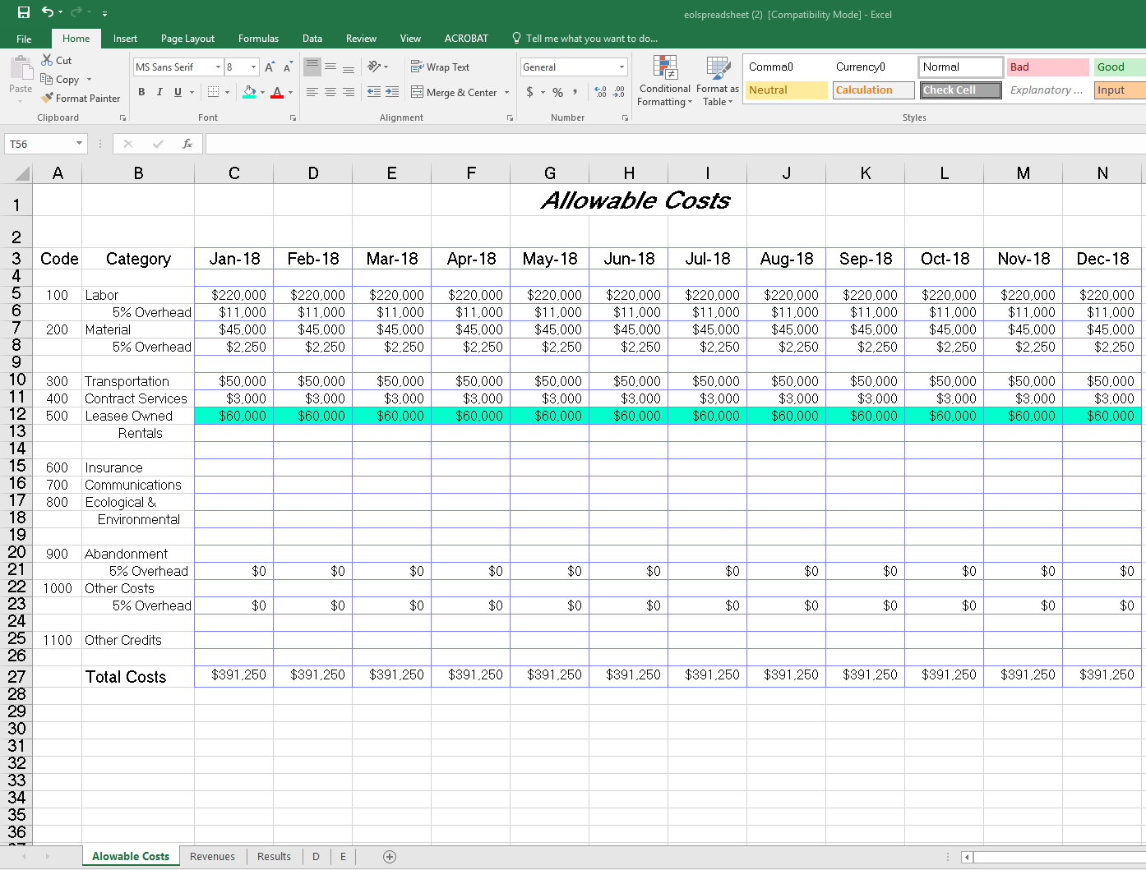
Add monthly rental costs
Allowable Costs

Slide 56
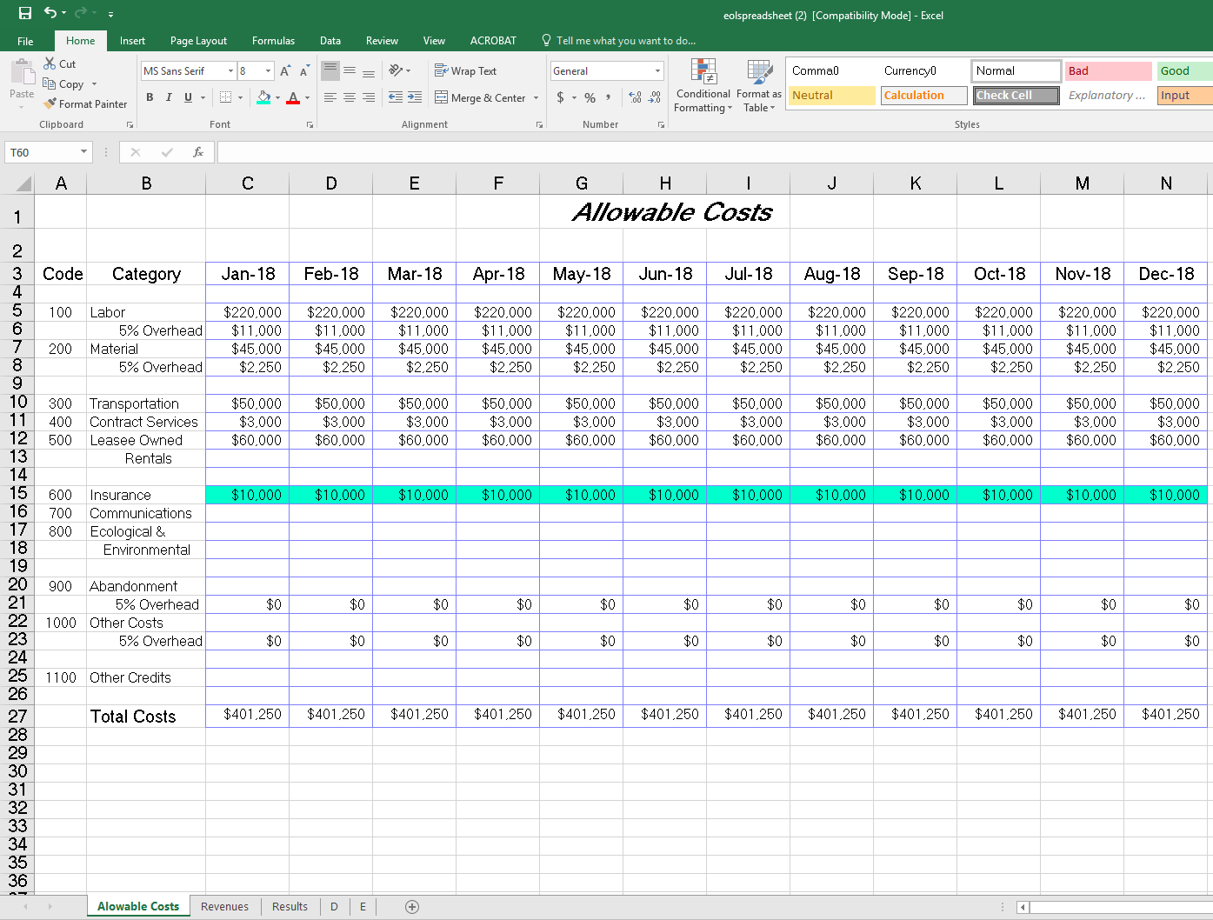
Add monthly insurance costs
Allowable Costs

Slide 57
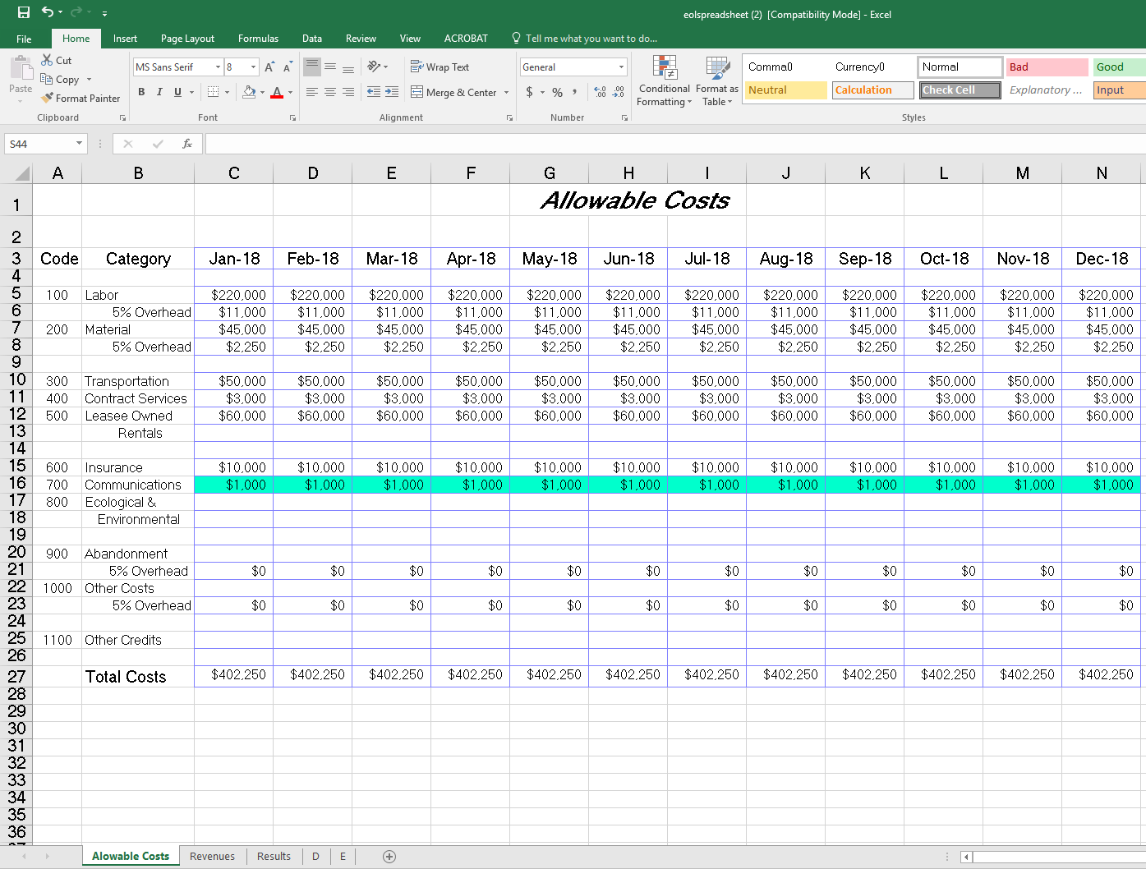
Add monthly communications costs
Allowable Costs

Slide 58

Add monthly environmental costs
Allowable Costs

Slide 59
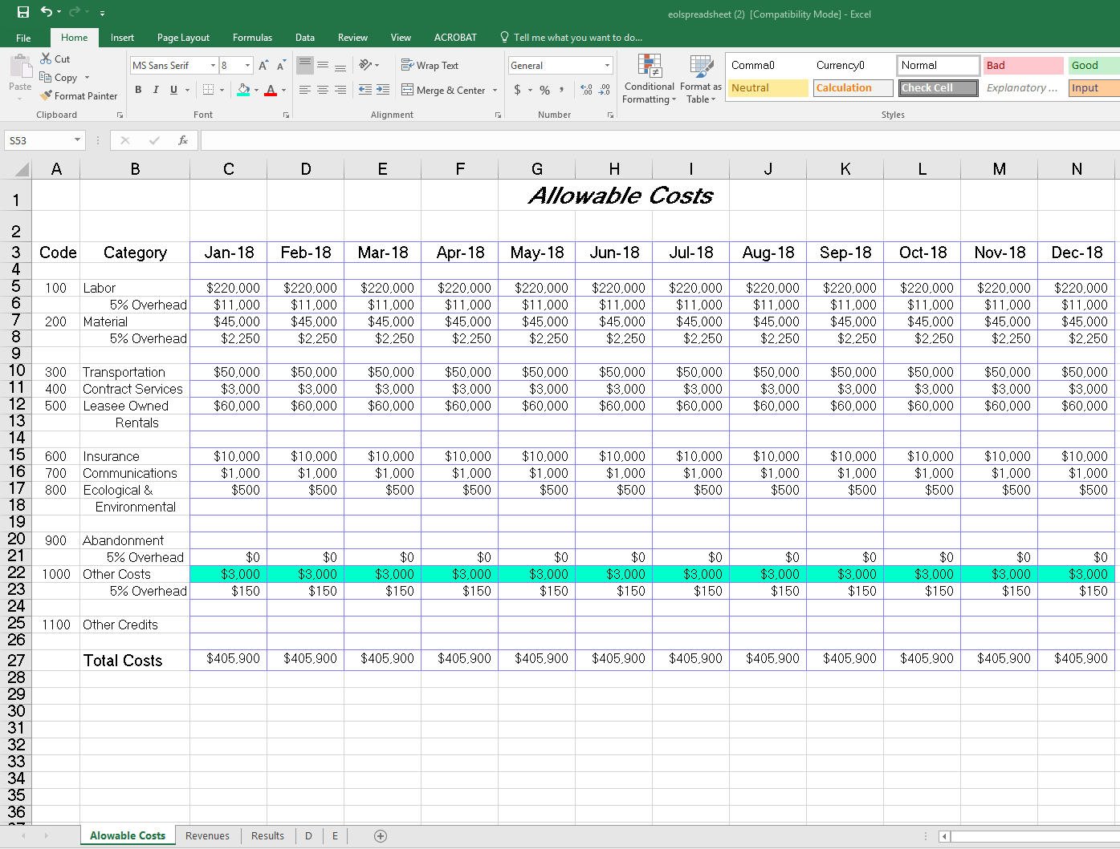
Add other monthly costs
5% overhead autocalculates
Allowable Costs

Slide 60
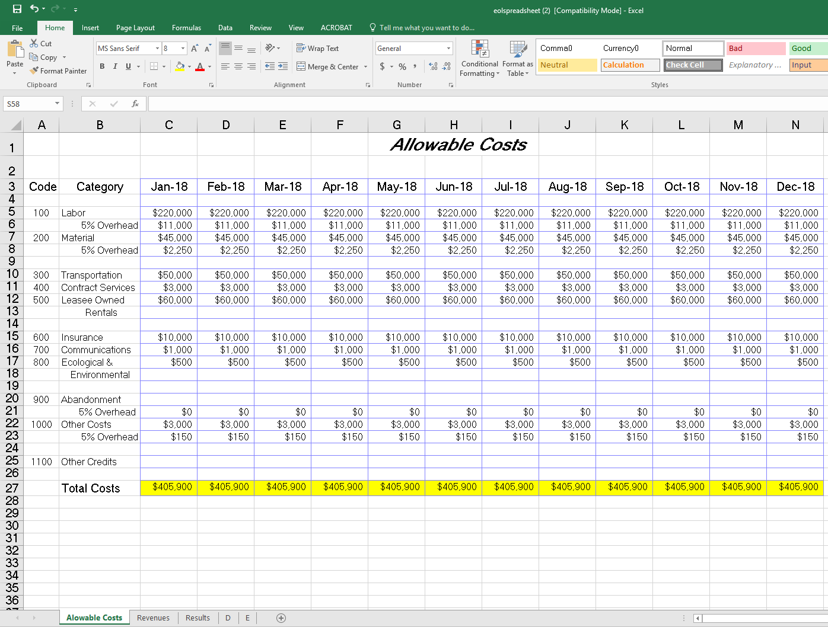
Total costs auto-sum
Allowable Costs

Slide 61
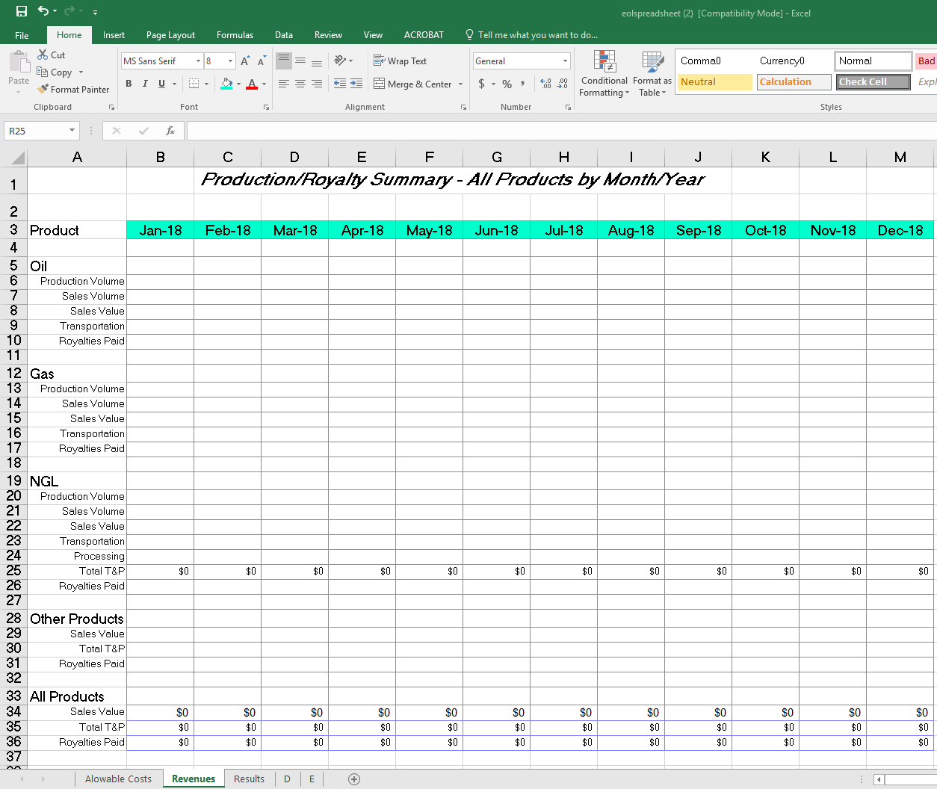
Update months for Qualifying Period
Revenues

Slide 62
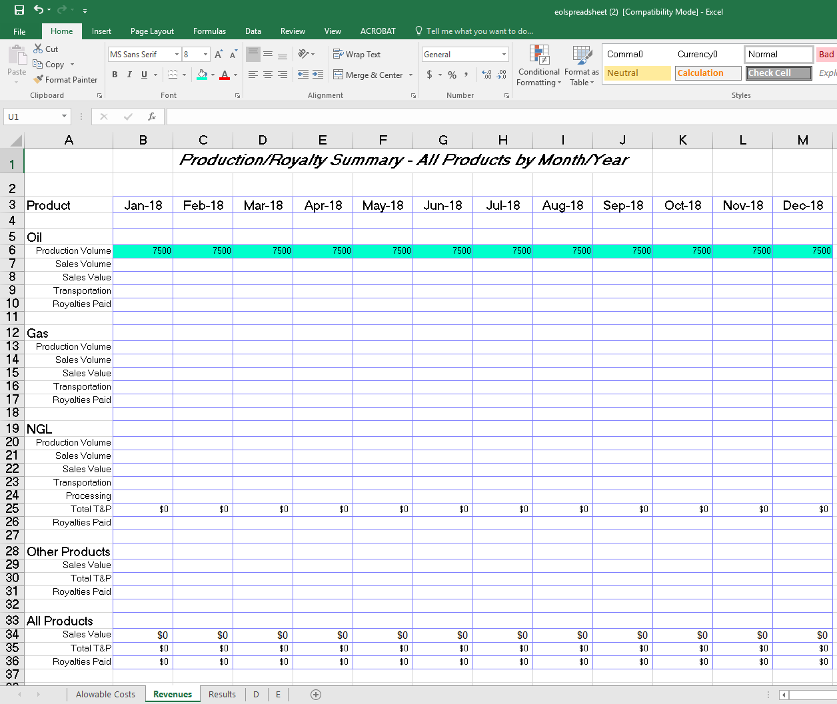
Add monthly oil production volume submitted to ONRR
Revenues

Slide 63
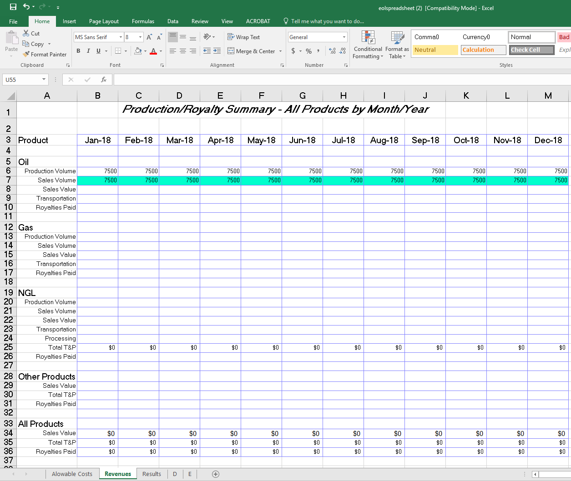
Add monthly oil sales volume (pre-royalty)
Revenues

Slide 64

Add monthly oil sales value (pre-royalty)
Revenues

Slide 65
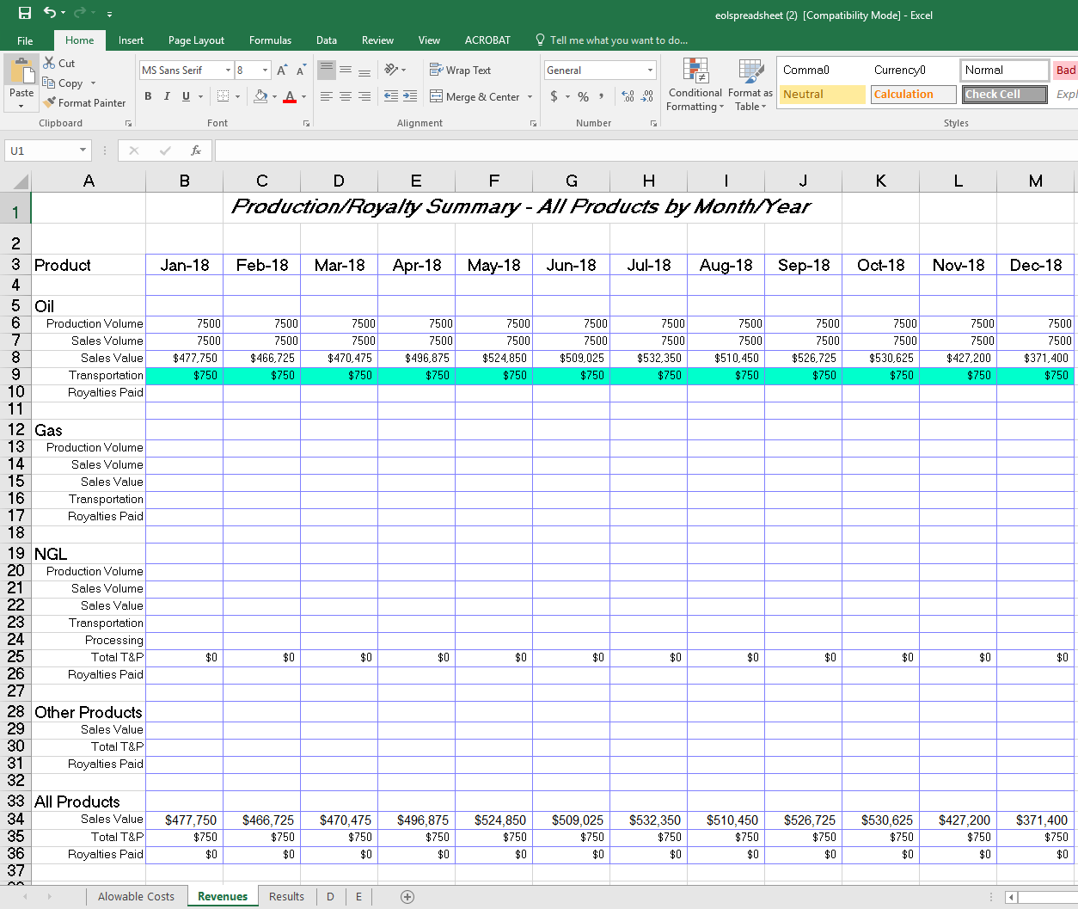
Add monthly transportation costs for oil
Revenues

Slide 66
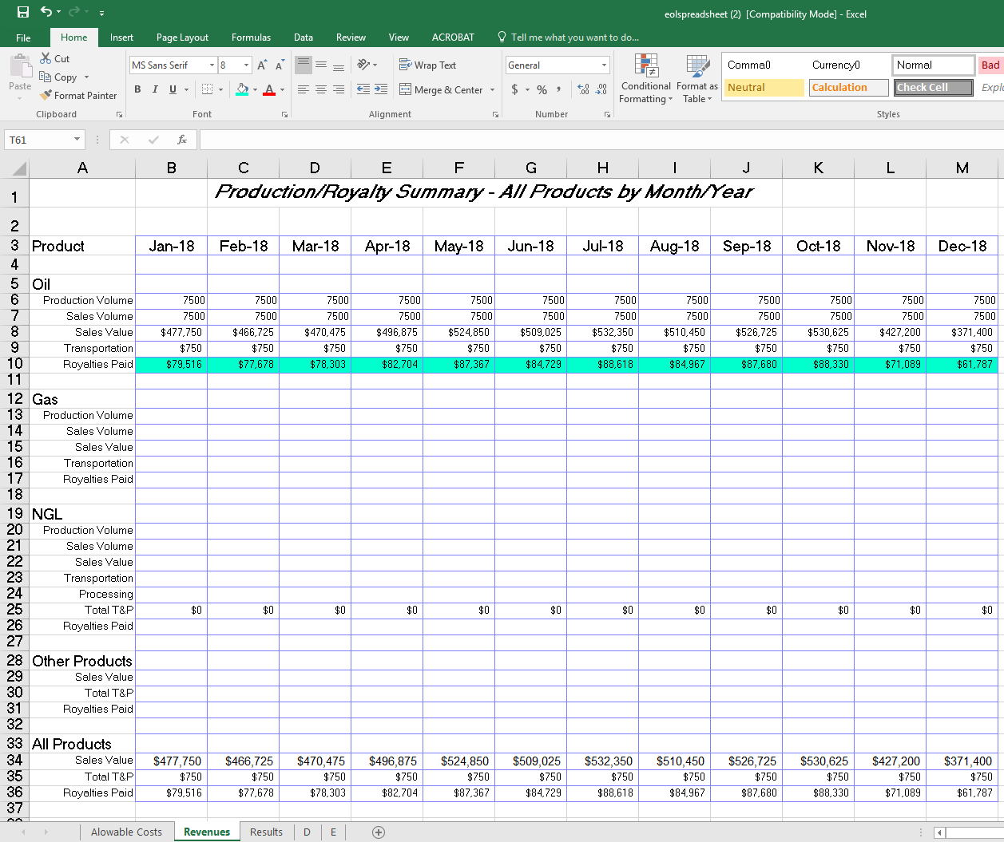
Add monthly royalties paid to ONRR for oil
Revenues

Slide 67
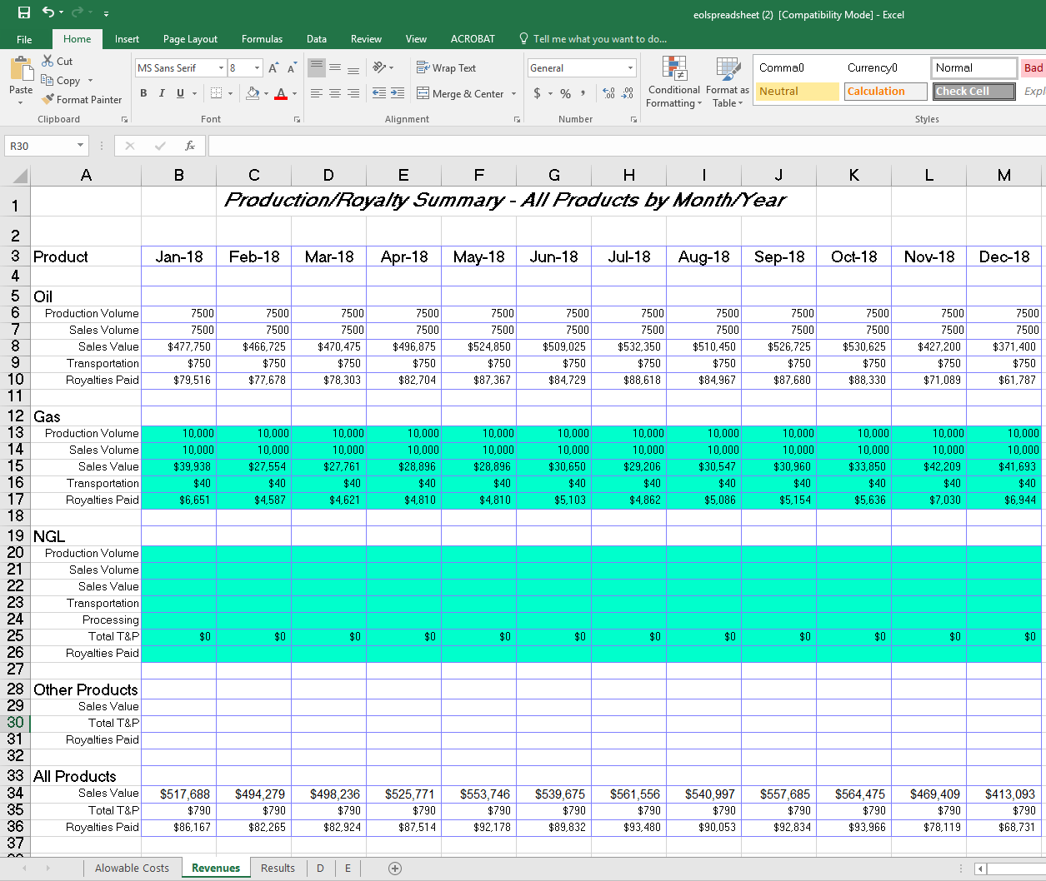
Repeat Production Volume, Sales Volume, Sales Value, Transportation & Processing Costs, and Royalties Paid for Gas & NGL products
Revenues

Slide 68
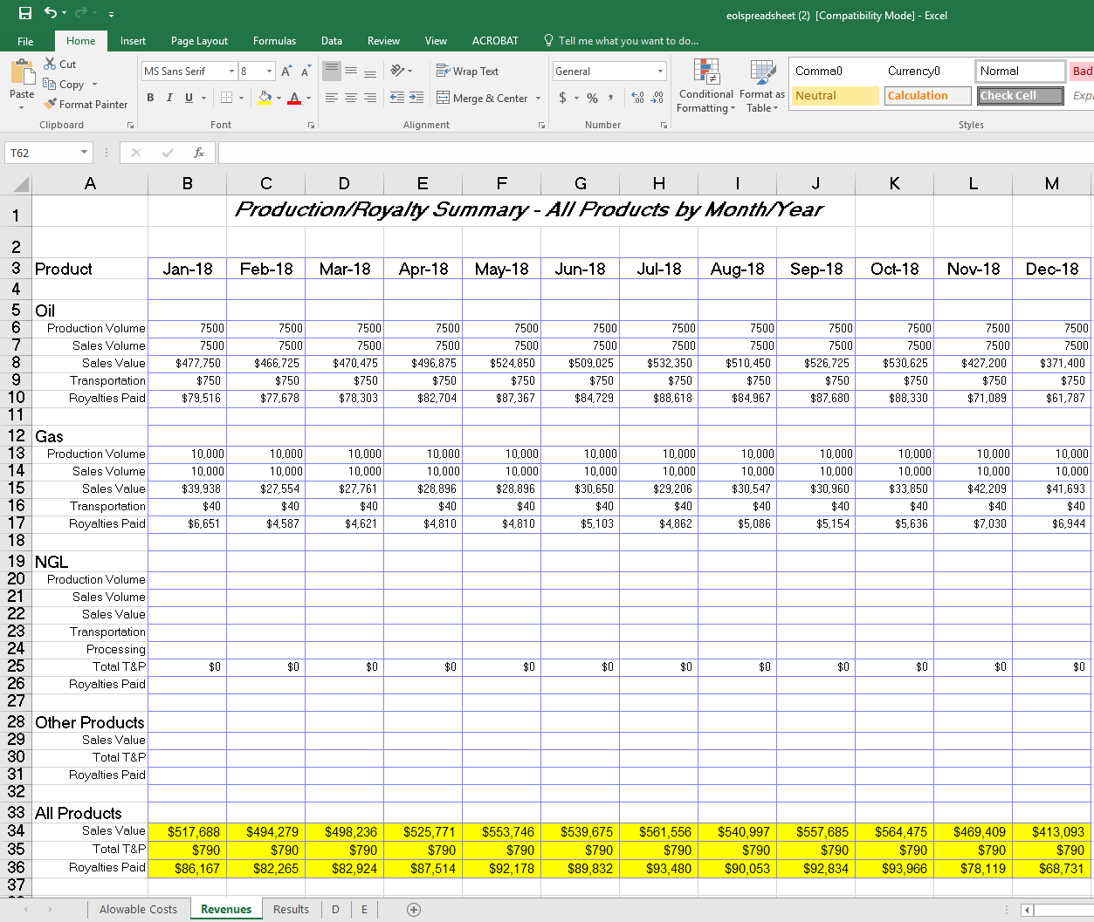
Total Sales Value, Transportation/Production Costs, and Royalties auto-sum
Revenues

Slide 69
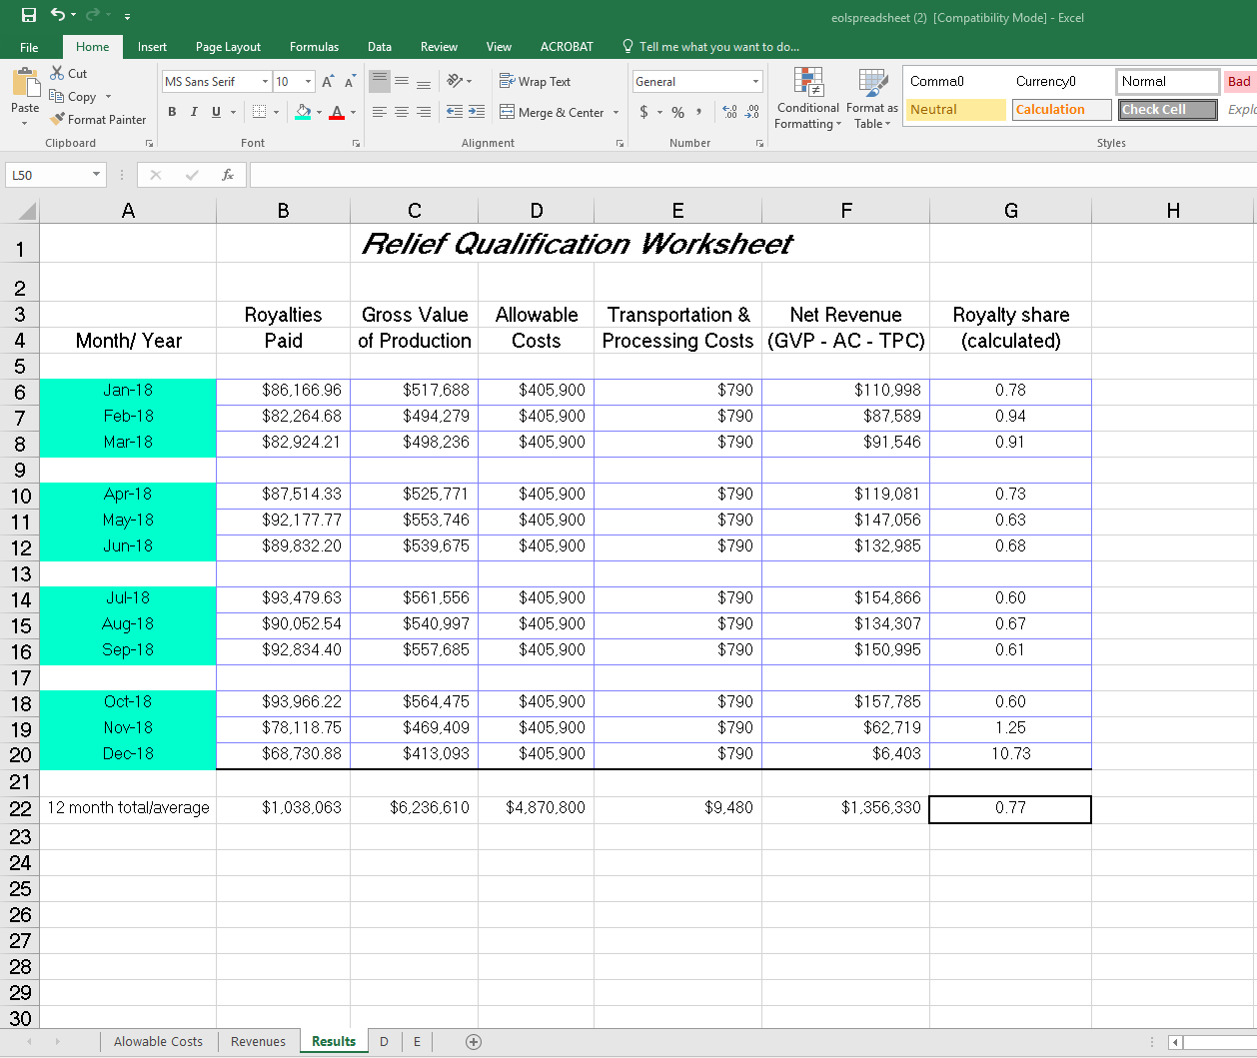
Update months for Qualifying Period
Results

Slide 70
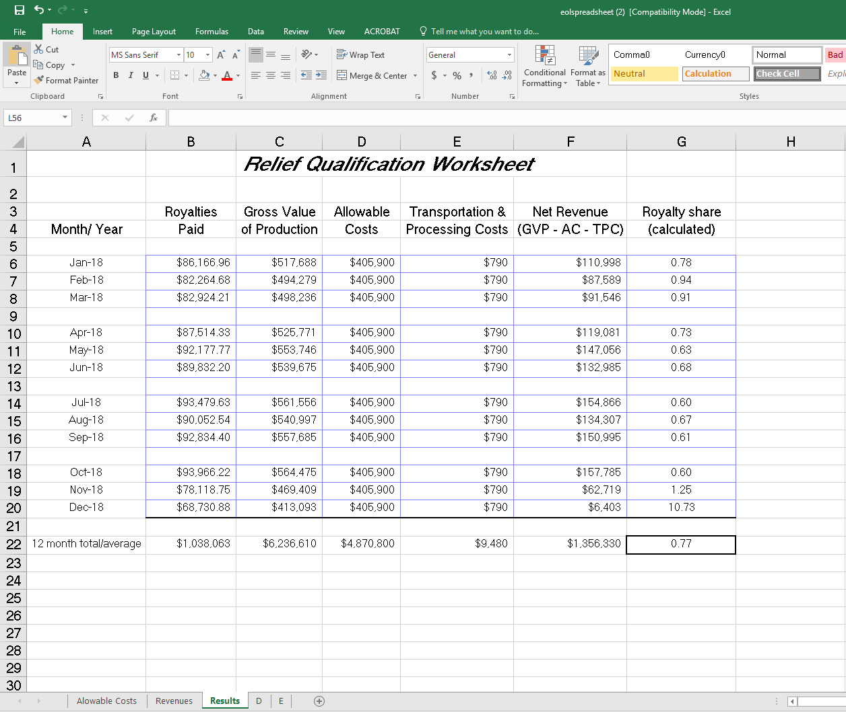


All cells on “Results” tab are calculated – do not overwrite!
Final result should be
≥ 0.75.
✓
$1,038,063
$519,031
Results

Slide 71
Example Decision Letter
1) Royalty Rates
Effective royalty rate = 16.67%
Royalty relief rate = 8.335%
2) Royalty Relief Volume
  9,279 BOE/month
3) Effective Date of New Terms
  Usually first day of the month following relief approval
4) Base Reference Price
(Weighted Average Price over Qualifying Period)
$56.01/BOE
5) Suspension Threshold Price (Base Reference Price + 25%)
$70.01/BOE

Slide 72



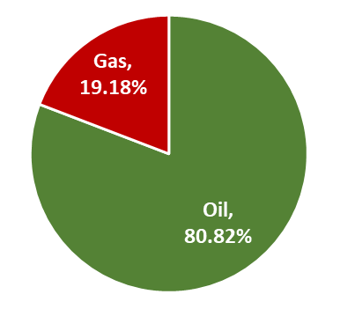
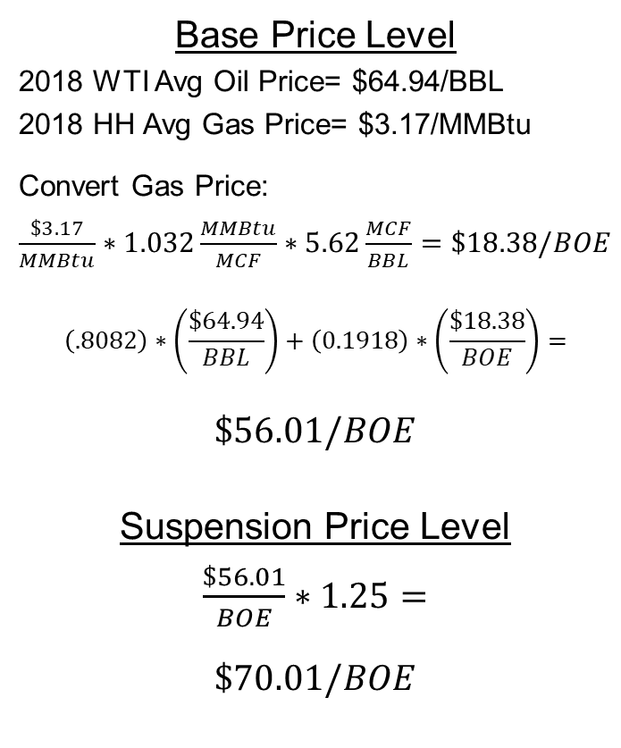
Calculations
All price and production weighting factors use historical data from the 12-month qualifying period.
Production Weighting Factors
Base Price Level
2018 WTI Avg Oil Price= $64.94/BBL
2018 HH Avg Gas Price= $3.17/MMBtu
Convert Gas Price:
$\frac{\$3.17}{MMBtu}∗1.032\frac{MMBtu}{MCF}∗5.62\frac{MCF}{BBL}=\$18.38/BOE$
$$\left(.8082\right)∗\left(\frac{\$64.94}{BBL}\right)+\left(0.1918\right)∗\left(\frac{\$18.38}{BOE}\right)=$$
$$\$56.01/BOE$$
Suspension Price Level
$\frac{\$56.01}{BOE}∗1.25=$
$$\$70.01/BOE$$

Slide 73
Price Effects Tracking Example
$70.01
$56.01
Effective royalty rate due on all lease production in a month that the rolling weighted average price is greater than the suspension price threshold.
12-Month Qualifying Period

Slide 74
Price Tracking with Relief Suspension

Slide 75
Price Tracking with Relief Suspension
80% Oil
20% Gas

Slide 76
Price Tracking with Relief Suspension
12-Month Qualifying Period

Slide 77
Price Tracking with Relief Suspension
12-Month Qualifying Period
4
2
3
5
6
7
8
1
9
10

Slide 78
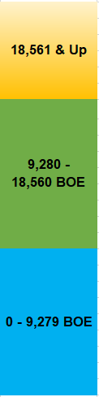
Production Thresholds Example
If monthly production volume is less than royalty relief volume
  Pay royalty relief rate on that month’s volume.
If monthly production volume is greater than royalty relief volume, but less than twice the royalty relief volume
  Pay royalty relief rate up to royalty relief volume
  And pay 1.5x effective royalty rate on production above royalty relief volume.
If monthly production volume is above twice the royalty relief volume
  Pay effective royalty rate on all production.
16.67% Royalty Rate
25% Royalty Rate
8.335% Royalty Rate

Slide 79
Scaled Royalties Owed
Royalty Relief Volume
2X Royalty Relief Volume
In effect, the average relief royalty rate gradually increases (as monthly production increases) to a cap at the pre-relief effective royalty rate.
While EOL RR is in place, the maximum rate of royalties that would be owed is the pre-relief effective royalty rate.

Slide 80
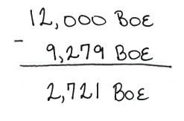


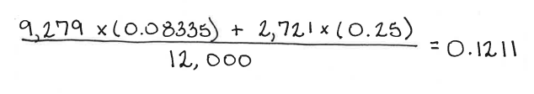

Production Above Royalty Relief Volume
In Our Example:
After relief is granted, assume lease produces 12,000 BOE in one month.
This is 2,721 BOE above the royalty relief volume.
Royalty relief rate of 8.335% applies to royalty relief volume of 9,279 BOE.
Royalty rate of 25% (1.5 x 16.67% effective royalty rate) applies to production above the royalty relief volume.
Average royalty rate for this month is 12.11%.

Slide 81
Tracking & Termination
It is the responsibility of the operator to determine the appropriate royalties due each month.
  BSEE will perform lookbacks to ensure compliance.
If royalty rate paid equals the effective royalty rate for 12 consecutive months, relief will end.

Slide 82
Agenda
Purpose & Authority
Regulations
Process
Example Case
Helpful Tips
Q&A

Slide 83
End-Of-Life Helpful Tips

Slide 84
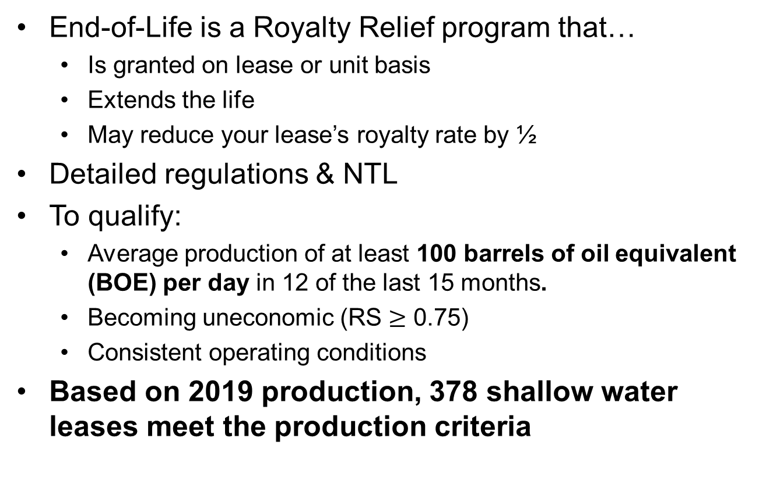
Helpful Tips
General
End-of-Life is a Royalty Relief program that…
  Is granted on lease or unit basis
  Extends the life
  May reduce your lease’s royalty rate by ½
Detailed regulations & NTL
To qualify:
  Average production of at least 100 barrels of oil equivalent (BOE) per day in 12 of the last 15 months.
  Becoming uneconomic (RS $≥$ 0.75)
  Consistent operating conditions
Based on 2019 production, 378 shallow water leases meet the production criteria

Slide 85
Helpful Tips
Application/Evaluation
1) Required Fee
  $8,000
2) Administrative Information Report
3) Net Revenue & Relief Justification Report
4) CPA Certification
Submit application up to 120 days after end of last qualifying month.
EOL decisions ~2-3 months, depending on completeness of application

Slide 86
Helpful Tips
Net Revenue & Relief Justification Report
Download the spreadsheets found on BSEE’s website
Leave equations as is
Please fill out all 3 tabs in spreadsheet

Slide 87
Helpful Tips
Net Revenue & Relief Justification Report
All volumes and values are entered by you
  Full lease historical data
  Pre-royalty value and volume
  Clear and consistent cost allocation
  Actual month incurred expenses is preferred
  Explain significant variability within a cost category
BSEE will review and compare data submitted on ONRR-4054/2014 forms
RS>1 might not be in paying quantities

Slide 88
Helpful Tips
Royalty Suspension/Tracking/Termination
Suspend:
  Prices more than 25%
    12-month rolling weighted average
  Production increases over royalty relief volume
    Calculate average royalty rate if production is 1-2x royalty relief volume.
Tracking:
  Operator calculates and pays additional royalties due if price or production increases above thresholds
  BSEE will periodically monitor for compliance
Terminate:
  Operator
  When the calculated average royalty rate equals the effective royalty rate for 12 consecutive months.
  Violation of other stated conditions of approval

Slide 89
Agenda
Purpose & Authority
Regulations
Process
Example Case
Helpful Tips
Q&A

Slide 90
Questions?

Slide 91
Thank you!

Slide 92
Regulations

Slide 93
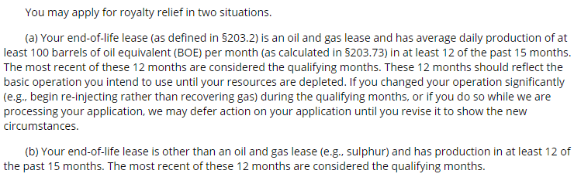
§203.50 - Who may apply for end-of-life royalty relief?

Slide 94
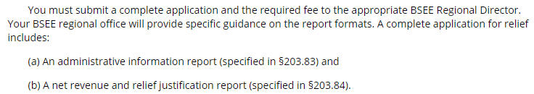
§203.51 - How do I apply for end-of-life royalty relief?

Slide 95
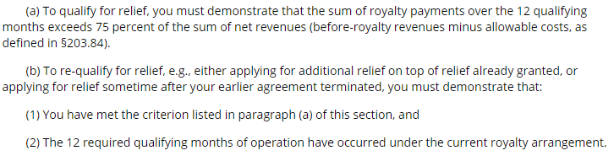
§203.52 - What criteria must I meet to get relief?

Slide 96
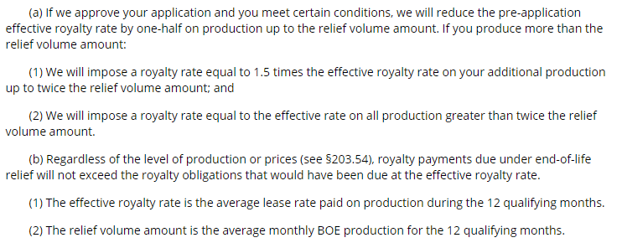
§203.53 - What relief will BSEE grant?

Slide 97
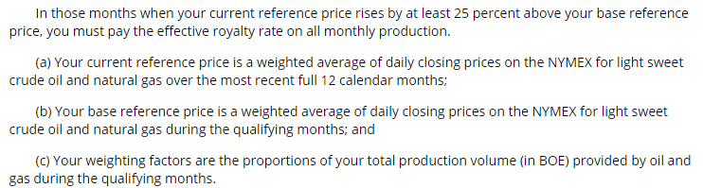
§203.54 - How does my relief arrangement for an oil and gas lease operate if prices rise sharply?

Slide 98
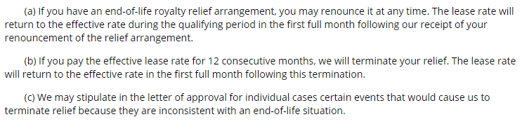
§203.55 - Under what conditions can my end-of-life royalty relief arrangement for an oil and gas lease be ended?

Slide 99
§203.56 - Does relief transfer when a lease is assigned?
Yes. Royalty relief is based on the lease circumstances, not ownership. It transfers upon lease assignment.

Slide 100
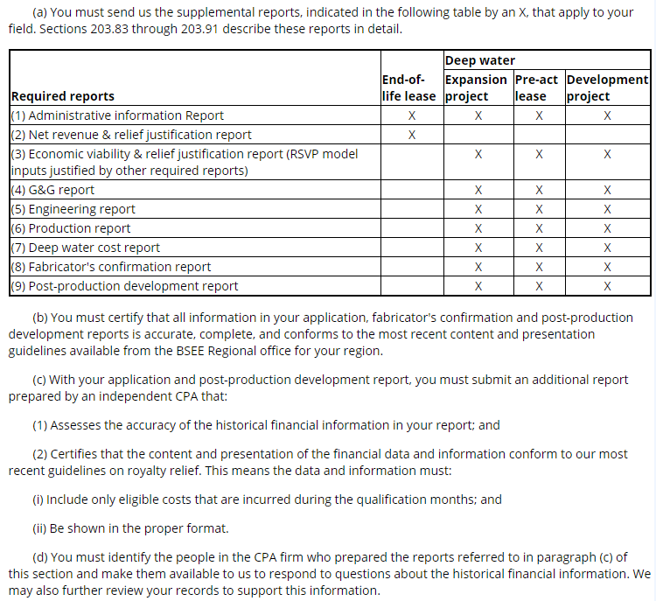
§203.81 What supplemental reports do royalty-relief applications require?

Slide 101
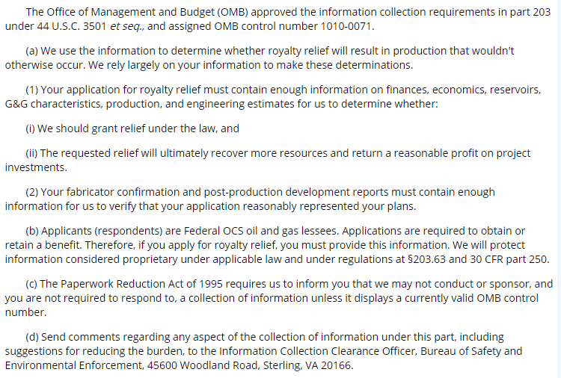
§203.82 What is BSEE's authority to collect this information?

Slide 102
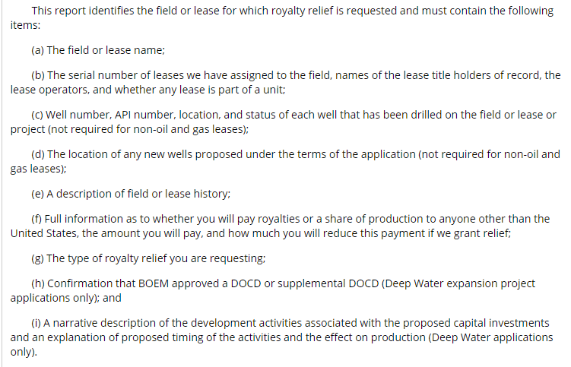
§203.83 What is in an administrative information report?

Slide 103
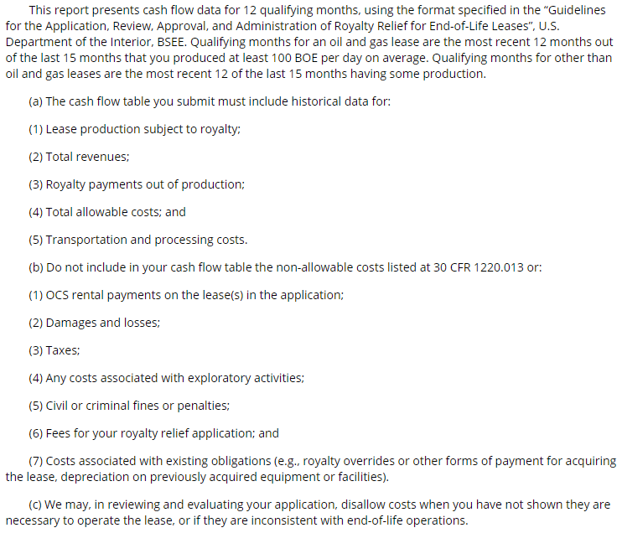
§203.84 What is in a net revenue and relief justification report?

