Slide 1
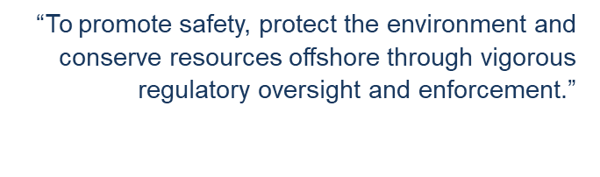
Royalty Relief Workshop End-of-Life & “Special Case”
January 31, 2020
Hyatt Regency Hotel
Houston, Texas

Slide 2
Agenda
9:00 Registration
9:30 Introduction
Scott Angelle
10:00 End-of-Life Royalty Relief
Rebecca Rich & Lauren Woitha
12:00 Lunch Break (on your own)
1:30 “Special Case” Royalty Relief
Andrew Cambus & Daniel Dauterive
4:00 Wrap up

Slide 3
Discretionary Royalty Relief Workshop:
“Special Case” Royalty Relief (SCRR)
Andrew Cambus – Petroleum Engineer Daniel Dauterive - Petroleum Engineer Gulf of Mexico Region
Production and Development
Development Unit
“To promote safety, protect the environment and conserve resources offshore through vigorous regulatory oversight and enforcement.”

Slide 4
Presentation Agenda
Overview of SCRR & Application History
Overview of Regulations
SCRR Application Process
Example Application #1
Example Application #2
Frequently Asked Questions
Questions from Audience

Slide 5
Overview of SCRR
SCRR is a 2 step process:
Pre-Application
Formal Application
Policy changes effective November 21, 2019, include:
Applications can be approved on a “project” basis that include operations in multiple, non-adjacent locations and leases
Applications can include exploratory resources IF they promote development or increase production of discovered resources
Discount Range: 0 to 25% for Lease or projects in water depths 200 meters or less in the GOM
Note: Deep water discount range hasn’t changed, 10 to 15%

Slide 6
Application History in GOM
Fiscal Year | Received | Approved | Denied | Withdrawn | Pending
2004 | 2 | 2 | 0 | 0 | 0
2006 | 1 | 1 | 0 | 0 | 0
2007 | 2 | 2 | 0 | 0 | 0
2008 | 2 | 1 | 1 | 0 | 0
2009 | 1 | 1 | 0 | 0 | 0
2018 | 2 | 1 | 0 | 0 | 1
2019 | 3 | 1 | 0 | 1 | 1
TOTAL | 13 | 9 | 1 | 1 | 2

Slide 7
Presentation Agenda
Overview of SCRR & Application History
Overview of Regulations
SCRR Application Process
Example Application #1
Example Application #2
Frequently Asked Questions
Questions from Audience

Slide 8
Overview of Regulations
§203.1 What is BSEE’s authority to grant royalty relief?
(b) Under 43 U.S.C. 1337(a)(3)(B), we may reduce, modify, or eliminate any royalty to promote development, increase production, or encourage production of marginal resources on certain leases or categories of leases.

Slide 9
Overview of Regulations
§203.2 How can I obtain royalty relief?
BSEE may reduce or suspend royalties for Outer Continental Shelf (OCS) leases or projects that meet the criteria in the following table.
If you have a lease . . . | And if you . . . | Then we may grant you . . .
(a) With earnings that cannot sustain production (i.e., End-of-life lease), | Would abandon otherwise potentially recoverable resources but seek to increase production by operating beyond the point at which the lease is economic under the existing royalty rate, | A reduced royalty rate on current monthly production and a higher royalty rate on additional monthly production (see §§203.50 through 203.56).
(b) Located in a designated GOM deep water area (i.e., 200 meters or greater) and acquired in a lease sale held before November 28, 1995, or after November 28, 2000, | Propose an expansion project and can demonstrate your project is uneconomic without royalty relief, | A royalty suspension for a minimum production volume plus any additional production large enough to make the project economic (see §§203.60 through 203.79).
(c) Located in a designated GOM deep water area and acquired in a lease sale held before November 28, 1995 (Pre-Act lease), | Are on a field from which no current pre-Act lease produced (other than test production) before November 28, 1995, (Authorized field,) | A royalty suspension for a minimum production volume plus any additional volume needed to make the field economic (see §§203.60 through 203.79).
(d) Located in a designated GOM deep water area and acquired in a lease sale held after November 28, 2000, | Propose a development project and can demonstrate that the suspension volume, if any, for your lease is not enough to make development economic, | A royalty suspension for a minimum production volume plus any additional volume needed to make your project economic (see §§203.60 through 203.79).
(e) Where royalty relief would recover significant additional resources or, offshore Alaska or in certain areas of the GOM, would enable development, | Are not eligible to apply for end-of-life or deep water royalty relief, but show us you meet certain eligibility conditions, | A royalty modification in size, duration, or form that makes your lease or project economic (see §203.80).
(f) Located in a designated GOM shallow water area and acquired in a lease sale held before January 1, 2001, or after January 1, 2004, or have exercised an option to substitute for royalty relief in your lease terms, | Drill a deep well on a lease that is not eligible for deep water royalty relief and you have not previously produced oil or gas from a deep well or an ultra-deep well, | A royalty suspension for a volume of gas produced from successful deep and ultra-deep wells, or, for certain unsuccessful deep and ultra-deep wells, a smaller royalty suspension for a volume of gas or oil produced by all wells on your lease (see §§203.40 through 203.49).
(g) Located in a designated GOM shallow water area, | Drill and produce gas from an ultra-deep well on a lease that is not eligible for deep water royalty relief and you have not previously produced oil or gas from an ultra-deep well, | A royalty suspension for a volume of gas produced from successful ultra-deep and deep wells on your lease (see §§203.30 through 203.36).
(h) Located in planning areas offshore Alaska, | Propose an expansion project or propose a development project and can demonstrate that the project is uneconomic without relief or that the suspension volume, if any, for your lease is not enough to make development economic, | A royalty suspension for a minimum production volume plus any additional volume needed to make your project economic (see §§203.60, 203.62, 203.67 through 203.70, 203.73, and 203.76 through 203.79).

Slide 10
Overview of Regulations
§203.2 How can I obtain royalty relief? (cont.)
If you have a lease …
(e) Where royalty relief would recover significant additional resources or, offshore Alaska or in certain areas of the GOM, would enable development,
And if you …
Are not eligible to apply for end-of-life or deep water royalty relief, but show us you meet certain eligibility conditions,
Then we may grant you …
A royalty modification in size, duration, or form that makes your lease or project economic (see §203.80.)

Slide 11
Overview of Regulations
§203.80 When can I get royalty relief if I am not eligible for royalty relief under other sections in the subpart?
We may grant royalty relief when it serves purposes summarized in §203.1 and our formal relief programs, including but not limited to the applicable levels of the royalty suspension volumes and price thresholds, provide inadequate encouragement to promote development or increase production.
Unless your lease lies offshore of Alaska or wholly west of 87 degrees, 30 minutes West longitude in the GOM, your lease must be producing to qualify for relief.

Slide 12
Overview of Regulations
§203.80 When can I get royalty relief if I am not eligible for royalty relief under other sections in the subpart? (cont.)
Before you may apply for royalty relief apart from our programs for end-of-life leases or for pre-Act deep water leases and development and expansion projects, we must agree that your lease or project has met two or more of the following characteristics.
Note: A project means any activity that requires at least a permit to drill.

Slide 13
§203.80 Characteristics
(a) The lease has produced for a substantial period and the lessee can recover significant additional resources. Significant additional resources mean enough to allow production for at least a year more than would be profitable without royalty relief.
Example:
A lease was acquired in 2002 and has nearly depleted its developed reserves. Without new drilling, the lease will stop producing in the next few months. The company would like to sidetrack a previously depleted well to previously discovered hydrocarbons, which would extend lease production nearly three years.

Slide 14
§203.80 Characteristics
(b) Valuable facilities (e.g., a platform or pipeline that would be removed upon lease relinquishment) exist that we do not expect a successor lessee to use. If the facilities are located off the lease, their preservation must depend on continued production from the lease applying for royalty relief. We will only consider an allocable share of costs for off-lease facilities in the relief application.
Example:
An operator would like to drill a well, which requires royalty relief to become economic, that flows back to a platform that is no longer being used, has no future utility, and would definitely be decommissioned if the lease expires.

Slide 15
§203.80 Characteristics
(c) A substantial risk exists that no new lessee will recover the resources.
Example:
The block was available for leasing, but did not receive a bid for many years prior to the current lease (which is set to expire unless the operator receives royalty relief and drills a new well). In addition, the lease is located in an area of the GOM that has limited recent bidding.

Slide 16
§203.80 Characteristics
(d) The lessee made major efforts to reduce operating costs too recently to use the formal program for royalty relief (e.g., recent significant change in operations).
Example:
An operator would like to apply for End-of-Life Royalty Relief, but cannot because it made major efforts to reduce operating costs too recently. Under 30 CFR 203.50(a), your 12 “qualifying months” for an End-of-Life application should reflect the basic operation you intend to use until your resources are depleted.

Slide 17
§203.80 Characteristics
(e) Circumstances beyond the lessee’s control, other than water depth, preclude reliance on one of the existing royalty relief programs.
Example:
An operator is targeting a previously discovered zone that would not qualify for Shallow Water Deep Gas royalty relief, the circumstances of the lease would not qualify it for an End-of-Life royalty relief application, and the lease is not subject to any automatic royalty relief (e.g. deep water royalty relief) in the terms of the lease instrument.

Slide 18
Presentation Agenda
Overview of SCRR & Application History
Overview of Regulations
SCRR Application Process
Example Application #1
Example Application #2
Frequently Asked Questions
Questions from Audience

Slide 19
SCRR Process Flowchart
Notes:
Initial Meeting is to “Introduce your project”. Detailed Meeting is to “Explain through your G&G, Engineering, and Project Economic Modeling your need for royalty relief”.

Slide 20
Pre-Application
Before an operator may submit a formal SCRR application, they must submit a “pre-application” as defined in §203.80.
The pre-application must contain a demonstration that you have met at least two of the five characteristics (with supporting documentation).
The pre-application should contain the following information:
A project scope that includes the number of wells being drilled and number of sands being targeted for development,
A reasonable activity schedule detailing the major milestones within the development of the lease or project, and
A demonstration that royalty relief is required to promote development, increase production, or encourage production of marginal resources.

Slide 21
Pre-Application
BSEE will review the submitted pre-application based on your pre-application letter containing detailed supporting information.
If we are in agreement that you have met the requirements of §203.80, we will send a letter approving the pre-application.
We have found it helpful in the past for operators to meet with us before submitting the pre-application to discuss the project scope and characteristics required by §203.80.

Slide 22
SCRR Process Flowchart

Slide 23
Pre-Application Decision
A BSEE approval letter will inform the operator that they may submit a formal royalty relief application, and will contain:
The appropriate cost recovery fee (if the project scope is defined), and
An appendix outlining all submission requirements for the formal application.
SCRR cost recovery fees are estimated on a case-by-case basis, and are based on the actual costs required to review the application.
The cost recovery fee will be determined by the scope of the project (e.g., number of wells to be drilled, target sands).
It is important that operators clearly define their project scope to prevent delays in the review process.

Slide 24
Pre-Application Decision
Submission Requirements:
Discounted Cash Flow Scenarios
Economic Data
Geological and Geophysical (G&G) and Engineering Data

Slide 25
Discounted Cash Flow Scenarios
Required Data
Provide a cash flow scenario using an appropriate discount rate and the current royalty rate, which results in a negative Net Present Value (NPV) cash flow
Demonstrates that the project is uneconomic without royalty relief
Using the same model and discount rate as above, provide a cash flow scenario using royalty relief which results in a NPV cash flow equal to $0.
Demonstrates that the project would become economic with royalty relief

Slide 26
Discounted Cash Flow Scenarios
Operators choose their appropriate discount rate within BSEE limits.
Shallow water applications use a discount rate range of 0% to 25%
Deep water applications use a discount rate range of 10% to 15%
You must use the same discount rate in both cash flow scenarios.
Your discounted cash flow scenarios should be in alignment with your submitted reasonable schedule of activity.
You may internally use whichever software to generate your discounted cash flow scenarios; however to expedite the BSEE review process, submit your data in Microsoft Excel format.

Slide 27
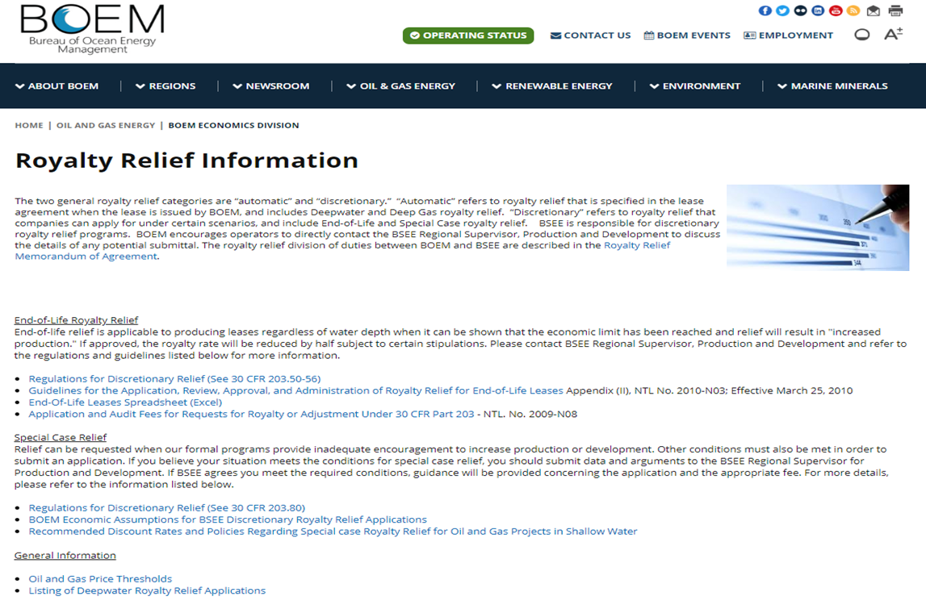
Economic Data
Price forecast from “Economic Assumptions for BSEE Discretionary Royalty Relief Applications”
https://www.boem.gov/oil-gas-energy/energy-economics/royalty-relief/royalty-relief-information

Slide 28
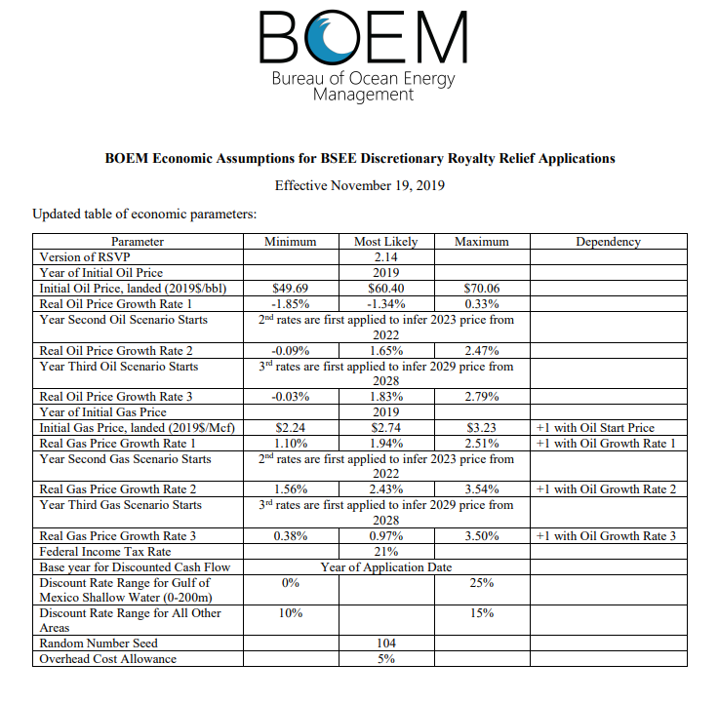
Economic Data
Use the “Most Likely” column for your price forecast.
Note that there are 3 separate oil & gas growth rates to be used if your project life extends beyond the first rate range.
BOEM updates this Economic Assumptions sheet periodically.

Slide 29
Economic Data
Data and calculations should be provided through the life of the project in Microsoft Excel format, and include:
Monthly oil/gas production
Monthly oil/gas revenue
Monthly royalty paid
Monthly direct operating costs (OPEX)
Capital expenditures (CAPEX) in the month they are projected to occur
Monthly undiscounted Before Tax Cash Flow (BTCF)
Monthly discounted BTCF

Slide 30
Economic Data
Provide detailed estimates for CAPEX and include supporting information.
CAPEX may include drilling, completions, platform modifications, recompletions, decommissioning, etc.
Supporting information may consist of AFEs, third party engineering estimates, recent analogous cost data, etc.
CAPEX should be allocated appropriately and clearly explained.
Provide detailed estimates for OPEX and include supporting information.
OPEX may include your direct costs for inspection, maintenance, repair, personnel, support, contract services, transportation, insurance, communication, rentals, fuel, chemicals, etc.
OPEX should be allocated appropriately and clearly explained.
Follow the guidelines within Appendix II to NTL No 2010-N03 Attachment 1.

Slide 31
Economic Data
Provide detailed estimates for transportation costs including justification and supporting information.
These costs cover oil and gas pipeline tariffs, gas plant processing fees, and other transportation system costs.
Supporting information may consist of third-party engineering estimates, recent analogous cost data, etc.
Follow the guidelines within Appendix II to NTL No 2010-N03 Attachment 1.
Provide detailed estimates for decommissioning costs including justification and supporting information.
These costs cover the removal of wells, production and transportation infrastructure, etc. that will be used in the application.
Costs not allowed for pre-existing obligations.
Decommissioning cost timing should be align with BSEE regulations.
Only project forward costs will be considered (no sunk costs).

Slide 32
G&G and Engineering Data
Required Data
Well logs clearly identifying targets
Structure, net sand, hydrocarbon isopach, & amplitude maps
3D seismic survey data used for interpretation
Actual data submission only necessary if BSEE doesn’t have internally
Cross sections
Analog wells with markers
Core and well test data (if available)

Slide 33
G&G and Engineering Data
Required Data
Reservoir data for each reservoir to be produced (Most Likely case)
Reservoir name
Acres
Net pay
Volume (acre-ft)
Fluid contacts (original and current)
OOIP/OGIP
Recovery factor
Estimated ultimate recovery
Porosity
Initial water saturation
Permeability
Formation volume factor
Initial flowrate
GOR or condensate yield
Decline rate

Slide 34
G&G and Engineering Data
For exploratory targets, assume no dry hole risk and use a P50 estimate of resources in analyses.
State what seismic volume was used for mapping.
Provide clear, concise, and well labeled information.
Extraneous materials will hinder the review process.

Slide 35
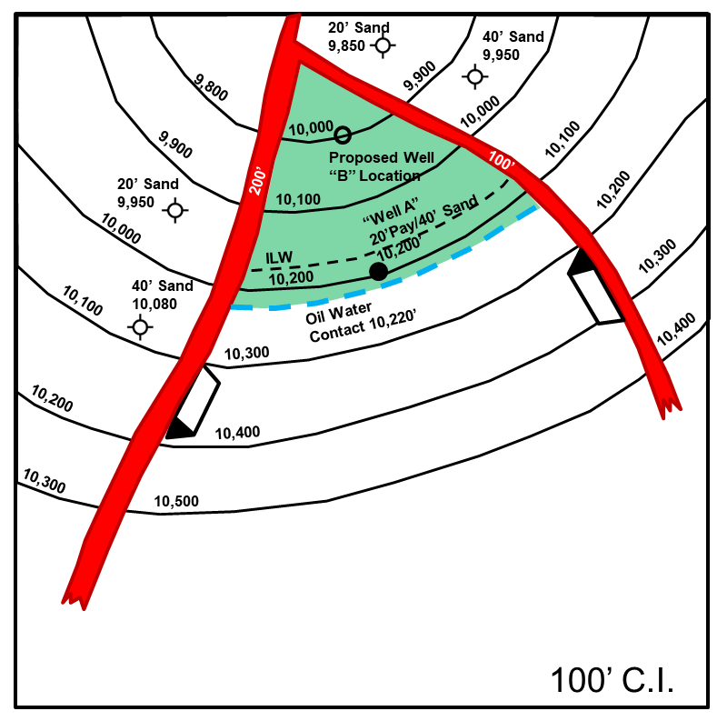
G&G and Engineering Data
Helpful Tips for Geological Review:
Preferred printed scale: 1”:2000’
Include the proposed well location(s) and relevant well data
Label relevant contacts
i.e. OWC, HKW, LKO, LKG, ILW, Structural Spill Point, etc.
If the reservoir extent is unknown, base your interpretation on Most Likely or P50 case
Include supporting material for determining these cases
Honor all well tops and label all faults
If there is compartmentalization, clearly label the different reservoirs

Slide 36
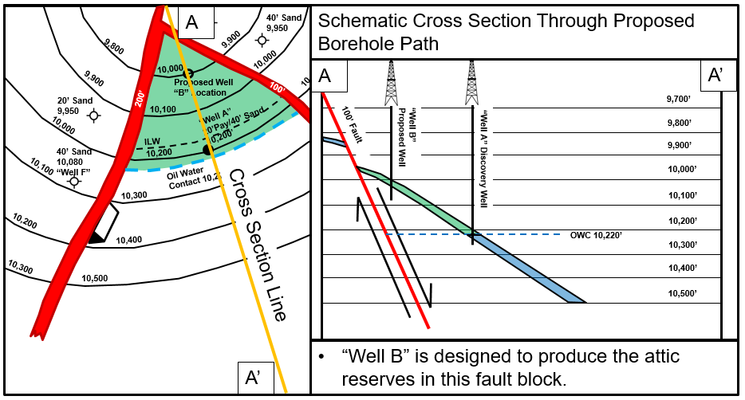
G&G and Engineering Data
Helpful Tips for Geological Review

Slide 37
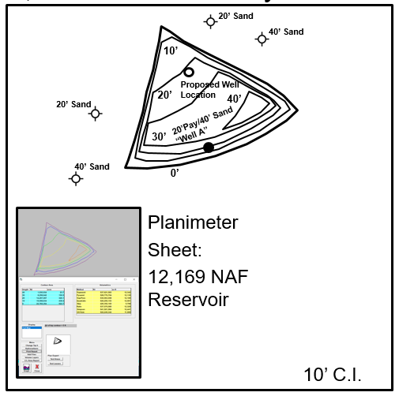
G&G and Engineering Data
Helpful Tips for Geological Review
Clearly label all contours, including zero contours
Honor all well data
Volumes submitted should match the maps submitted

Slide 38
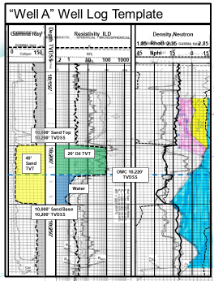
G&G and Engineering Data
Helpful Tips for Geological Review
Well logs should have the tops and bases of each reservoir interval clearly labeled
Label fluid contacts and lowest knowns
Clearly label pay counts
Appropriately label petrophysical properties and any other assumptions

Slide 39
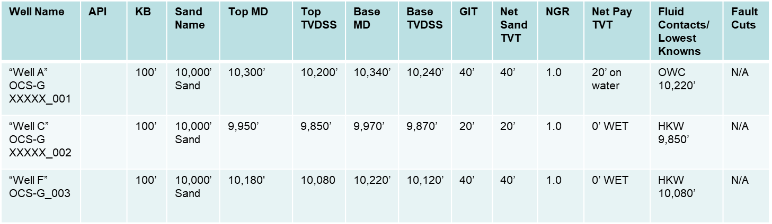
G&G and Engineering Data
Helpful Tips for Geological Review
Note: Depending on the geology, additional information may be needed.

Slide 40
SCRR Process Flowchart

Slide 41
Formal Application
The formal application must be accompanied with the appropriate cost recovery fee (via Pay.gov receipt) and all required data before BSEE can begin evaluating your application.
If you had not previously provided your project scope, and therefore have not received an assigned cost recovery fee, BSEE will request your project scope, and once received, calculate and provide notification of your cost recovery fee.
The first step in BSEE’s review process, once we receive a formal application is to perform a completeness review.
Verify that the scope of the project is aligned with what was described in the pre-application for proper cost recovery fee.
Verify that all required data has been properly submitted.
To expedite the review process, if there is any required data that has not been submitted, provide a reasoning as to why.
Verify that the operator’s model is uneconomic with full royalties paid and becomes economic with relief.
Once the completion review is deemed complete, we will begin our internal review of the royalty relief application.

Slide 42
Formal Application
A geological review consists of BSEE:
Analyzing the operator’s submission
Using the operator’s submitted data, BSEE should be able to validate and follow your work, maps, and volumes
Independently mapping sands to be penetrated in all proposed wells
An engineering review and economic evaluation are performed to:
Verify that the lease or project is eligible for royalty relief
Independently perform a project evaluation using findings from geological review to determine appropriate royalty relief
After BSEE has concluded its reviews of the application, a decision will be made on whether or not to grant royalty relief

Slide 43
SCRR Process Flowchart

Slide 44
Application Decision
After reviewing your application and concluding our independent analyses, a decision will be made by the Regional Director whether to approve or deny the application.
Approval letters will include the terms of royalty relief granted, as well as conditions of approval and/or thresholds.
Failure to meet the conditions of approval and/or if thresholds are triggered could lead to a forfeiture of royalty relief.
By regulation, BSEE is only allowed to grant enough royalty relief to make your project economic (our thresholds are generated to protect this).

Slide 45
Application Decision
Examples of forms of relief that BSEE may grant include:
A reduced royalty rate for the lease or project.
A value of suspended royalties (VSR): A predetermined dollar amount that the operator does not pay in royalties received. Once the VSR is met, royalty payments resume as per the lease instrument.
A royalty suspension volume (RSV): A fixed volume of initial production that is royalty free. Once the RSV is met, royalty payments resume as per the lease instrument.

Slide 46
Application Decision
Examples of conditions of approval/thresholds include:
A commitment to meet certain minimum CAPEX and a commitment to provide documentation demonstrating the actual expenditures incurred
A specified timeframe in which drilling on the lease or project is expected to commence
BSEE can grant up to 3 years to commence drilling
BSEE decides on a case-by-case basis and is determined by the reasonable schedule of activity
Commodity price ceilings
A requirement to complete well operations targeting discovered resources before relief would be extended to other production from the lease or project

Slide 47
Presentation Agenda
Overview of SCRR & Application History
Overview of Regulations
SCRR Application Process
Example Application #1
Example Application #2
Frequently Asked Questions
Questions from Audience

Slide 48
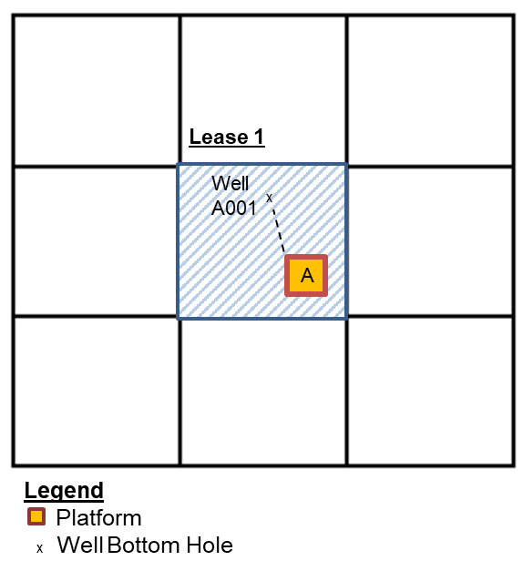
Example Application #1
Description: Drill well, located in less than 200 meters water depth, proposing to penetrate previously discovered gas reservoir. Use existing Platform A and associated infrastructure for processing and transporting to sales.
Proven Targets:
Lease 1, Platform A Well A001, Uneconomic @ 25% Discount Rate with Full Royalties Paid

Slide 49
Project Inputs

Slide 50
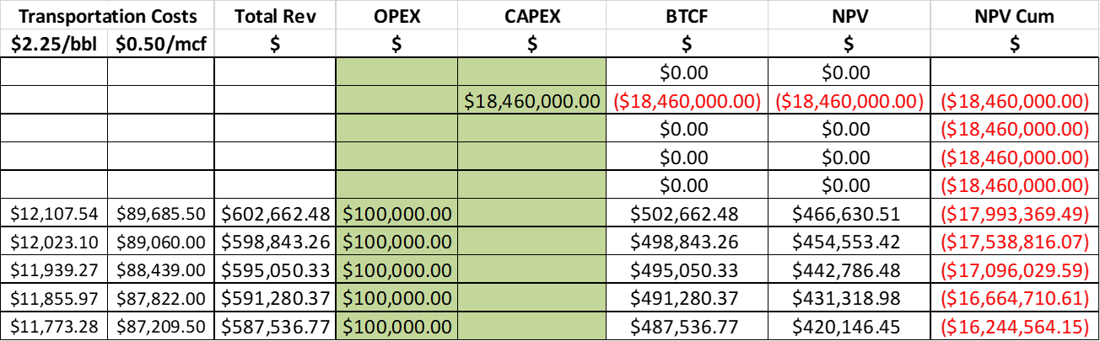
Example Cash Flow Scenario

Slide 51
Project Value, Before Relief
Demonstrates that the economic model returns a negative NPV at company-selected discount rate.

Slide 52
Project Value, After Relief
Using exact same inputs and values, demonstrate that the economic model returns NPV=0 by adjusting on the royalty rate (applying royalty relief).

Slide 53
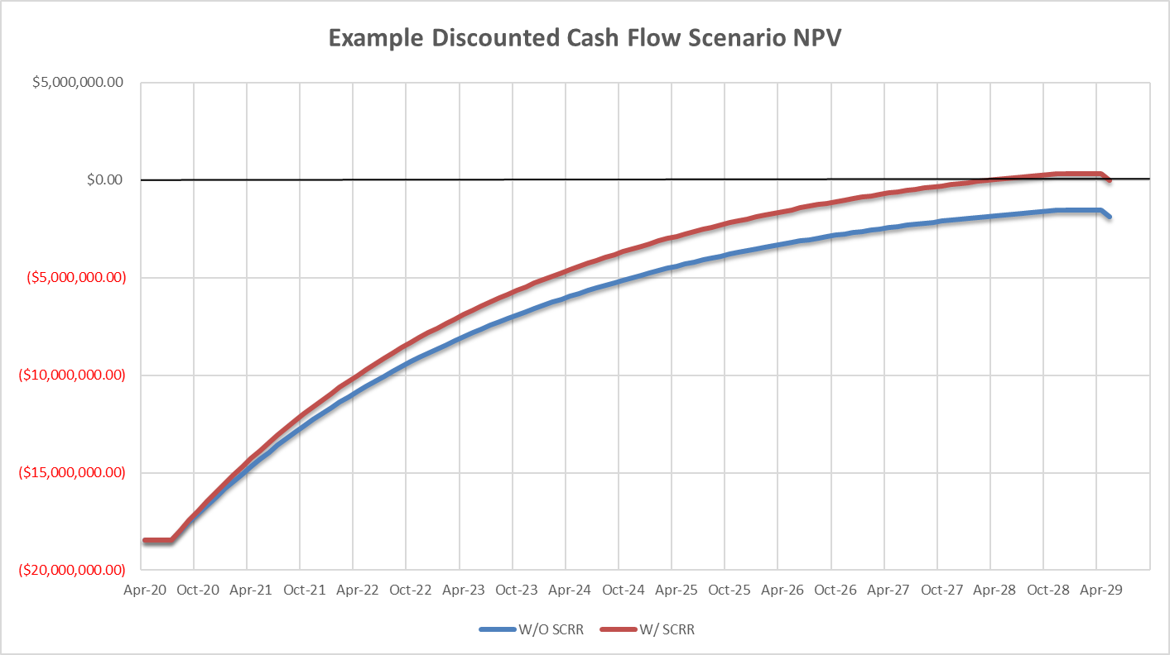
Project Value Graph

Slide 54
Special Case Royalty Relief Possibilities
Both the amount of relief granted and the thresholds used are at the discretion of the Regional Director.

Slide 55
Presentation Agenda
Overview of SCRR & Application History
Overview of Regulations
SCRR Application Process
Example Application #1
Example Application #2
Frequently Asked Questions
Questions from Audience

Slide 56
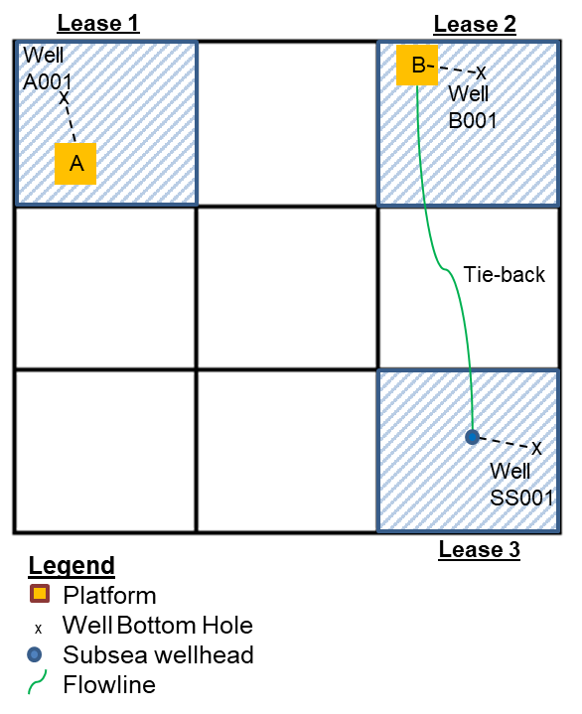
Example Application #2
Description: Drill 3 wells, all located in less than 200 meters water depth, proposing to penetrate both previously discovered oil reservoirs and an undiscovered (exploratory) oil resource. Use existing Platforms A and B for processing and transporting to sales as well as installing a subsea tie-back development.
Discovered Targets:
Lease 1, Platform A Well A001, Uneconomic @ 25% Discount Rate with Full Royalties Paid
Lease 2, Platform B Well B001, Uneconomic @ 25% Discount Rate with Full Royalties Paid
Undiscovered Target:
Lease 3, Subsea Well SS001, Uneconomic @ 25% Discount Rate with Full Royalties Paid

Slide 57
Project Inputs

Slide 58
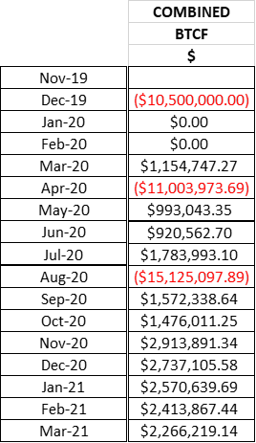
Example Combined Cash Flow Scenario

Slide 59
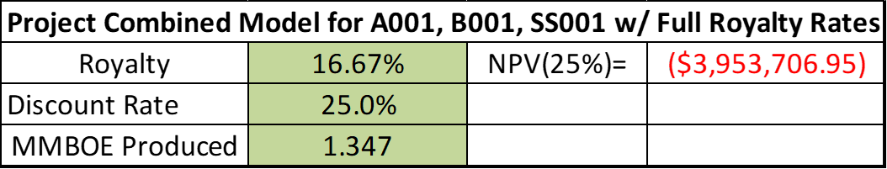
Project Value, Before Relief
Demonstrates that the economic model returns a negative NPV at company selected discount rate.

Slide 60
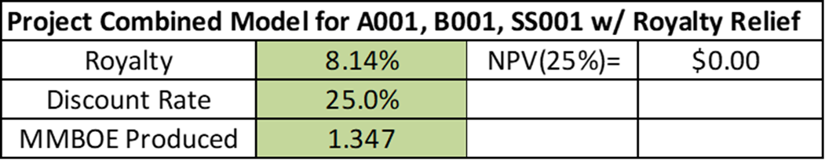
Project Value, After Relief
Using exact same inputs and values, demonstrate that the economic model returns NPV=0 by adjusting on the royalty rate.

Slide 61
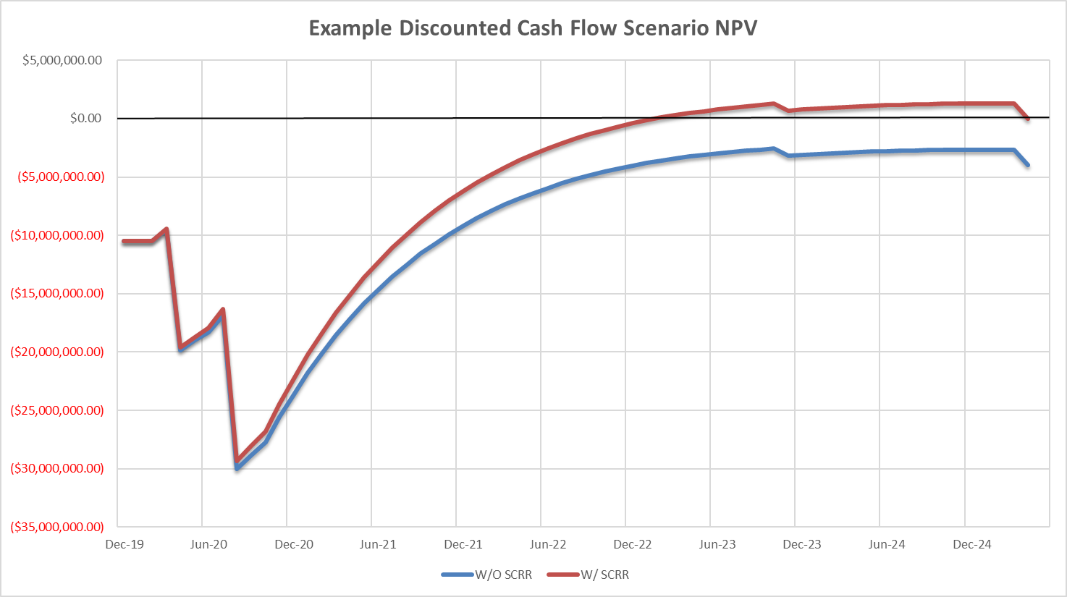
Project Value Graph

Slide 62
Special Case Royalty Relief Possibilities
*Well SS001 could not receive any relief as a stand-alone project since it only targets undiscovered resources
Both the amount of relief granted and the thresholds used are at the discretion of the Regional Director.
VSR and RSV, on a project basis, may be distributed in an allocated fashion.
Examples: per well, per capital expenditures, etc.

Slide 63
Presentation Agenda
Overview of SCRR & Application History
Overview of Regulations
SCRR Application Process
Example Application #1
Example Application #2
Frequently Asked Questions
Questions from Audience

Slide 64
FAQ
How are the American taxpayers being protected within the SCRR program?
BSEE ensures protection for the taxpayer in multiple ways.
We perform independent analyses to ensure that the relief awarded is equal to the amount needed to make the lease or project economic.
We implement several conditions of approval such as CAPEX thresholds, commodity price ceilings, suspension volumes, etc.
Companies submit accurate data as they are aware there are civil and/or criminal penalties for knowingly or willingly preparing, maintaining, or submitting false, inaccurate, or misleading reports, notices, affidavits, records, data, or other written information.
(30 CFR 250.1460 & 1480)

Slide 65
FAQ (cont.)
Are there new BSEE policies regarding SCRR?
The only new policy specific to the shallow water GOM (<200m) is the increase of the discount rate’s upper limit from 15% to 25%.
BSEE implemented two other new policies that apply to both shallow water and deep water:
BSEE can approve applications for royalty relief on a "project" basis that include operations in multiple, non-adjacent locations and leases
BSEE can approve royalty relief for projects that include exploratory operations when doing so would also promote development or increased production of discovered resources

Slide 66
FAQ (cont.)
What will the cost recovery fee be and how is it determined?
May 2015 Federal Register Notice: SCRR applications do not have a set fee, as they are determined on a case-by-case basis.
31 USC 9701: charges are to be based, among other things, on the costs to the government. This includes personnel costs, overhead, etc.
Current fees are based on recent processed applications, and the cost recovery fee will likely be re-assessed as BSEE processes more applications.

Slide 67
FAQ (cont.)
What and when do I need to submit to BSEE to determine my cost recovery fee?
BSEE needs to know information about all the wells you intend to drill, and all of the prospective targets within each of the wells.
We encourage you to meet with us before submitting your pre-application to discuss the scope of your operations (this is optional).
If you choose to not meet before the pre-application, we request that you include the project scope with your pre-application.

Slide 68
FAQ (cont.)
How long will BSEE take to review my request?
There is no time limit by regulation, but we expedite applications as much as possible. Timing depends on workload, complexity of the application, and the completeness of the application.
We will review applications on a first-come, first-served basis.
Pre-application decisions can be made within a few weeks, but sometimes longer if the application is unclear.
Formal application decisions could take a few months or longer, depending on the complexity and completeness of the application.

Slide 69
FAQ (cont.)
If my project includes leases that are about to expire, can I submit an Suspension of Production (SOP) and an SCRR application simultaneously?
One of the requirements for an SOP is a firm commitment to production. If production is contingent upon receiving future SCRR approval to make it economic, that would not be considered a legitimate commitment to production.
Similarly, if you are definitely going to drill and produce from the well/project regardless of whether or not SCRR is approved, then you do not need SCRR and none would be awarded.

Slide 70
FAQ (cont.)
What conditions of approval and/or thresholds will be placed on SCRR approvals?
Conditions/thresholds are determined on a case-by-case basis.
The BSEE Director’s 11/21/2019 memorandum mentions the following as examples:
Value of suspended royalty and/or commodity price ceilings
Production volume limits
Minimum capital expenditure thresholds based on submitted estimates
Commencement of operation time limits

Slide 71
FAQ (cont.)
What happens if I don’t drill all the wells in my SCRR project that I originally proposed?
The BSEE Director’s November 21, 2019, memorandum states that operators are expected to achieve milestones set forth in a reasonable schedule of activity. Failure to achieve this may lead to a forfeiture of relief.
Additionally, operators are expected to meet certain minimum CAPEX, which if not met, may lead to a forfeiture of relief.

Slide 72
FAQ (cont.)
Do I have to commence drilling my first well within 3 years or start drilling all project wells within 3 years? Does everyone get 3 years?
We can allow up to 3 years to commence drilling your first well; however, BSEE will evaluate, on a case-by-case basis, whether or not your schedule of operations is consistent with a strategy to promote development by preventing current infrastructure from becoming uneconomic and platforms being scheduled for removal.
The intent of the program is to expedite drilling and production, not delay it.

Slide 73
FAQ (cont.)
What happens if I find zones that I didn’t propose in my SCRR request? Similarly, what if one of my target zones is significantly bigger or smaller than anticipated?
When you submit your application, you’re expected to inform BSEE of all the zones you’re targeting in each proposed well, and your most likely volume estimates for each.
BSEE will perform independent geological and geophysical reviews, and use the zones and volume estimates in our analyses based on the best available information at the time. Our current policy is to not adjust the amount of relief awarded after the fact, even if you find unexpected reservoirs, or one or more of your target zones is significantly bigger or smaller than anticipated.
Our policy can evolve in the future as we incorporate lessons learned.

Slide 74
Thank you … Questions?

